Slide 1
Noctis: revealing chemical pathways in reaction data
Nataliya Lopanitsyna, Marco Stenta
May 16, 2024

Slide 2
Reaction data is connected through a Network structure
Networks reveal information and insights hidden in tables
Insights make us more effective and efficient
Reaction network supports AI applications
All of this is impossible without high-quality data

Slide 3
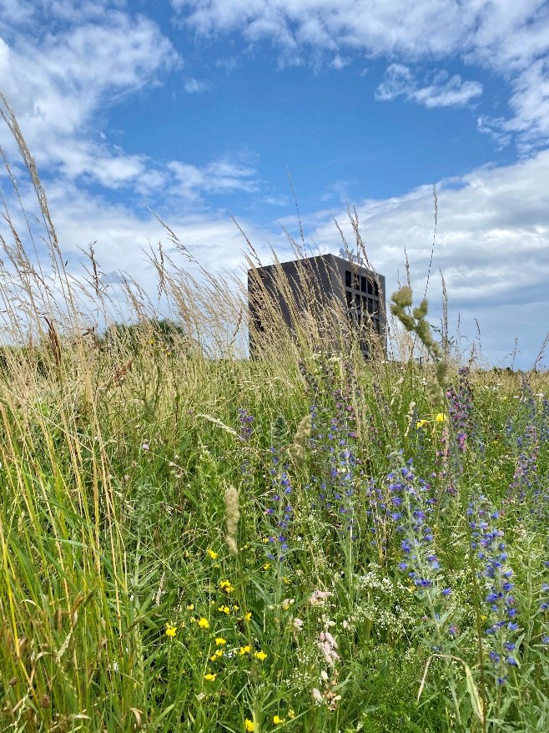
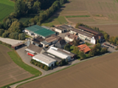
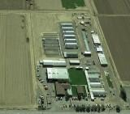
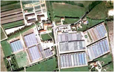
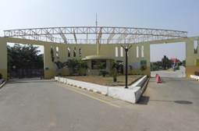
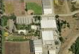
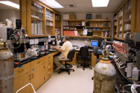
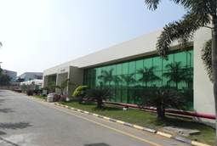
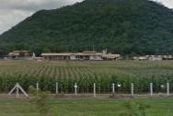
Syngenta in a seed pod
Over 140 R&D sites around the world supported by many field locations
Ghent Belgium
Jealott’s Hill UK
Clinton
US
Stanton
US
Enkhuizen Netherlands
Greensboro US
Bad Salzuflen Germany
Slater
US
Research Triangle Park, US
Beijing China
Woodland US
Saint Sauveur France
Sarrians France
General Santos Philippines
Gilroy
US
Alachua
US
Goa India
Hyderabad India
TakFah Thailand
Uberlândia Brazil
Stein, Switzerland
Notes:
3

Slide 4
Introducing DSTA
Design Evaluation
Prioritize
Synthesis
ANALYZE
DESIGN
TEST
SYNTHESIZE
Synthesis
Develop
Designs
Run Assays
Hypothesis
Data Analysis
Compound Selection

Slide 5
What is our data?
I want to make a new compound…
Business
Target
Operative
Who? When? Where?
Scientific
What? How?
Reactants>Reagents> Products
Timestamp/location
Version
Why?
Project
Experimentalist
Conditions
Procedures/Equipment
How do I make this compound?
How did I make this other compound?

Slide 6
If the future is already here where is the impact?
"We see computers everywhere except in the productivity statistics” R. Solow (1987)
The technology is here but not the FAIR reaction data to make it disruptive
Syngenta reaction data
Libraries and Reaction Optimisation protocols: Offline XL format only (before 2020)
Electronic Lab Notebook:
Only 60% of ELN reaction scheme usable for modelling
Reaction conditions unexploitable
Large scale protocols in embedded files
Public reaction data
Large volumes of data but highly biased and not sufficiently diverse
Yield and conditions prediction for very common reactions are not possible
Suzuki coupling: Machine Learning is no better than “popularity based” metrics
Beker, W.; Roszak, R.; Wołos, A.; Angello, N. H.; Rathore, V.; Burke, M. D.; Grzybowski, B. A. Machine Learning May Sometimes Simply Capture Literature Popularity Trends: A Case Study of Heterocyclic Suzuki–Miyaura Coupling. J. Am. Chem. Soc. 2022, 144 (11), 4819–4827. https://doi.org/10.1021/jacs.1c12005
No general C-N coupling yield prediction possible
Fitzner, M.; Wuitschik, G.; Koller, R.; Adam, J.-M.; Schindler, T. Machine Learning C–N Couplings: Obstacles for a General-Purpose Reaction Yield Prediction. ACS Omega 2023. https://doi.org/10.1021/acsomega.2c05546
Jablonka, K. M.; Patiny, L.; Smit, B. Making the Collective Knowledge of Chemistry Open and Machine Actionable. Nat. Chem. 2022, 14 (4), 365–376. https://doi.org/10.1038/s41557-022-00910-7

Slide 7
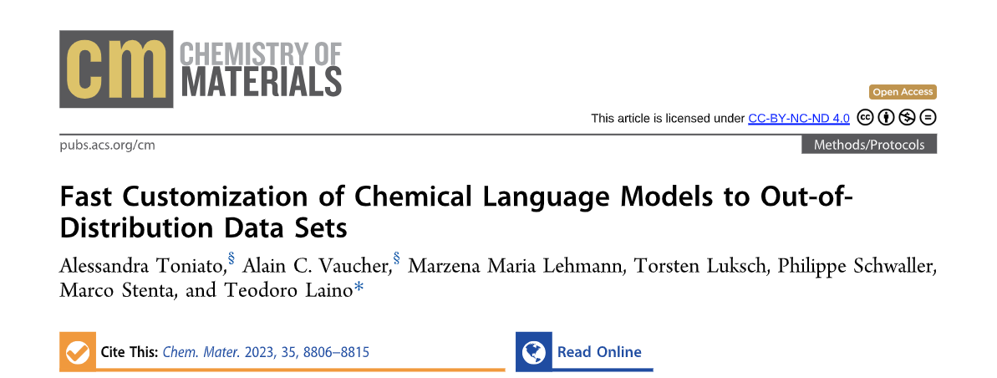
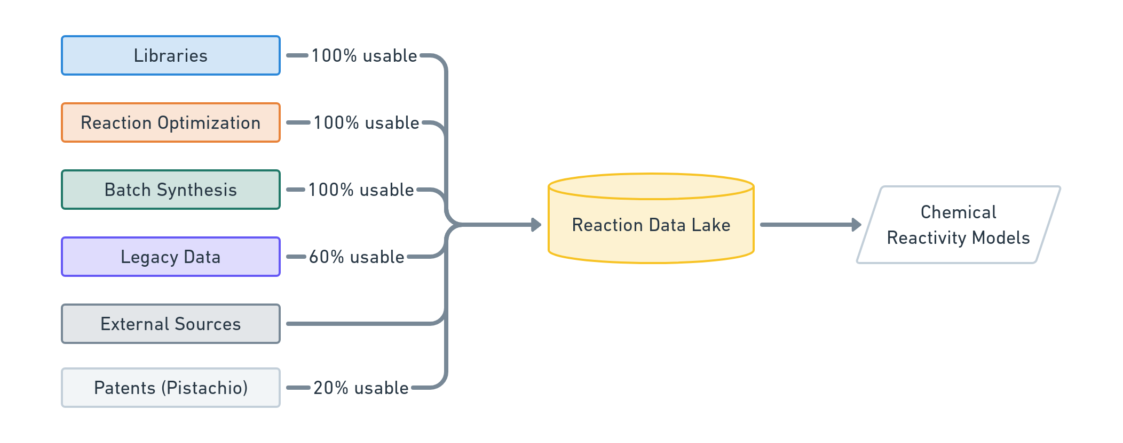
Connecting all reaction data together to create powerful network effects
High Quality data
Tailored interfaces
Negative results
High relevance
?
Network of Organic Chemistry
High Volume Data
Lower quality
Large amounts
Document-based database
Graph database

Slide 9
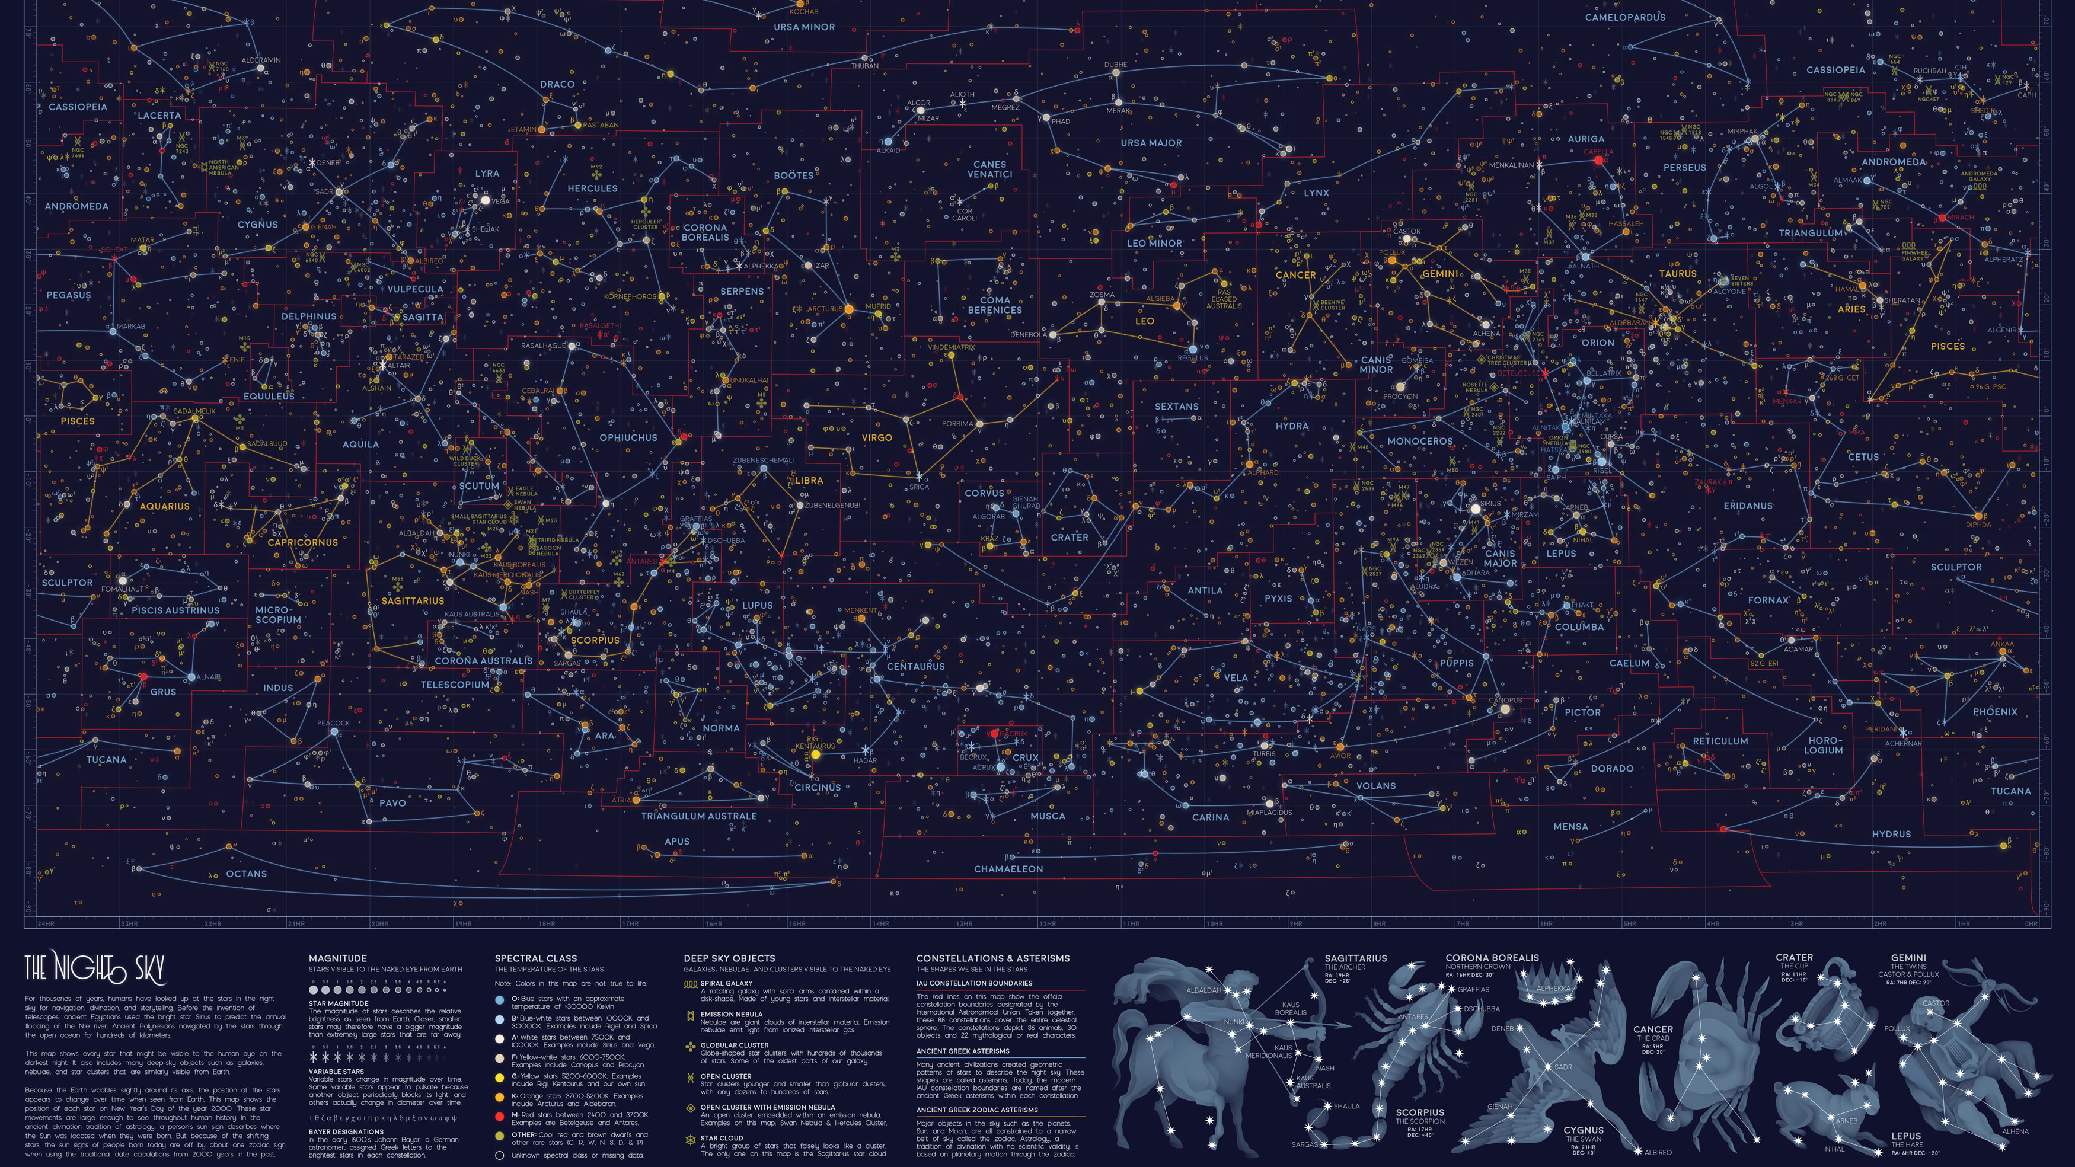

Slide 10
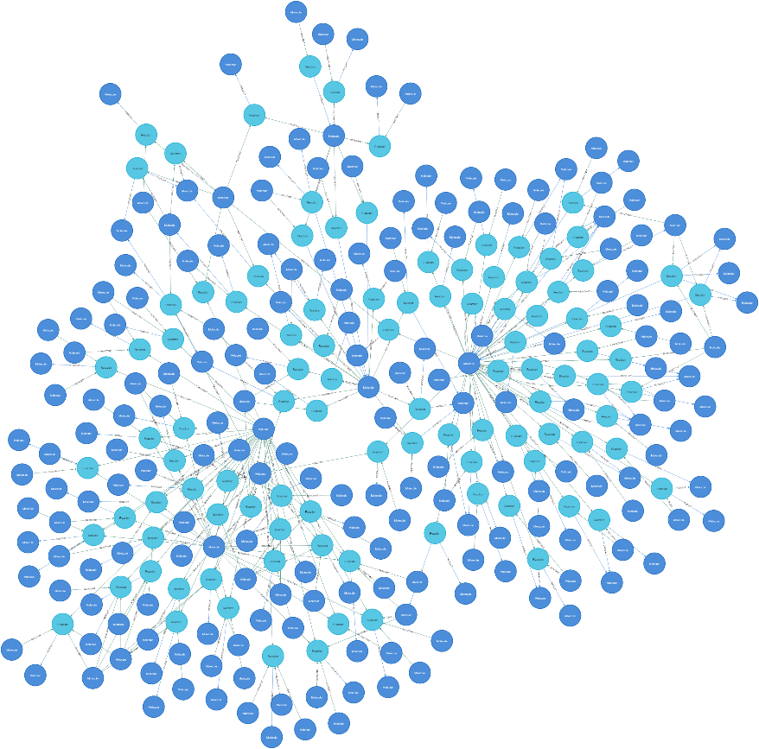
What is inside?
populates
interacts with
Chemical strings
Translation module
Internal data class
Repository
Open source

Slide 11
Noctis: population of the graph DB
High Quality data
Tailored interfaces
Negative results
High relevance
Libraries
100% usable
Reaction Optimization
100% usable
Batch Synthesis
100% usable
Reaction Data Lake
Network of Organic Chemistry
Legacy Data
60% usable
High Volume Data
Lower quality
Large amounts
External Sources
Document-based database
Graph database
Patents (Pistachio)
20% usable

Slide 12
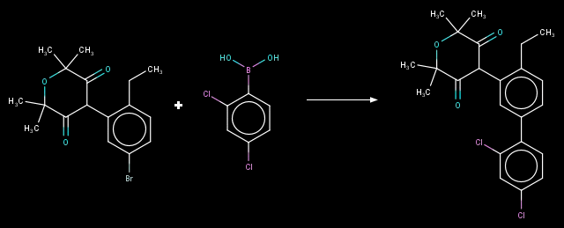
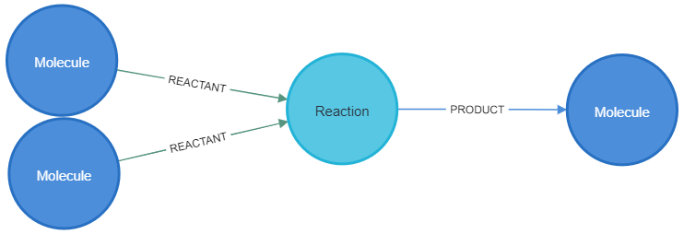
How does text become a graph ?
Chemical strings
Grzybowski, Bartosz A., et al. "The'wired'universe of organic chemistry." Nature Chemistry 1.1 (2009): 31-36.
Lapkin, A. A., et al. "Automation of route identification and optimisation based on data-mining and chemical intuition." Faraday discussions 202 (2017): 483-496.

Slide 13
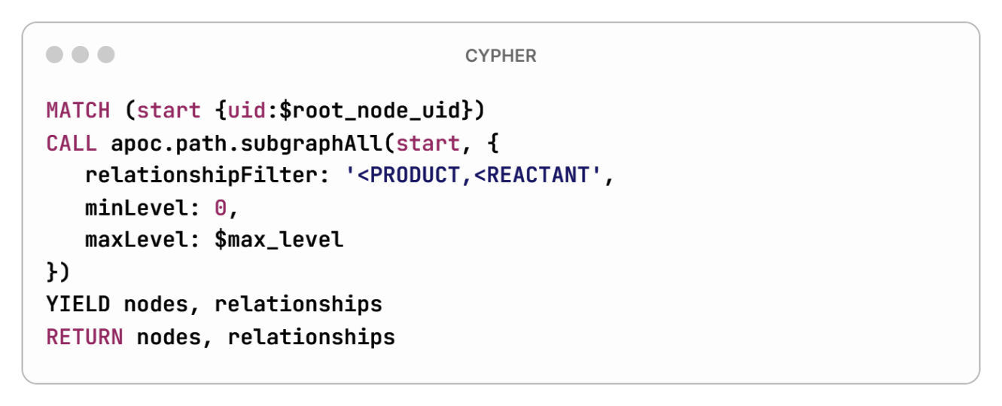
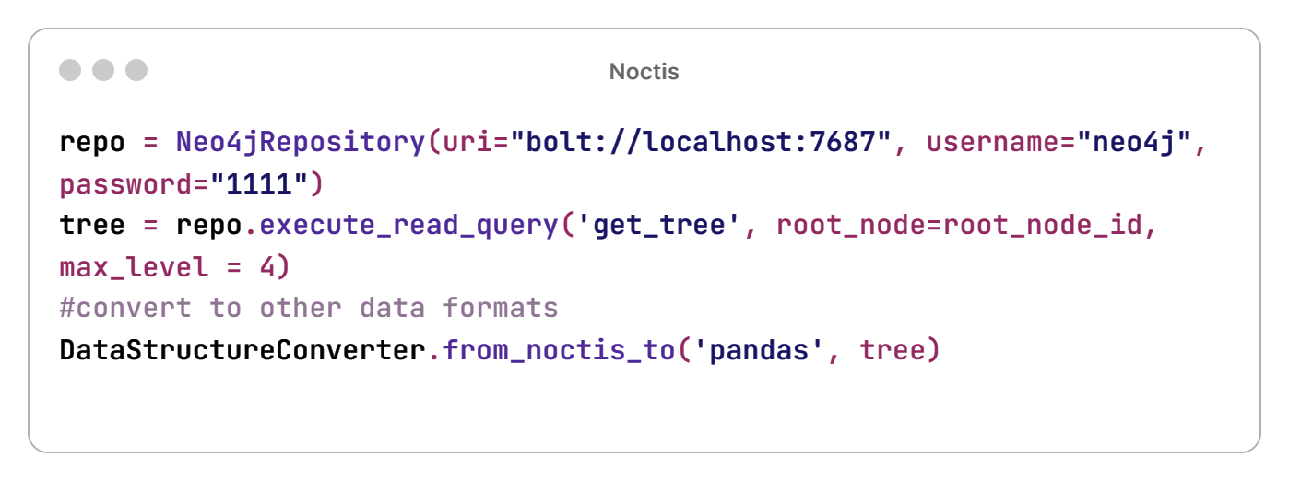
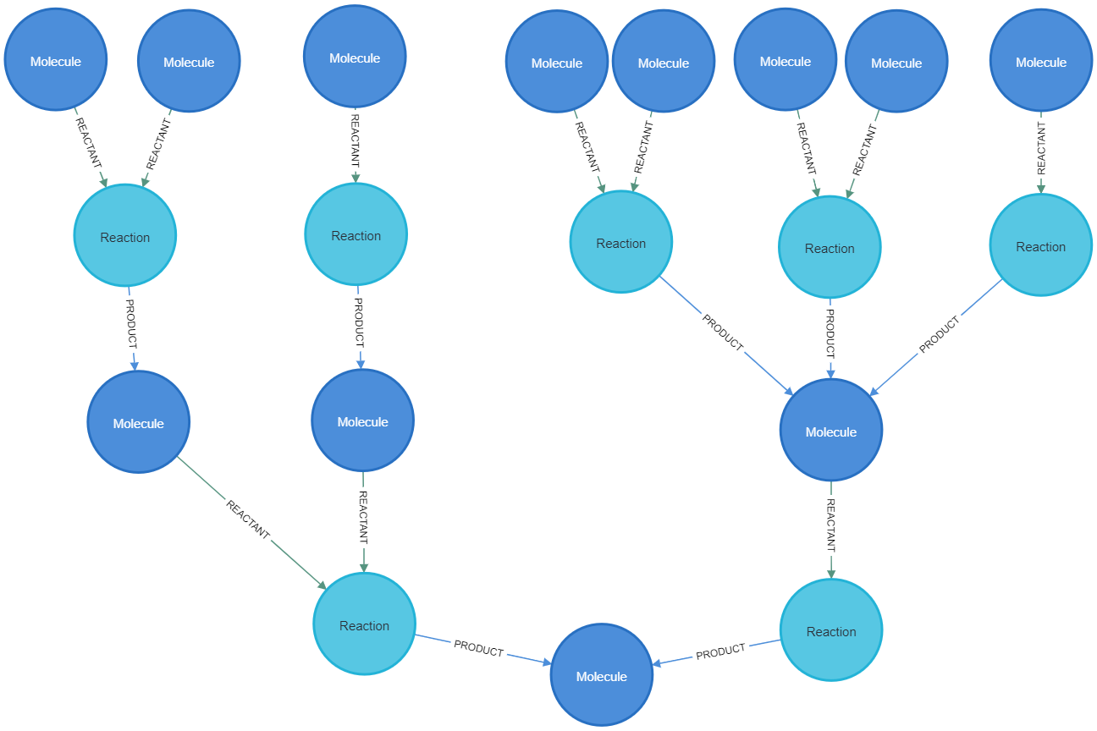
Synthesis tree
Target

Slide 14
Synthesis route
Target

Slide 15
(near)Future plans: bringing together predictions and reaction data
External innovation & collaborations
Coley, C. W.; Barzilay, R.; Jaakkola, T. S.; Green, W. H.; Jensen, K. F, ACS Cent. Sci. 2017, 3 (5), 434–443
ASKOS
Genheden, S.; Thakkar, A.; Chadimová, V.; Reymond, J. L.; Engkvist, O.; Bjerrum, E.. J. Cheminform. 2020, 12 (1)
Computer Assisted Synthesis Planning Module
Synthesis Design Module
AiZynthFinder
Schwaller, P.; Laino, T.; Gaudin, T.; Bolgar, P.; Hunter, C. A.; Bekas, C.; Lee, A. A. ACS Cent. Sci. 2019, 5 (9), 1572–1583.
IBM-RXN
Retrosynthetic models
Network of Organic Chemistry
Pasquini, M.; Stenta, M. LinChemIn: SynGraph. A Data Model and a Toolkit to Analyze and Compare Synthetic Routes. CHEMRxiv 2022. https://doi.org/10.26434/chemrxiv-2022-cmrjk

Slide 16
Future plans: data model extension
Execution #1
Execution #2
Experiment
Pattern
Template
Pattern
Coley, Connor W., William H. Green, and Klavs F. Jensen. "RDChiral: An RDKit wrapper for handling stereochemistry in retrosynthetic template extraction and application." Journal of chemical information and modeling 59.6 (2019): 2529-2537.

Slide 17
Future plans: knowledge graph + LM = chemical Netflix?
Would you like to try our new synthesis route?
Notes:
Enriching the data model to connect the relationships by templates
Link it to experiments

Slide 18
The last slide
Open source
https://github.com/syngenta
Marco Stenta
Marta Pasquini
Pasquini, Marta, and Marco Stenta. "LinChemIn: SynGraph—a data model and a toolkit to analyze and compare synthetic routes." Journal of Cheminformatics 15.1 (2023): 41. https://doi.org/10.1186/s13321-023-00714-y

Slide 20
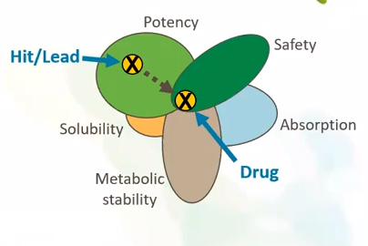
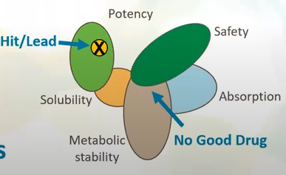
Do we need a DSTA? Introducing the «Property Space problem»
Identify chemicals with an optimal balance of properties
Human and environmental safety
Potency
Innovative class/new mode of action
Broad spectrum active ingredient
Cost efficiency
Integrated Pest Management
Climate resilience and soil health
Identify when such balance is not possible:
Fail fast = fail cheap
Only when confident
Avoid missed opportunities
Fit for specific farmer, consumers and food value chain needs
20
Classification: PUBLIC

