Slide 1
Deep learning based drift correction in atomically resolved STEM images
Vinko Sršan^{1,2}, Marjan Stoimchev ^{1,3}, Dragi Kocev³, Sašo Šturm^{1,2,4},
Sašo Džeroski³
1 Jožef Stefan International Postgraduate School
2 Department for Nanostructured Materials, Jožef Stefan Institute
3 Department of Knowledge Technologies, Jožef Stefan Institute
4 Department of Geology, Faculty of Natural Sciences and Engineering, University of Ljubljana
MLM4MS
Ljubljana, 2024

Slide 2
https://euinasean.eu/eu-green-deal/

Slide 3
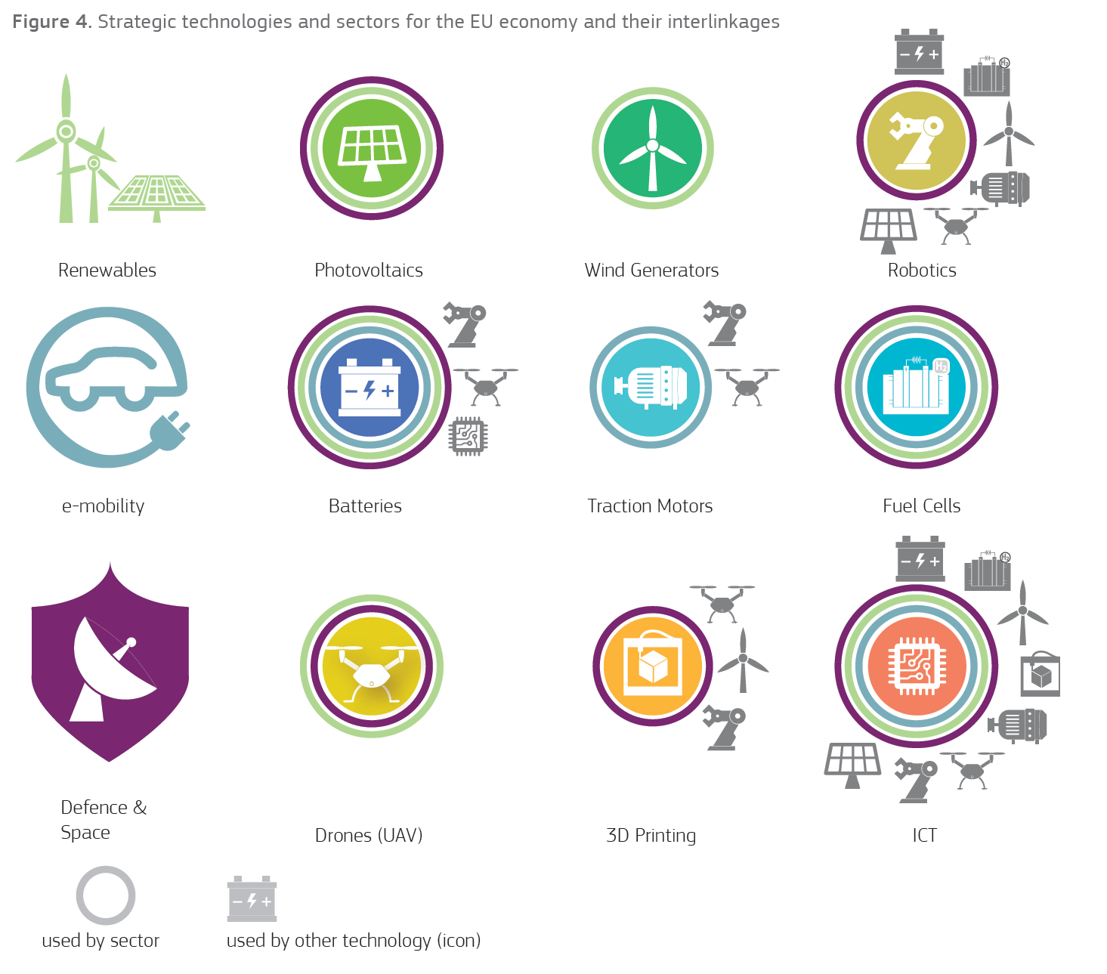

Slide 4
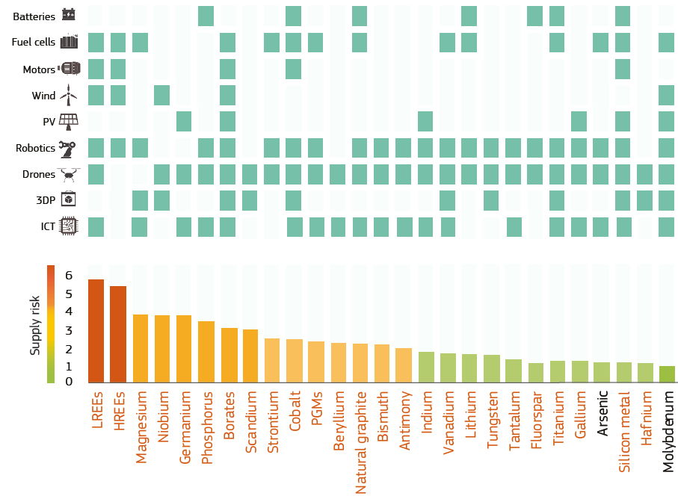
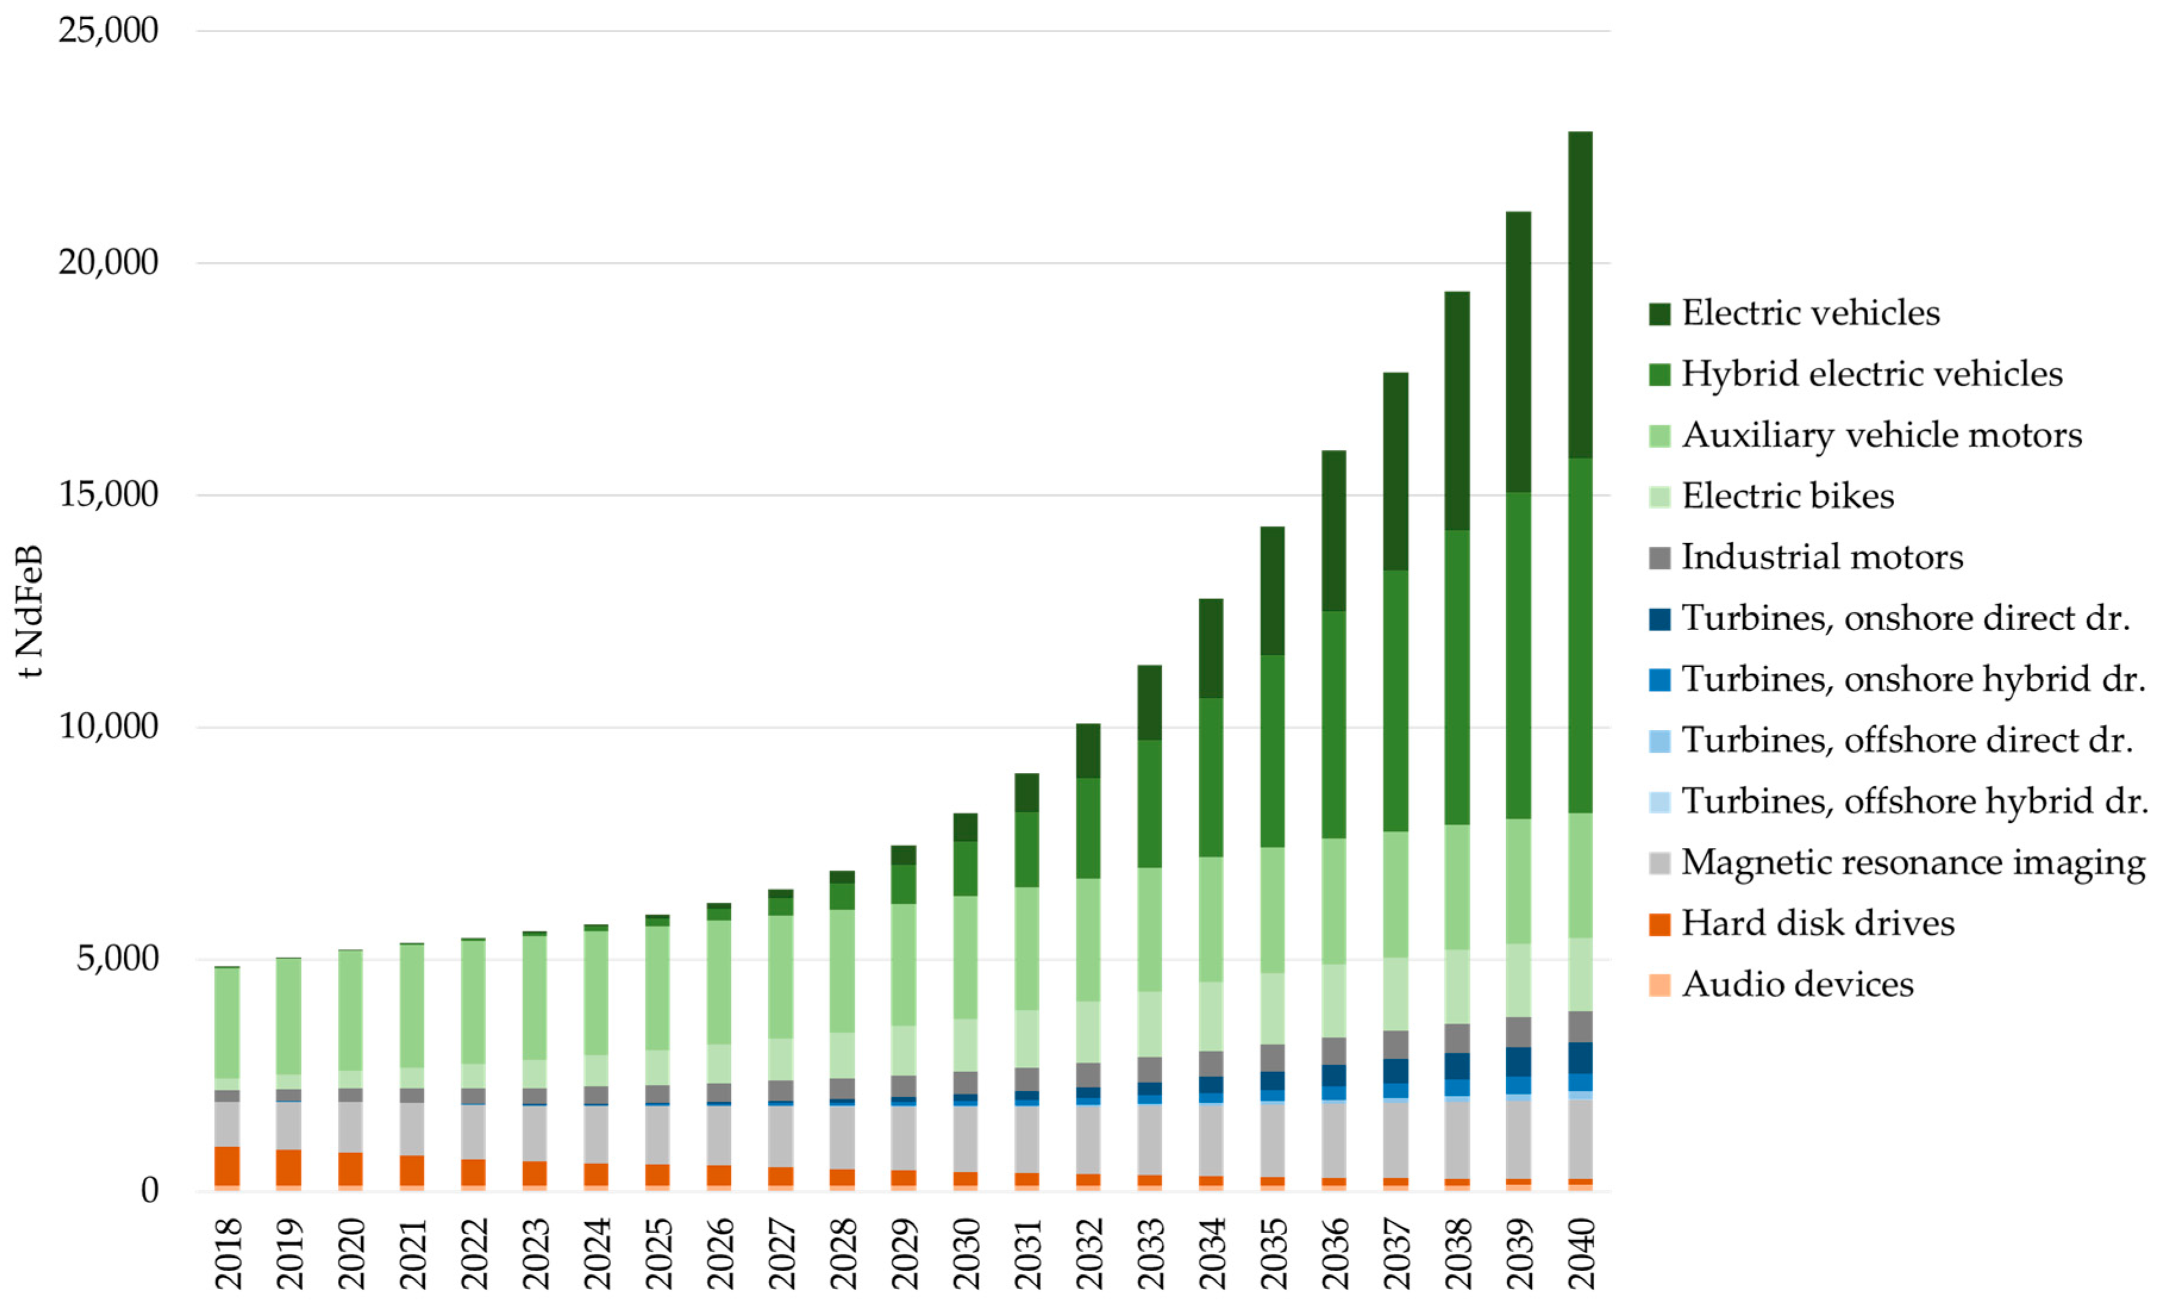
Reimer, Maximilian, et al., Metals, 2017
Critical Raw materials for Strategic Technologies and Sectors in the EU

Slide 5
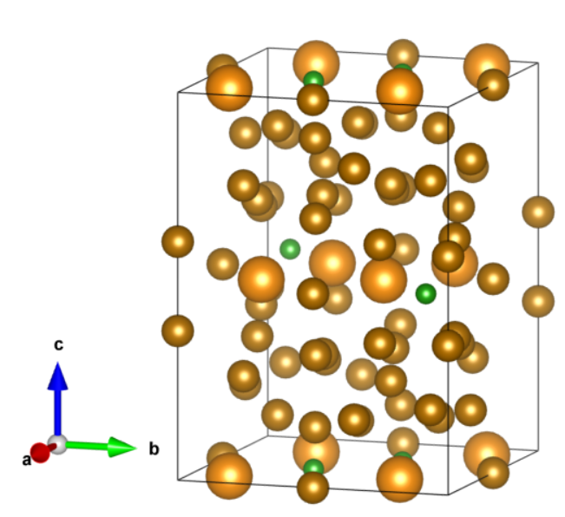
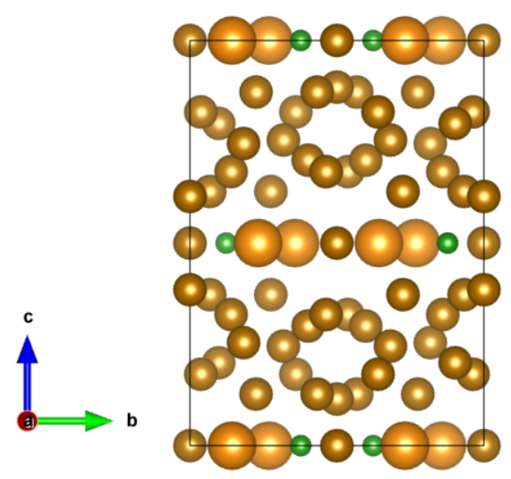
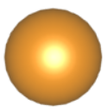
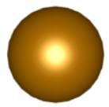
${Nd}_{2}{Fe}_{14}B$ crystal structure
a = b = 8.77600 $Å$, c = 12.11943 $Å$
Nd
Nd
Fe
Fe
B
B

Slide 6
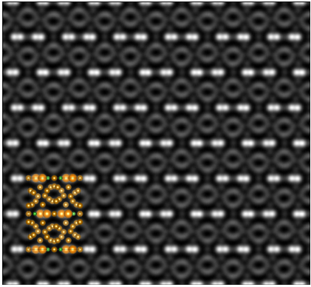
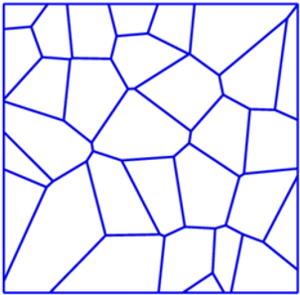
Scanning transmission electron microscope (STEM) provides detailed information about materials atomic structure

Slide 7
STEM mode of operation
Fast scan
Slow scan

Slide 8
Scanning ROI under drift
Fast scan
Fast scan
Fast scan
Slow scan
Slow scan
Slow scan

Slide 9
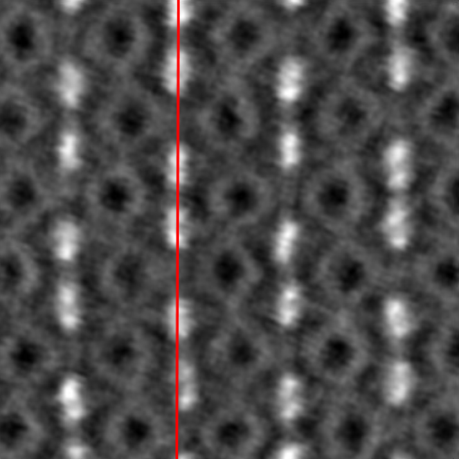
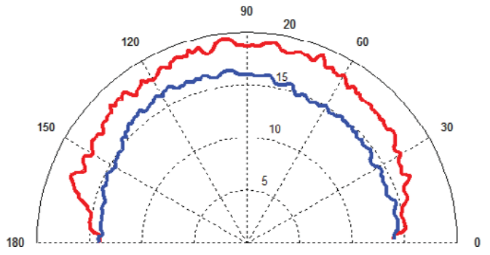
Jones, L., & Nellist, P. D. (2013). Identifying and correcting scan noise and drift in the scanning transmission electron microscope. Microscopy and Microanalysis, 19(4), 1050-1060.
Image source: Prof. Sašo Šturm

Slide 10
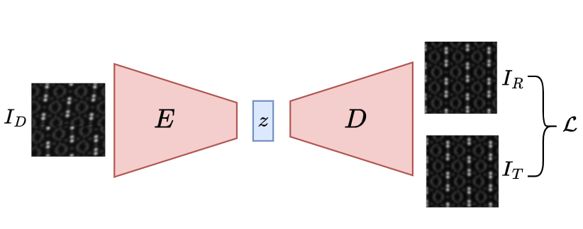
Convolutional Autoencoder
Encoder:
DinoV2
Decoder:
Sub-pixel convolution as an up-sampling layer to produce the high-resolution output
Oquab, M., Darcet, T., Moutakanni, T., Vo, H., Szafraniec, M., Khalidov, V., ... & Bojanowski, P. (2023). Dinov2: Learning robust visual features without supervision. arXiv preprint arXiv:2304.07193.

Slide 11
Convolutional Autoencoder
Luminance:
Contrast:
Structure:

Slide 12
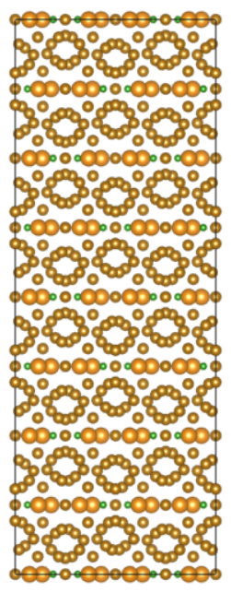
Multislice simulations for data generation
$$ψ_{0}$$
Simulation parameters:
Slice thickness = 1 $Å$
Electrostatic potential = Kirklands parametrization
TDS = 100 runs, 0.2 $Å$
HT = 200 kV
Convergence angle = 30 mrad
$$ψ_{1}$$
$$Δz$$
$$ψ_{2}$$
$$ψ_{3}$$
$$ψ_{4}$$
.
.
.
$$ψ_{n}$$
Jacob Madsen and Toma Susi. The abTEM code: transmission electron microscopy from first principles. Open Research Europe 1:24, 2021.

Slide 13
Target image
Total number of Target images: 2880
Original image resolution: 1024x1024
Total number of image pairs: 28800
Image parameters:
4 magnifications
15 dose levels
3 thicknesses
16 filters
Image pairs
Drifted image

Slide 14
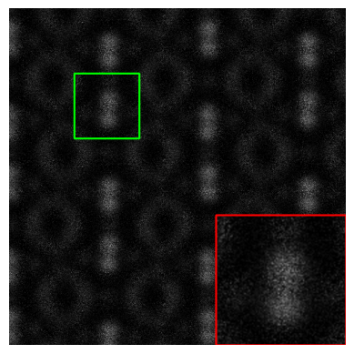
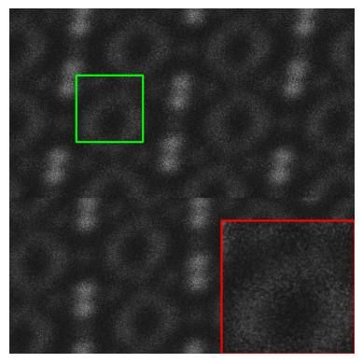
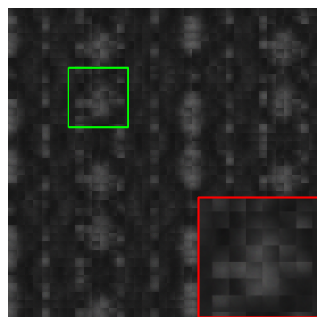
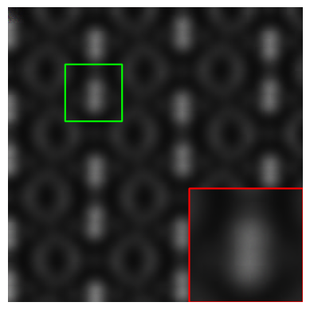
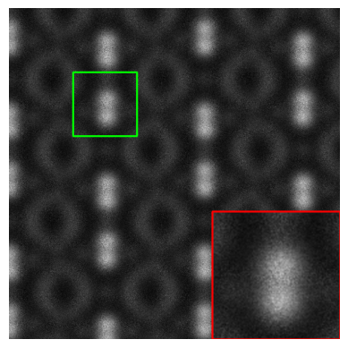
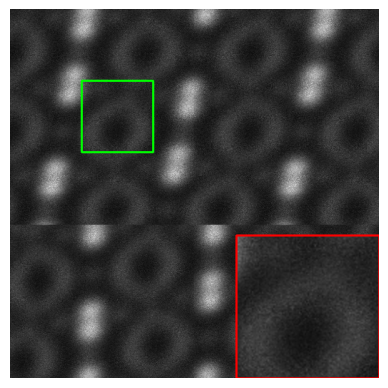
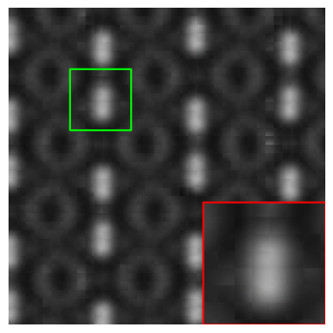
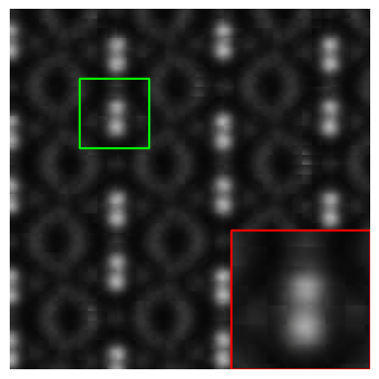
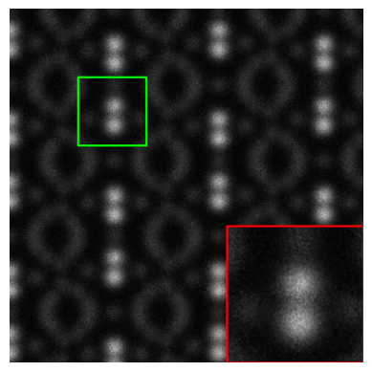
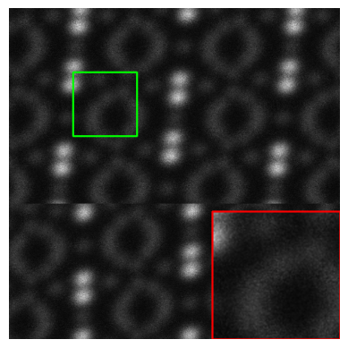
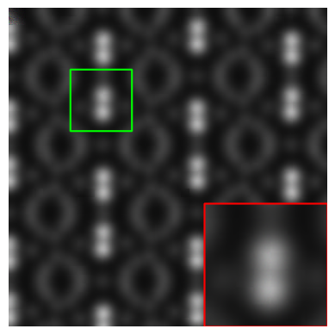
Results
MSE
MS-SSIM
PSNR: 21.124
SSIM: 0.250
MSE: 0.007
PSNR: 19.769
SSIM: 0.198
MSE: 0.01
PSNR: 28.342
SSIM: 0.542
MSE: 0.001
PSNR: 27.004
SSIM: 0.524
MSE: 0.001
PSNR: 28.718
SSIM: 0.614
MSE: 0.001
PSNR: 27.500
SSIM: 0.582
MSE: 0.001

Slide 15
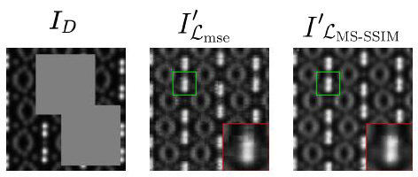
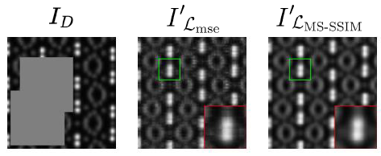

Slide 17
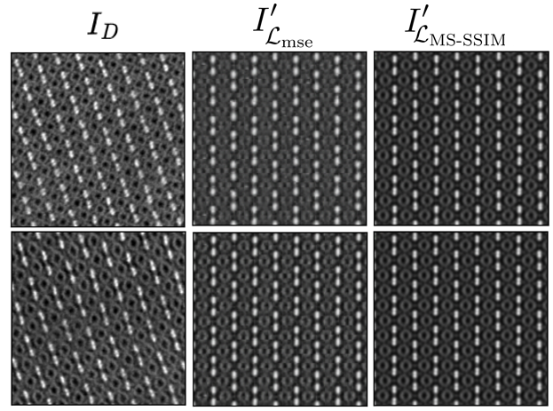

Slide 18
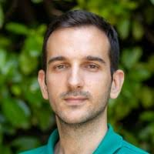
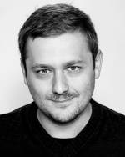
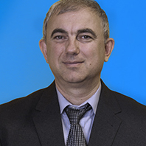
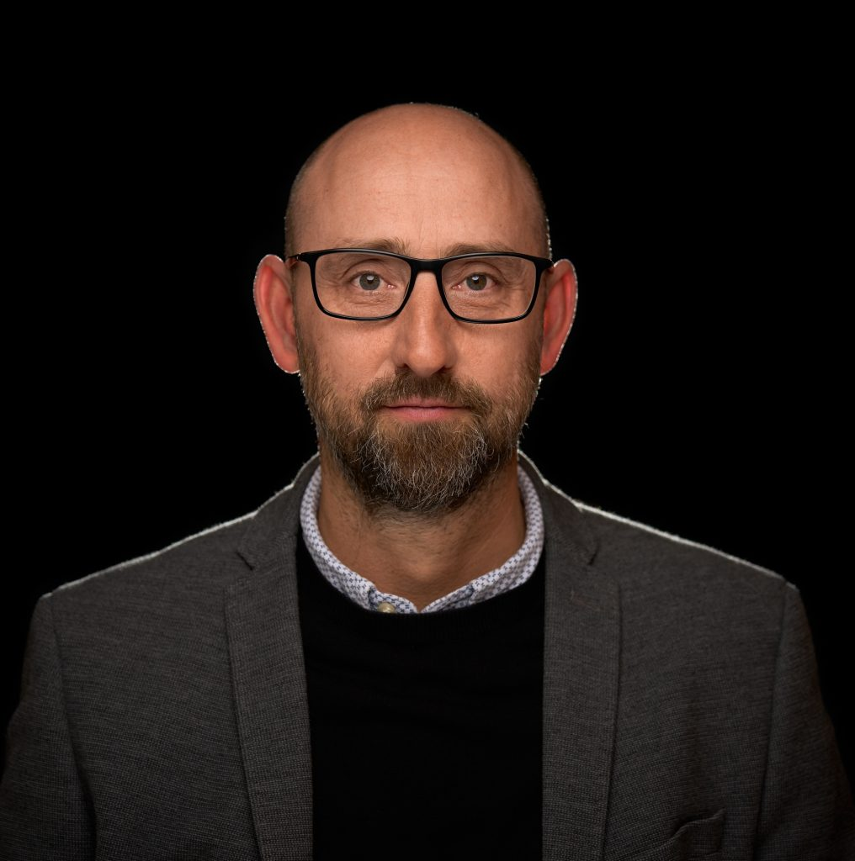
Acknowledgement
This work was supported by Slovenian research agency under programme P2-0084, project J7-4637.
Special thanks to Department of Knowledge Technologies (Marjan Stomchev, Dragi Kocev and Sašo Džeroski)

