Slide 1
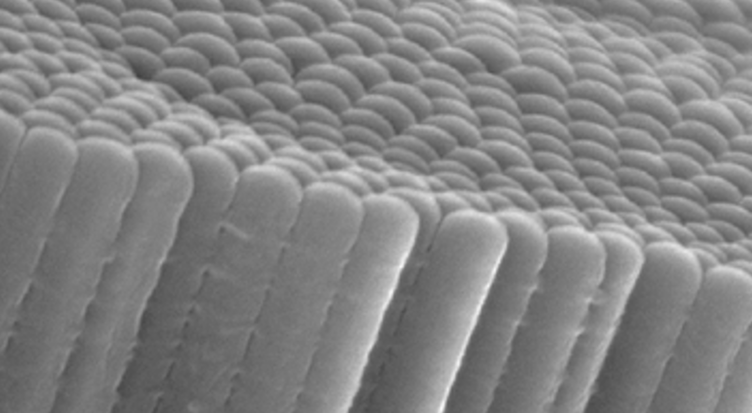

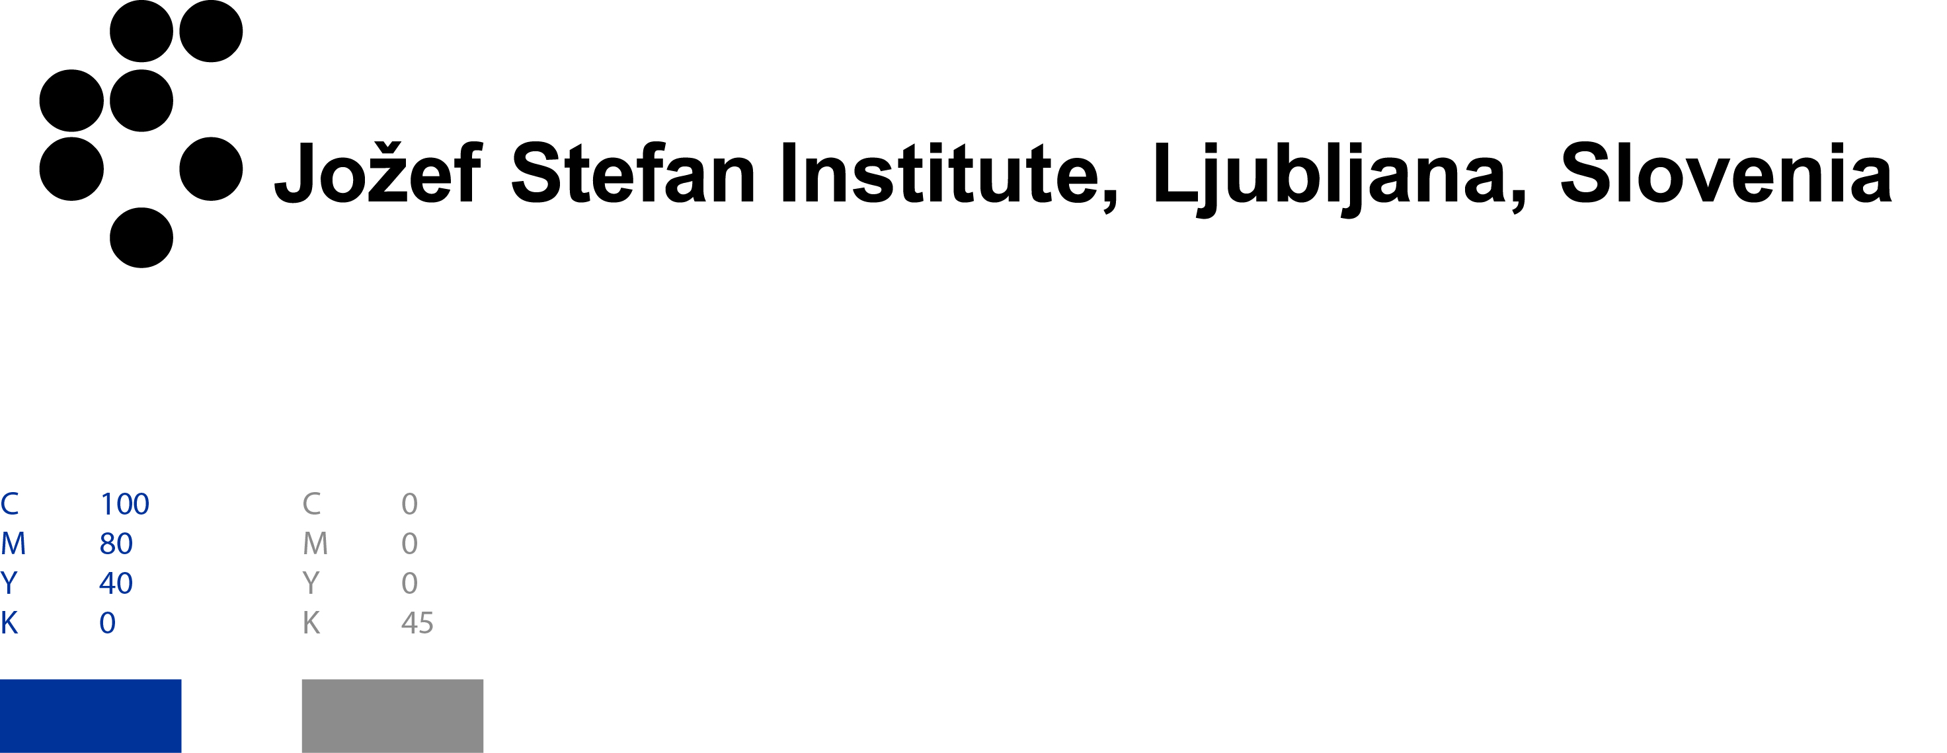



Autonomous laboratory for sustainable research and discovery of new materials
Sašo Šturm
Belisa Alcantara Marinho, Kristina Žagar Soderžnik, Barbara Ljubec Božiček, Lara Einfalt, Benjamin Podmiljšak, Matej Komelj, Nejc Skoporc, Miran Čeh
Luka Suhadolnik*, Živa Marinko*
Development of new high-entropy-oxide catalysts by the anodic oxidation of high-entropy alloys
*Previous collaborators

Slide 2

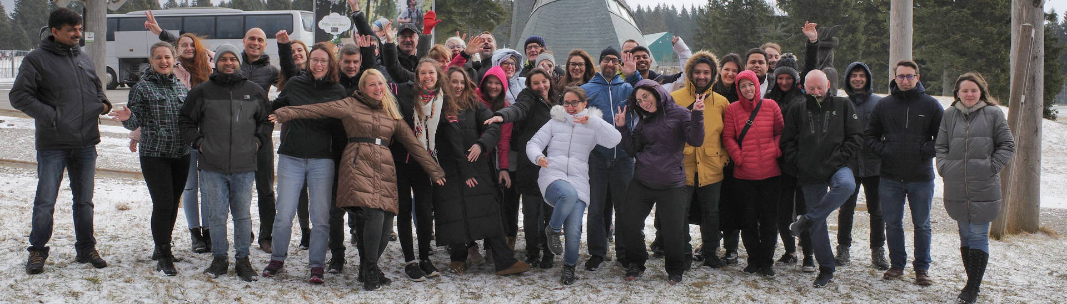



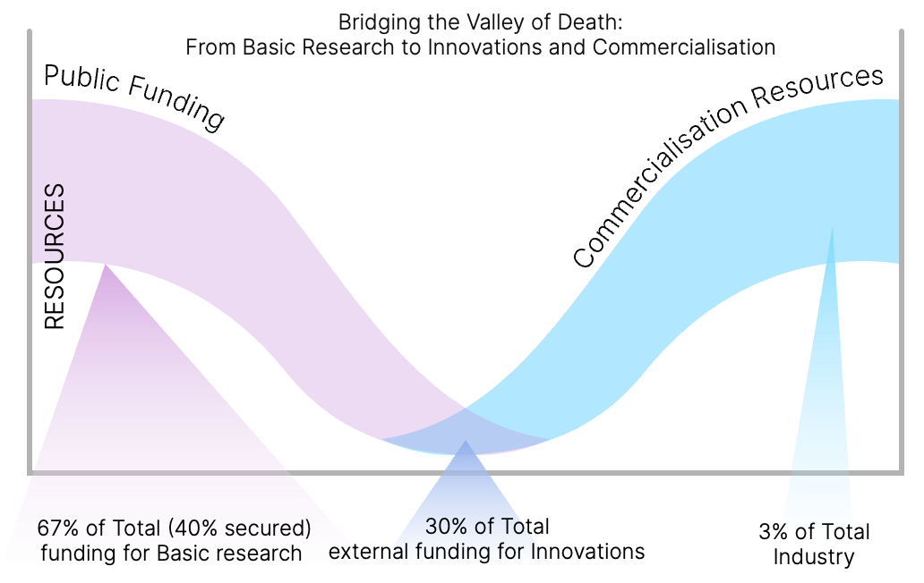









Department for nanostructured materials:
at the forefront of basic research and innovation in materials
55: staff members 12: academic habilitation
39: reaserchers&postdocs 13: PhD students
Magnetic materials
and Intermetallics
Fusion
Equipment purchase (2018-2022): ̴1M+ €
Catalysis
Organic toxin sensors
Revenue: ̴3M € (40% / 27% / 30% / 3%)
Societal Challenges
2022-2023
National research programs: 3
ARIS projects/Weave: 26
Industry: 11
Cost/EIT/HE: 21
Microplastics
Nanomedicine
Advanced engineering and bio materials
EU patent granted: 6
EU patent pending: 3
Functional ceramics
Electron microscopy and materials modeling

Slide 3

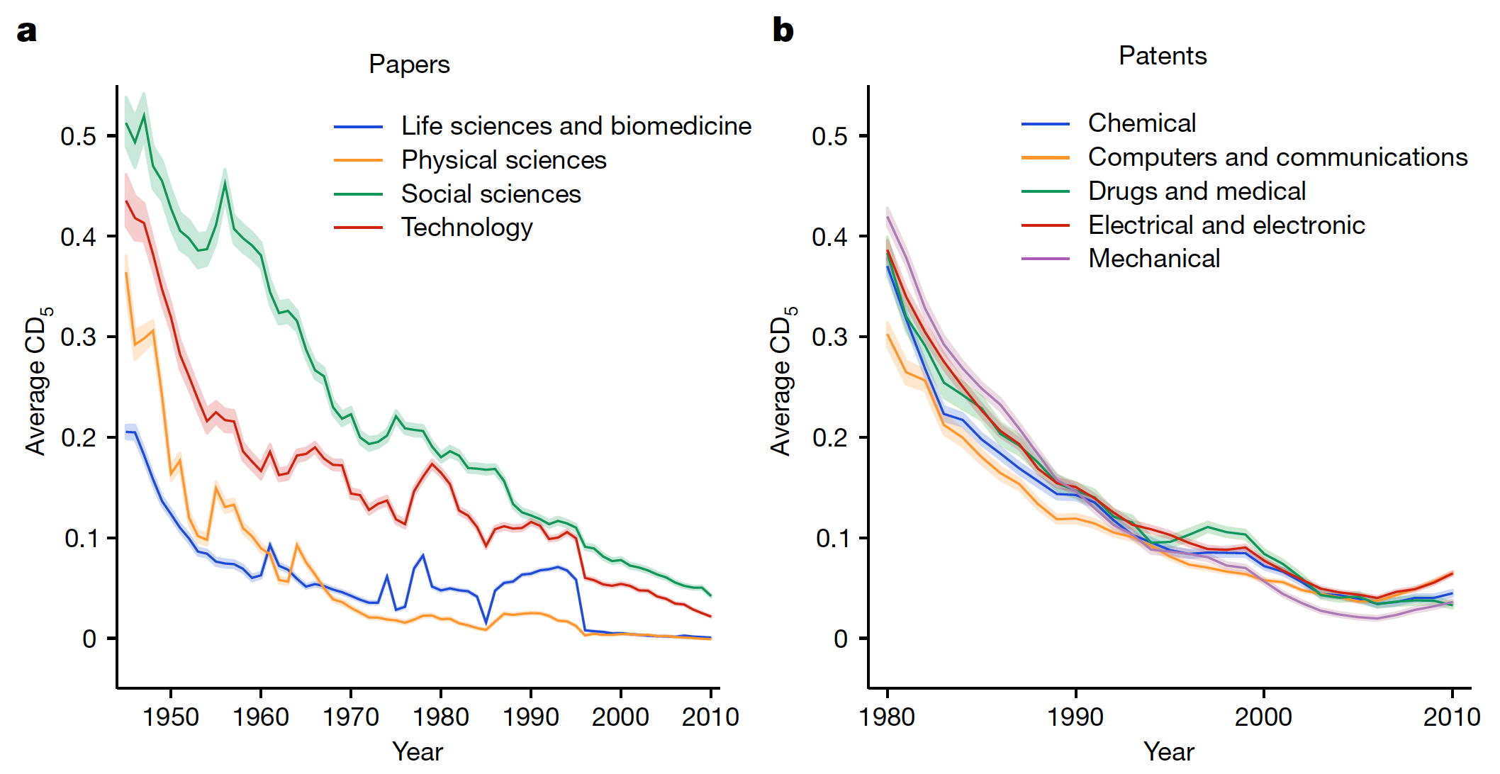
Challenges & prospects
Societal Challenges
Are we in the decline of disruptive science?
Decline of CD index over time
CD index: If an article is disruptive, subsequent papers will no longer cite the predecessors (the references of that article), where [1]: disruptive and [-1] consolidation work.
Park, M., Leahey, E., & Funk, R. J. (2023). Nature, 613(7942), 138-144.

Slide 4
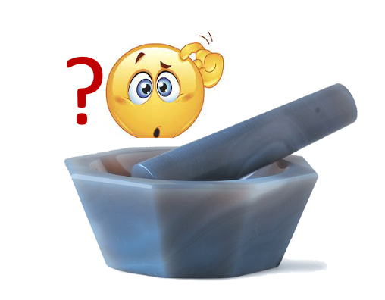
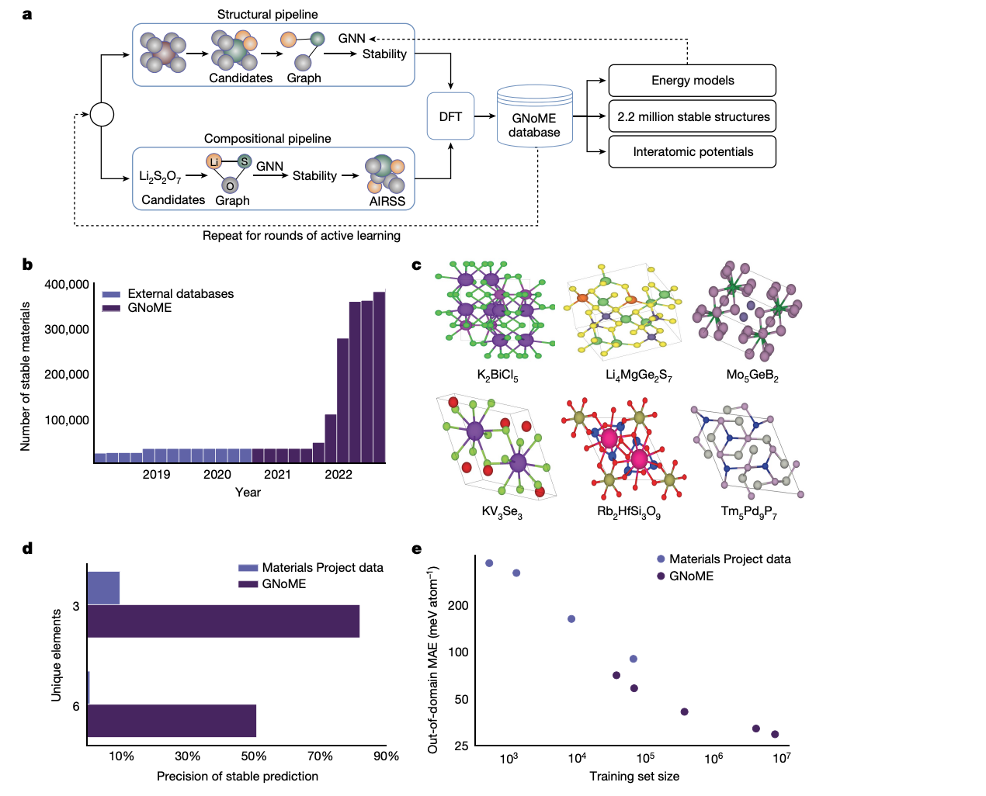
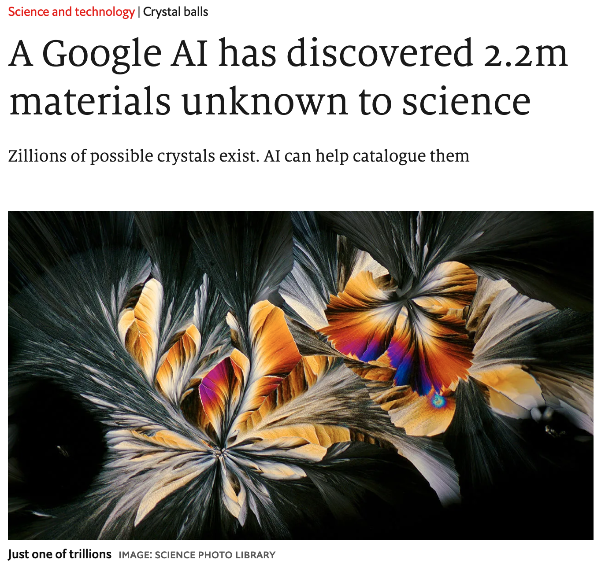
Challenges & prospects
Societal Challenges
Are we in the decline of disruptive science?
Scientists know of about 48.000 different crystals. DeepMind has created a machine-learning tool called gnome (Graph Networks for Materials Exploration) that can use existing libraries of chemical structures to predict new ones. It came up with 2.200.000 crystal structures, each new to science.
Merchant, Amil, et al. "Scaling deep learning for materials discovery." Nature 624.7990 (2023): 80-85.

Slide 5
Challenges & prospects
Societal Challenges
Are we in the decline of disruptive science?
Possible causes of the decline:
The theory of “low-hanging fruit” assumes that most discoveries have already been made.
The increasing burden of knowledge & the tendency toward ultra-specialization.
Growing difficulty in securing research funds (discouraging riskier projects).
Correlation to materials science trends & straightforward solutions
Not true: 41 of the 58 ML predicted compounds were synthesised in a little over two weeks.
A pressing need for ”truly” interdisciplinary research
Improving the “research yield per research cost unit”
The decline in disruptive science ≠ decline in the quality of science
Park, M., Leahey, E., & Funk, R. J. (2023). Nature, 613(7942), 138-144.

Slide 6
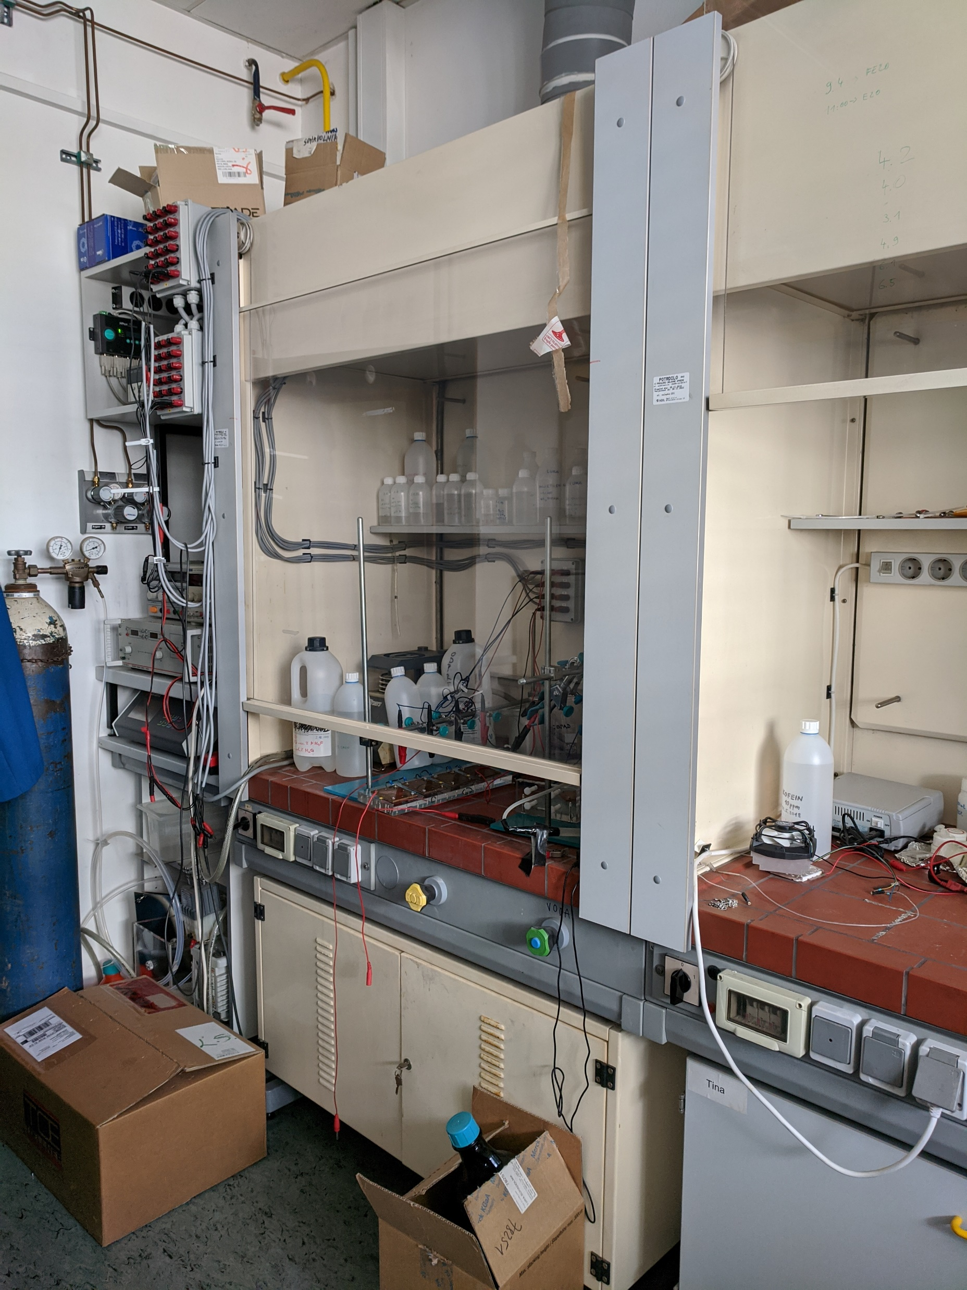

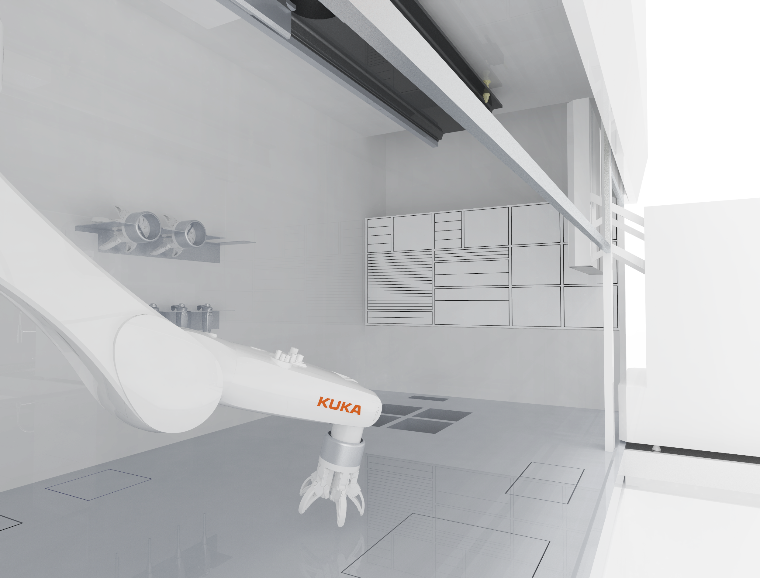
Autonomous laboratory for sustainable research and discovery of new materials
Motivation
To reshape materials discovery by establishing an autonomous lab dedicated to sustainable research and the development of new materials.

Slide 7
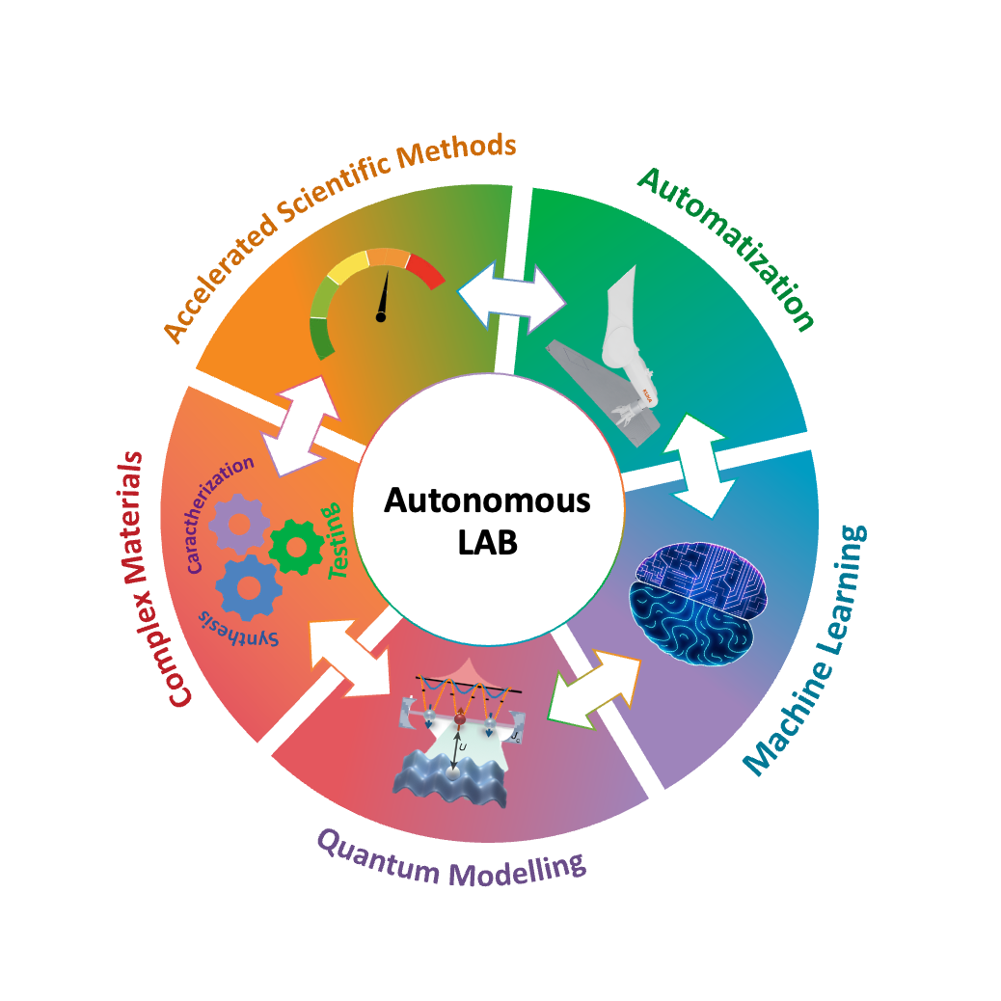
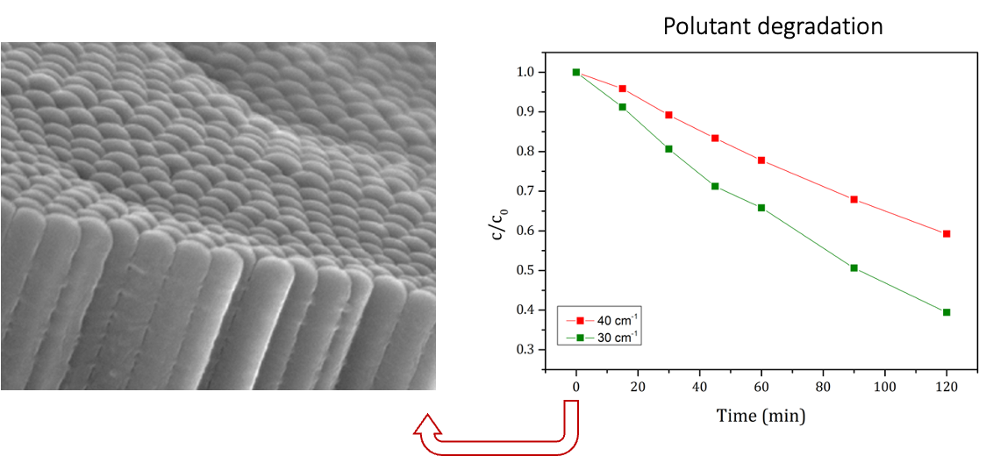
Autonomous laboratory for sustainable research and discovery of new materials
Autonomous LAB
General concept
The research concept will be dominated on an inverse materials design approach, where the desired end material property drives the entire discovery process.
Electrochemical-based synthesis
  Anodic oxidation
    Synthesis of thin films
      Applications in energy and environmental fields
  Electrochemical characterisation
    Cyclic voltammetry (CV), Linear sweep voltammetry (LSV), Electrochemical impedance spectroscopy (EIS), Chronoamperometry, Photoelectric conversion efficiency (η)…

Slide 8



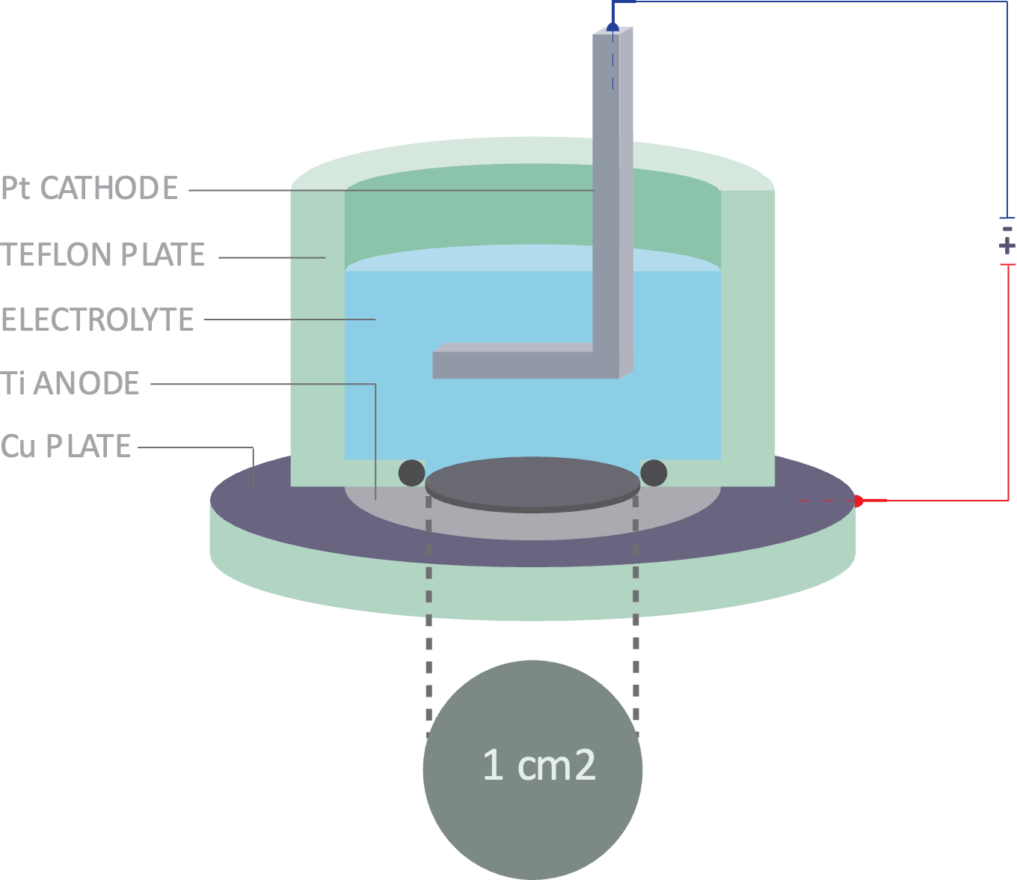
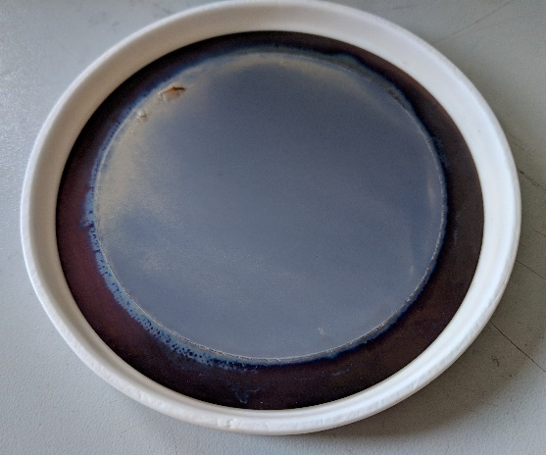
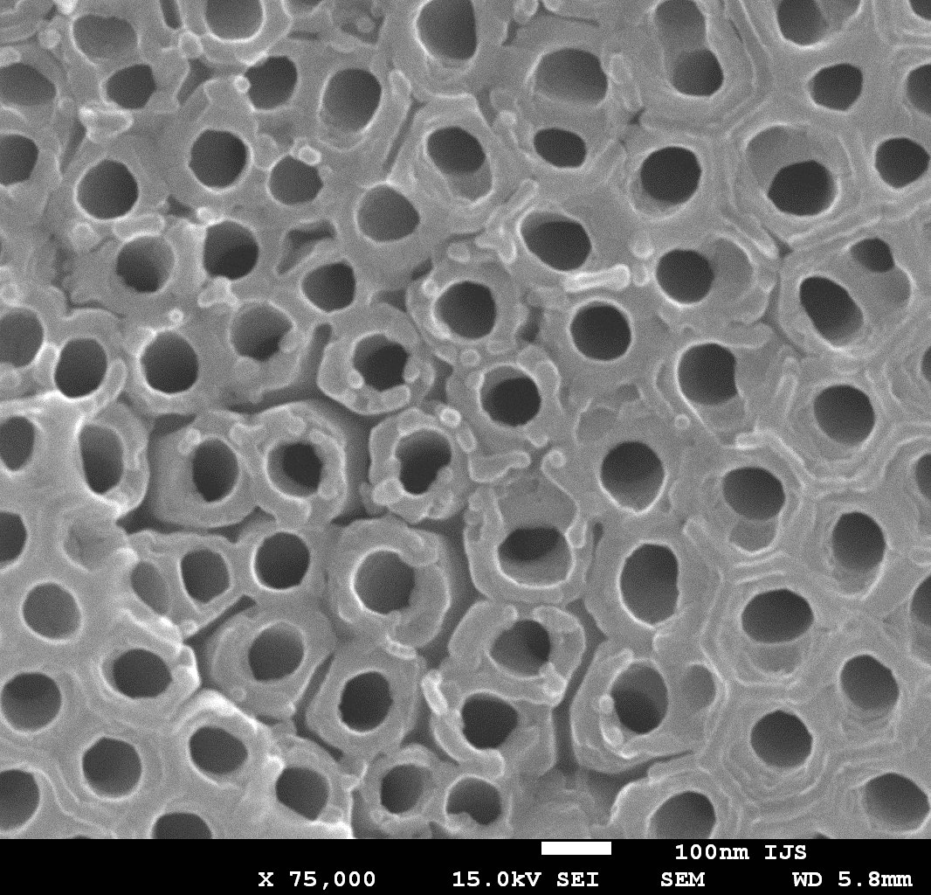




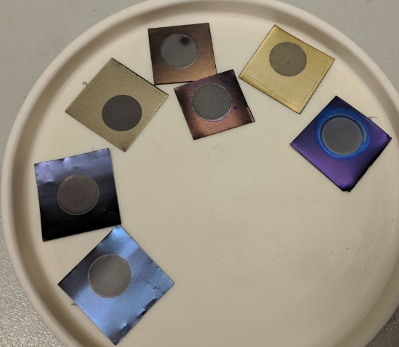

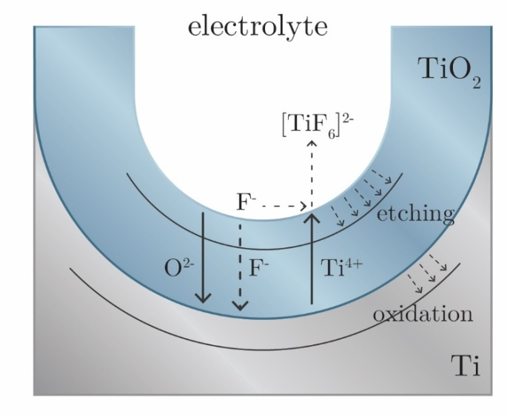





Roadmap: The research platform for catalytically active nanostructured oxide materials
Anodic oxidation process
Metal foil
anodized area of 50 cm²
anodized area of 0.79 ± 0.03 cm²
Starting material: Metal foil/substrate/rod, etc.
Desired material: Immobilized nanostructured oxide material
Synthesis approach: Versatile anodic oxidation process
Desired property: Excellent photo/photo-electro/electro -catalytic response
2011
Anodic oxidation
process
Acknowledgement: Kristina Žagar Soderžnik

Slide 9
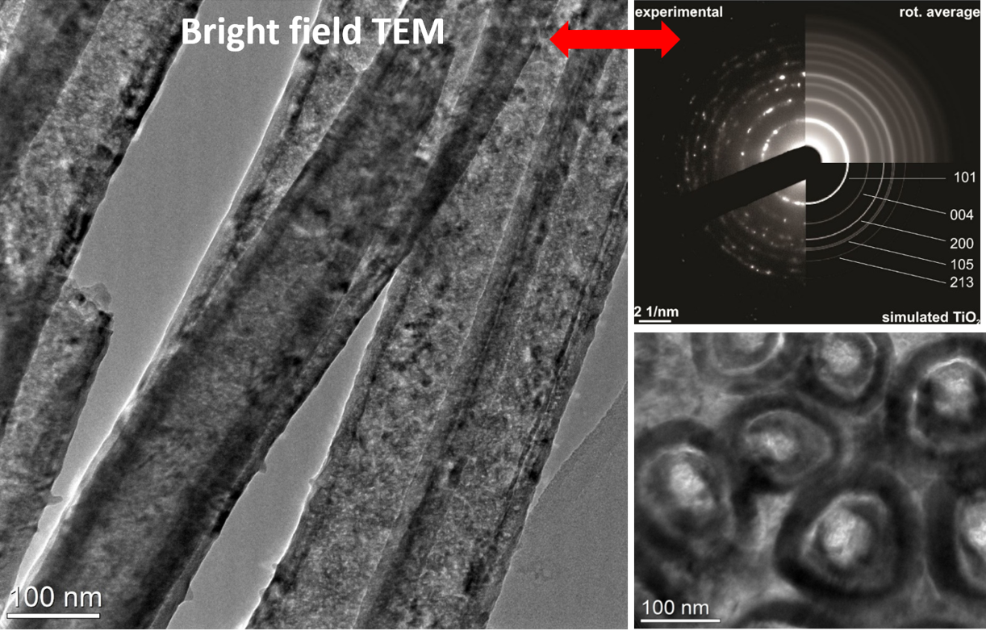


Roadmap: The research platform for catalytically active nanostructured oxide materials
Anodic oxidation process
Anodization of
single elements
Starting material: Metal foil/substrate/rod, etc.
Desired material: Immobilized nanostructured oxide material
Synthesis approach: Versatile anodic oxidation process
Desired property: Excellent photo/photo-electro/electro -catalytic response
2011
Anodic oxidation
process
Acknowledgement: Kristina Žagar Soderžnik

Slide 10
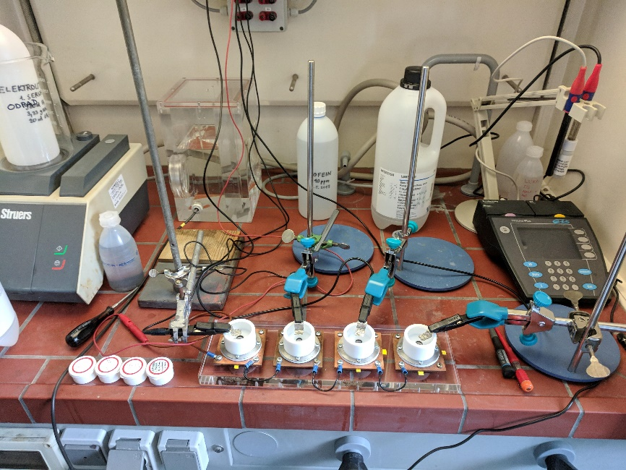
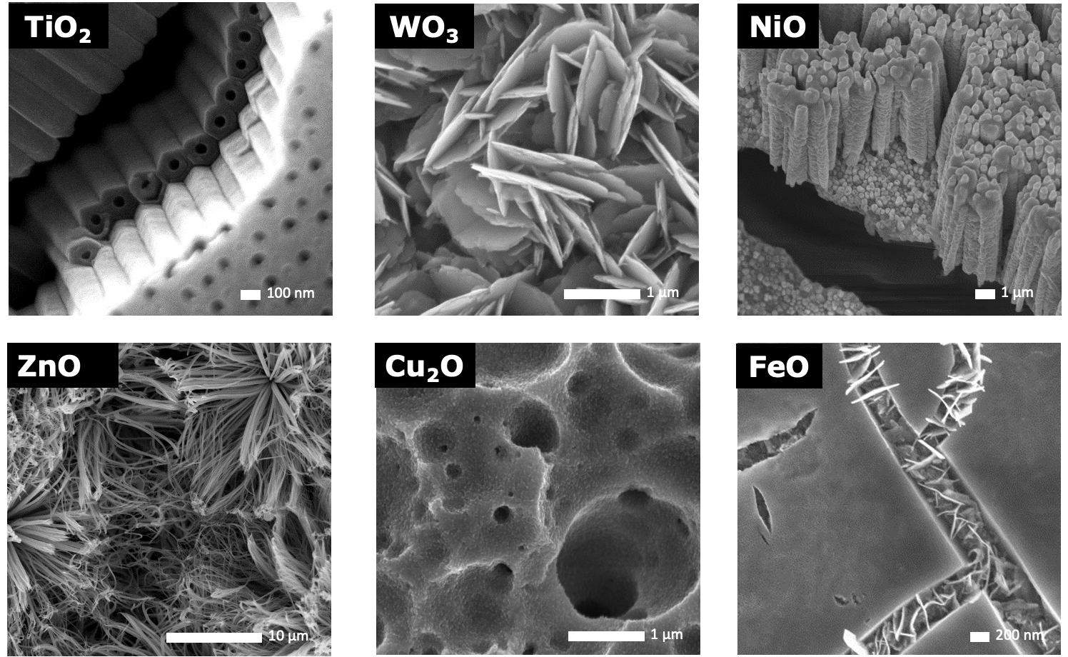

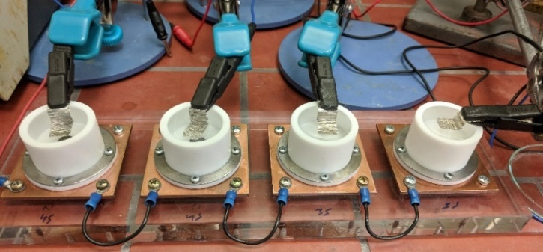
Roadmap: The research platform for catalytically active nanostructured oxide materials
Anodic oxidation process
Nanostructured thin films
Anodization of
single elements
Starting material: Metal foil/substrate/rod, etc.
Desired material: Immobilized nanostructured oxide material
Synthesis approach: Versatile anodic oxidation process
Desired property: Excellent photo/photo-electro/electro -catalytic response
2011
Anodic oxidation
process

Slide 11
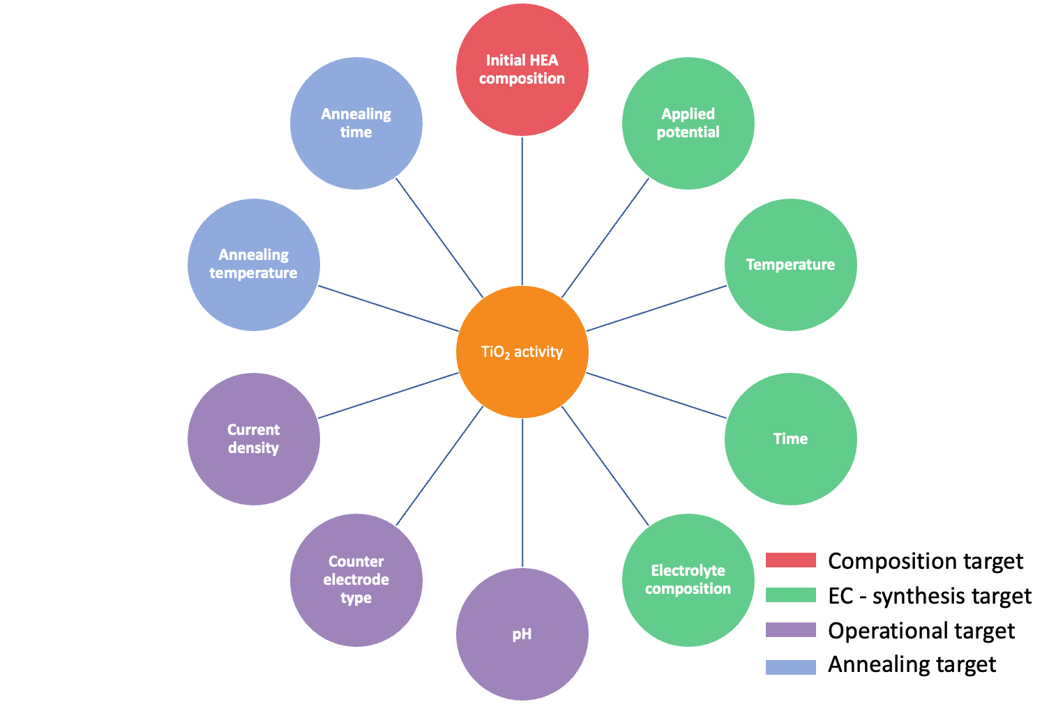
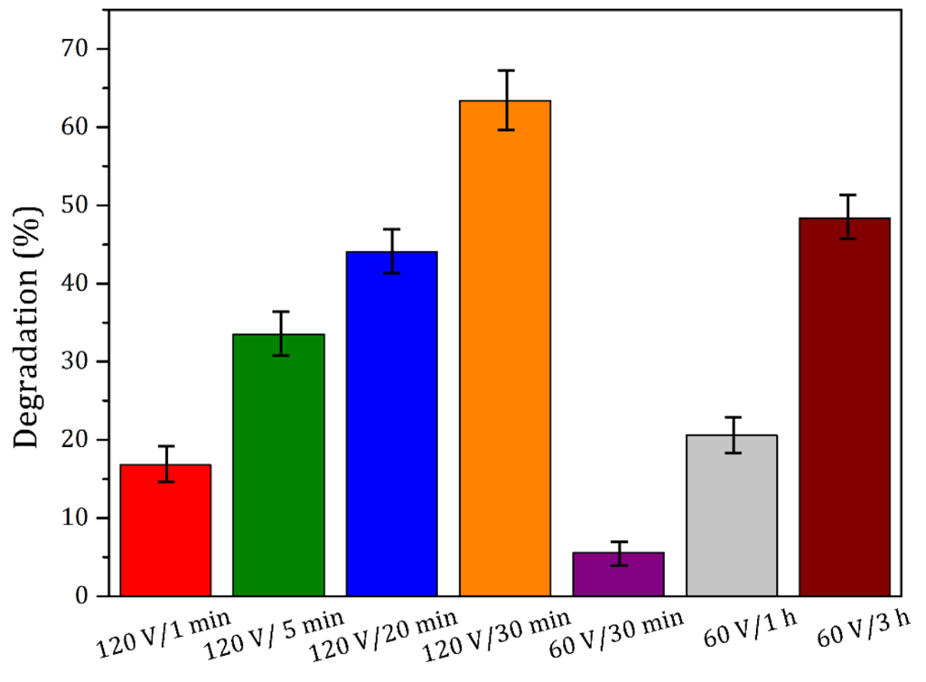


Roadmap: The research platform for catalytically active nanostructured oxide materials
Anodic oxidation process
A non-exhaustive list of processing parameters:
Activity of TiO₂ nanotubes:
degradation of organic polutant
Environmental
applications
Nanostructured thin films
Anodization of
single elements
Starting material: Metal foil/substrate/rod, etc.
Desired material: Immobilized nanostructured oxide material
Synthesis approach: Versatile anodic oxidation process
Desired property: Excellent photo/photo-electro/electro -catalytic response
2011
Anodic oxidation
process

Slide 12

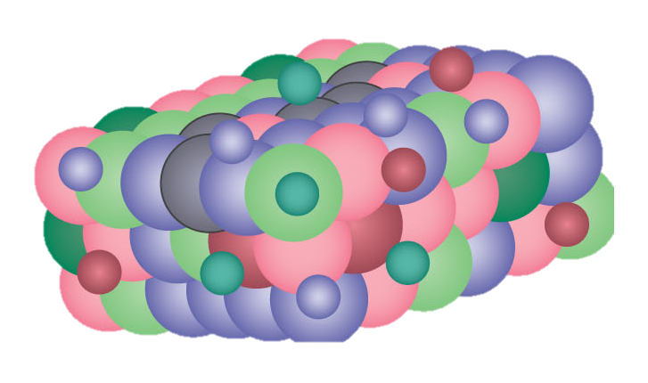



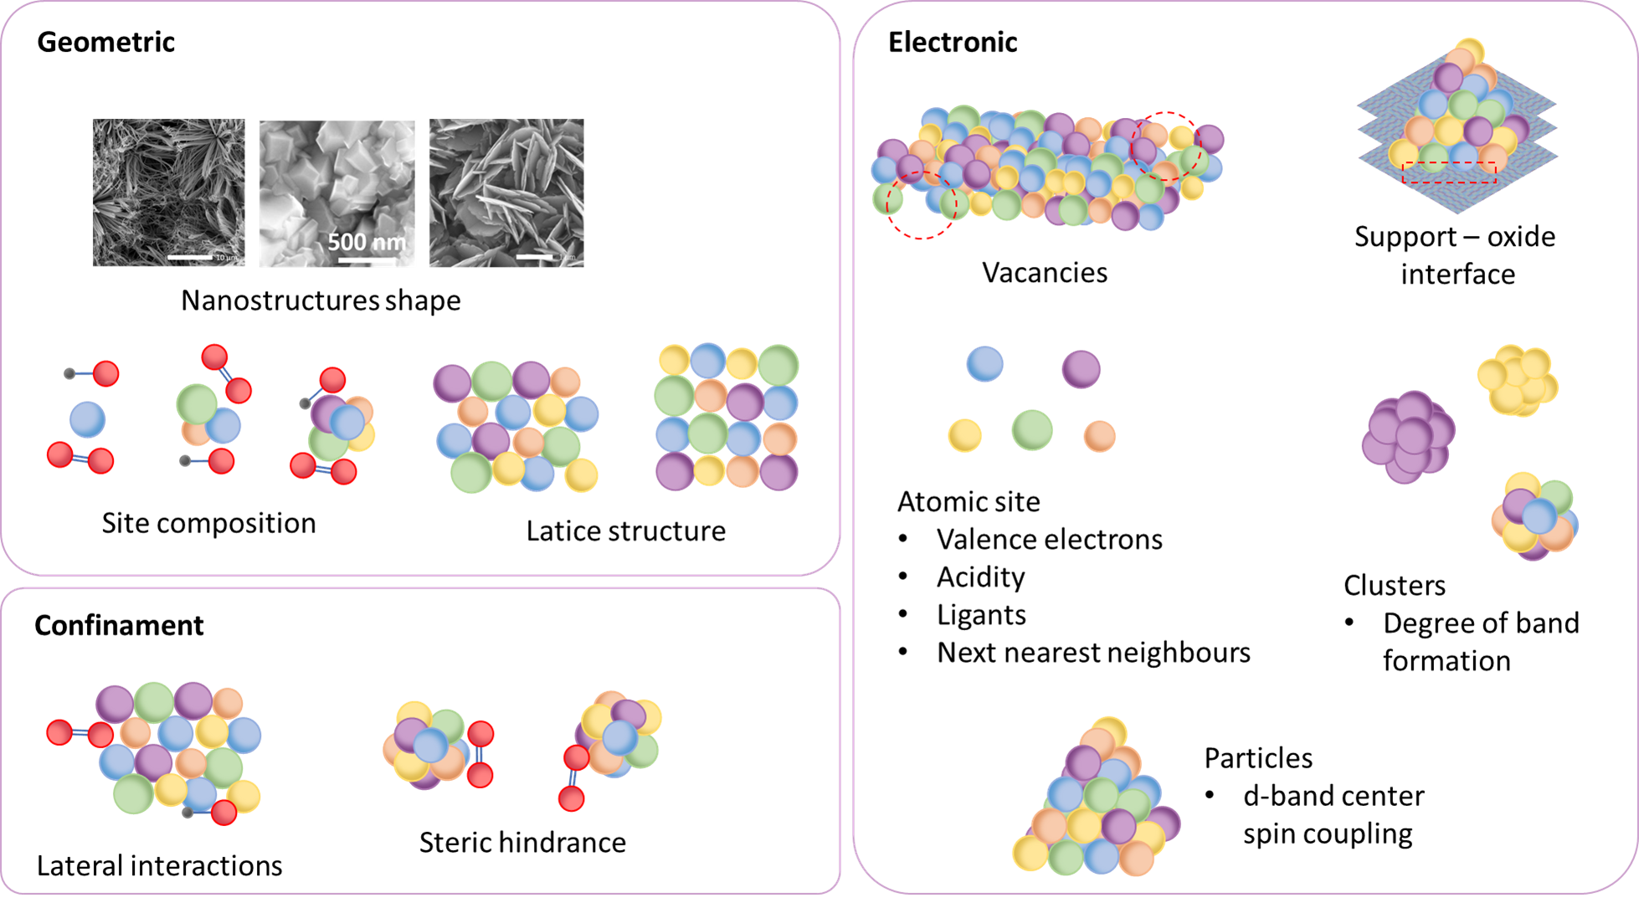
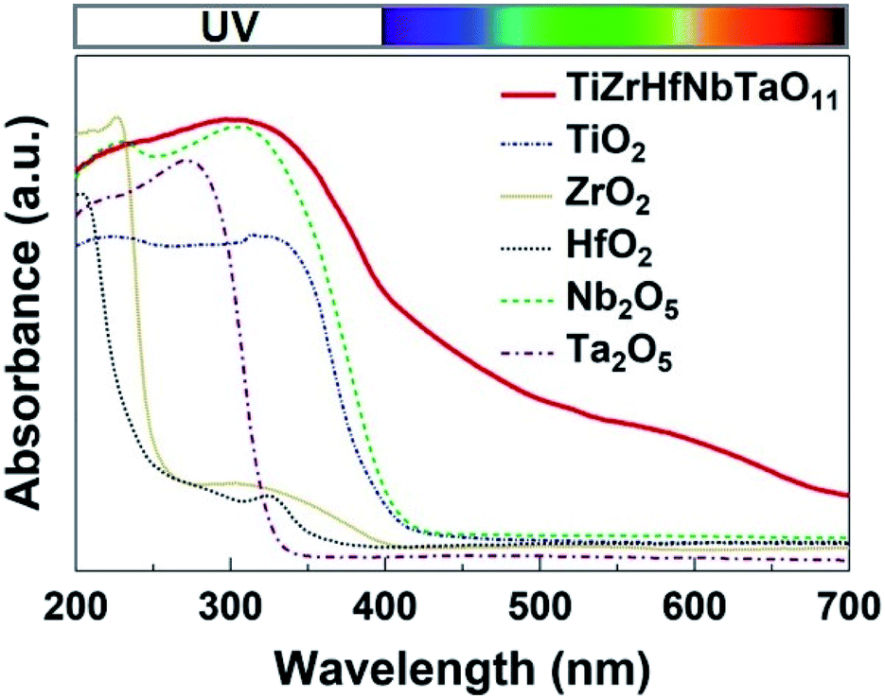
Great opportunity, great challenges: High-Entropy Materials
High entropy alloys (HEA)
Simultaneously proposed by Cantor¹ and Yeh² in 2004.
Possible HEA BCC: 30.201³
High entropy oxides (HEO)
First described in 2015 by Rost⁴.
Exploring new
applications (energy)
New class of
materials
Abundant active sites
For theoretical Ru_{0.2}Ti_{0.2}Ir_{0.2}Os_{0.2}Rh_{0.2}O₂ rutile HEO:
- estimated 1.95×10⁶ different adsorption sites⁵.
2022
Environmental
applications
Nanostructured thin films
Applications in catalysis
The existence of abundant and customizable catalytic active sites makes HEAs and HEOs excellent catalysts for different reactions⁶.
Anodization of
single elements
Promising catalyst material
HEA ⟶ HEO
Atomic-scale disorder ⟶ enhanced kinetic properties
Abundant active sites ⟶ different types of catalytic reactions
Thermally stable, mechanically strong and corrosion - resistant
[ Possible active sites: ～ 1M ]
x
[ Possible HEA/HEO: ～ 30k ]
⇒ (possible pathways)
2011
Anodic oxidation
process
¹Cantor, B. et al. , Mater. Sci. Eng. A., 2004, 375–377, 213; ²Yeh, J.W. et al. , Adv. Eng. Mater., 2004, 6, 299; ³Chen, Wei, et al. "A map of single-phase high-entropy alloys." Nature Communications 14.1 (2023): 2856.
⁴Rost, C.M. et al. , Nat. Commun., 2015, 6; ⁵Svane, K.L. and J. Rossmeisl , Angew. Chemie Int. Ed., 2022, 61, e202201146; ⁶M. Anandkumar, J. Alloys Compd., 2021, 850, 156716.

Slide 13
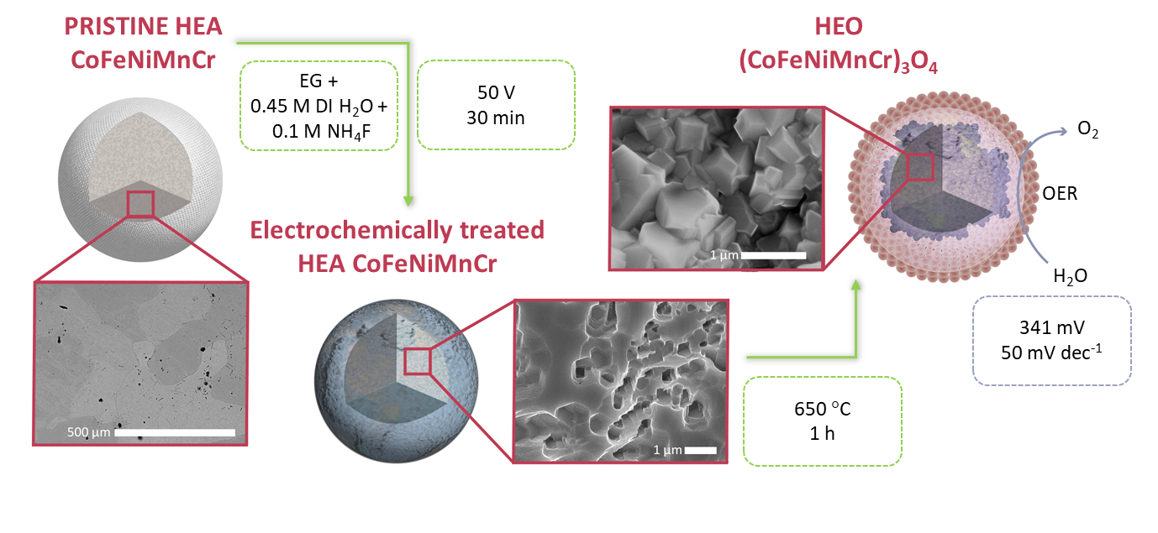
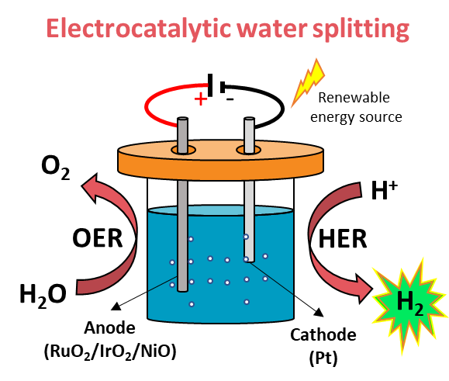

High Entropy Materials
Recent study: (Co,Fe,Ni,Mn,Cr)₃O₄ High-Entropy Oxides
Exploring new
applications (energy)
2024
New class of
materials
2022
Environmental
applications
Nanostructured thin films
 | (Co,Fe,Ni,Mn,Cr)₃O₄ (this work) | (Co,Fe,Ni,Mn,Cr)₃O₄ (Einert et al., 2022) | (Co,Cu,Fe,Mn,Ni)₃O₄ (Wang et al., 2019) | RuO₂ (Ma et al., 2022) | Reference values (SOTA materials)
Onset potential | 1.57 V | 1.58 V | 1.58 V | 1.47 | ≤ 1.61 V
Overpotential (at 10 mA/cm²) | 341 mV | 350 mV | 350 mV | 235 mV | ≤ 380 mV¹
Tafel slope | 50 mV/dec | 35 mV/dec | 59.5 mV/dec | 77.2 mV/dec | 30 - 120 mV/dec²
Anodization of
single elements
2011
Anodic oxidation
process
B.L. Božiček et al., Journal of Materials Science 2024, doi.org/10.1007/s10853-024-09710-5
¹Scott, et al. "Energy & Environmental Science 15.5 (2022): 1977-1987.
²Kapałka, et al., Electrochemistry Communications, 10(4), 607-610.

Slide 14



Conceptualization of an autonomous laboratory for sustainable research and discovery of HEO catalysts
Automatization
Testing
Synthesis
Caractherization
The unique advantageous position at the JSI: strong tradition in material processing, DFT modelling, robotics, automation and knowledge technologies, all in one confined place.

Slide 15
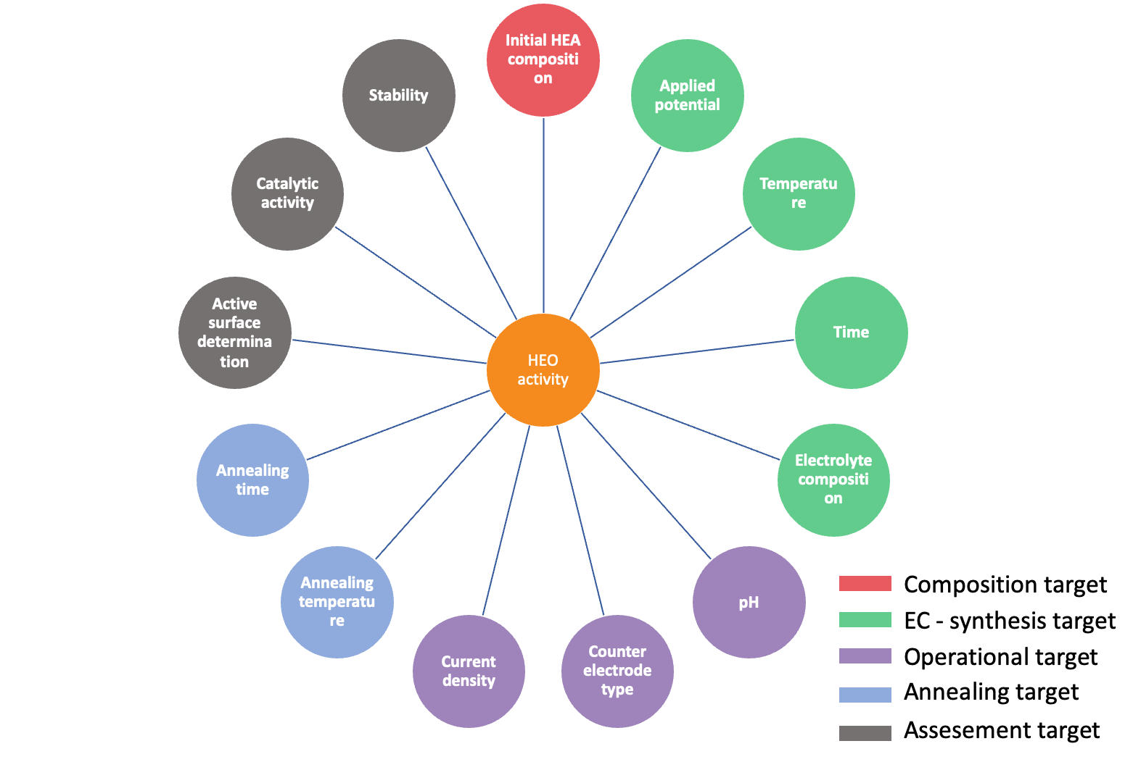
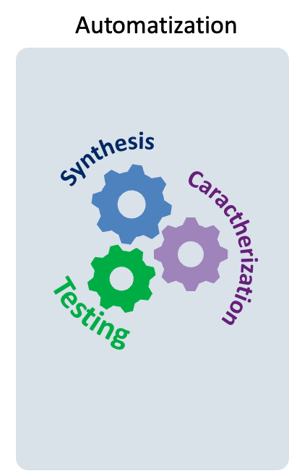
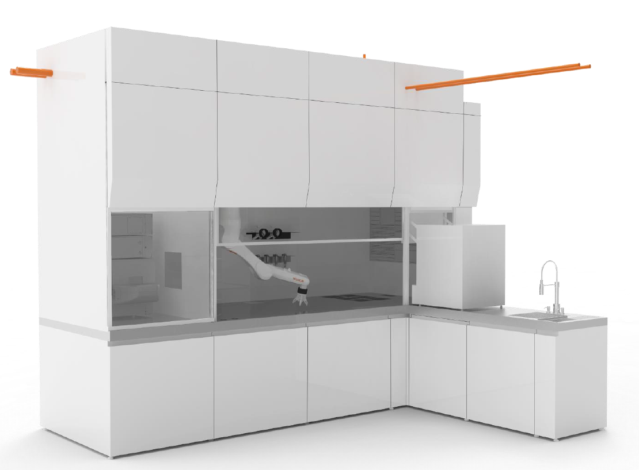
Conceptualization of an autonomous laboratory
The heart of the system: The state-of-the-art fume hood
Two main functionalities:
automated synthesis
automated characterisation
Custom-built facility for the autonomous synthesis and electrochemical characterization of materials (12 m²)

Slide 16
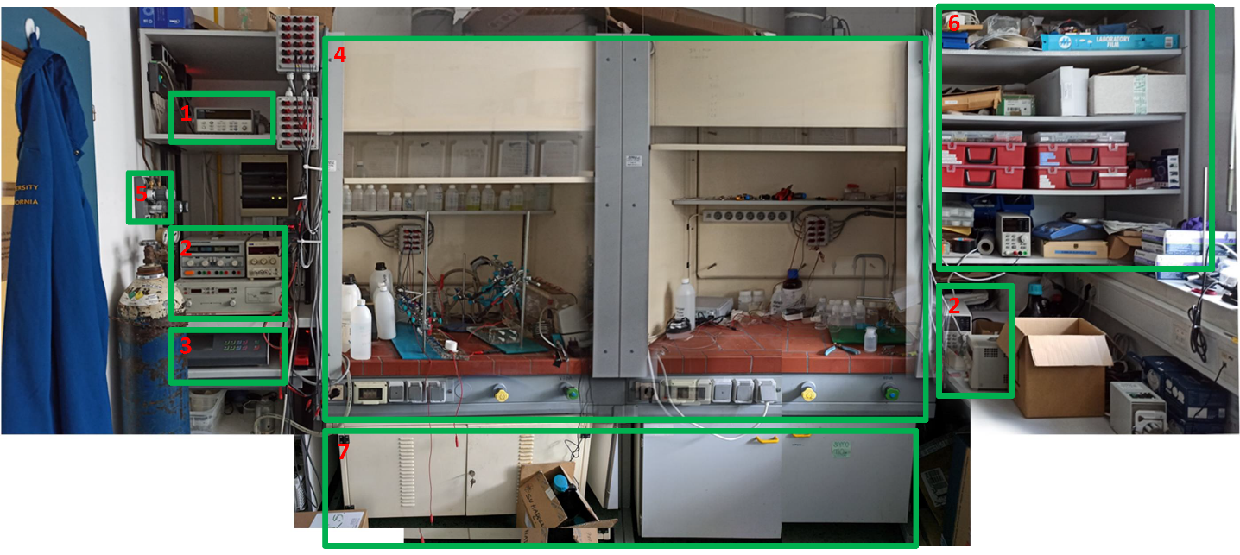
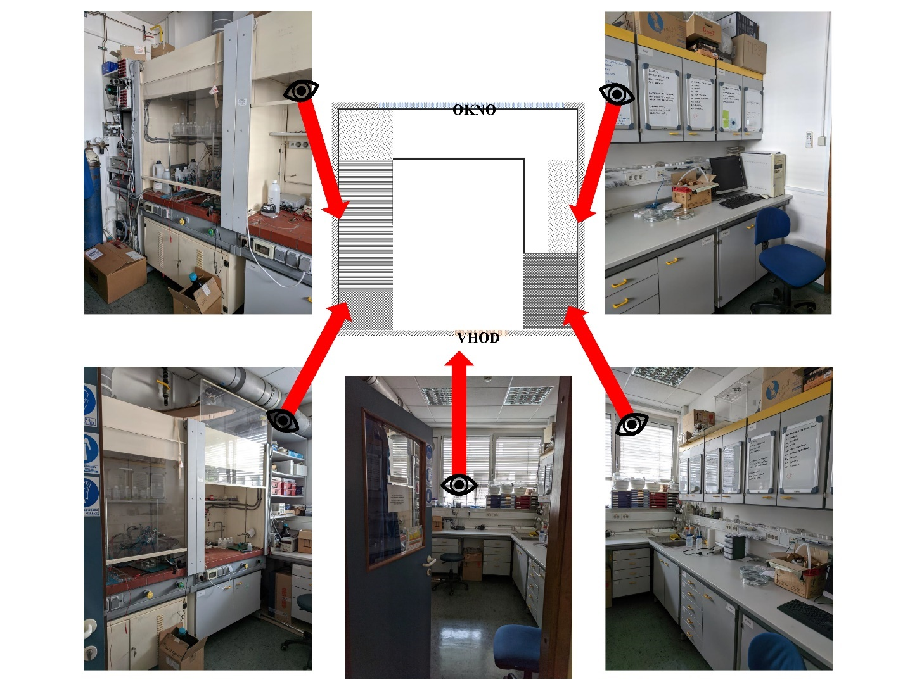
State before renovation
Window
Entrance
1 - multiplexer
2 - power supply
3 - electropolishing device
4 - fume cupboard (anodisation and photo-electro-catalysis)
5 - gas regulators
6 - storage cabinet
7 - chemical/electrolyte cabinet/chamber

Slide 17
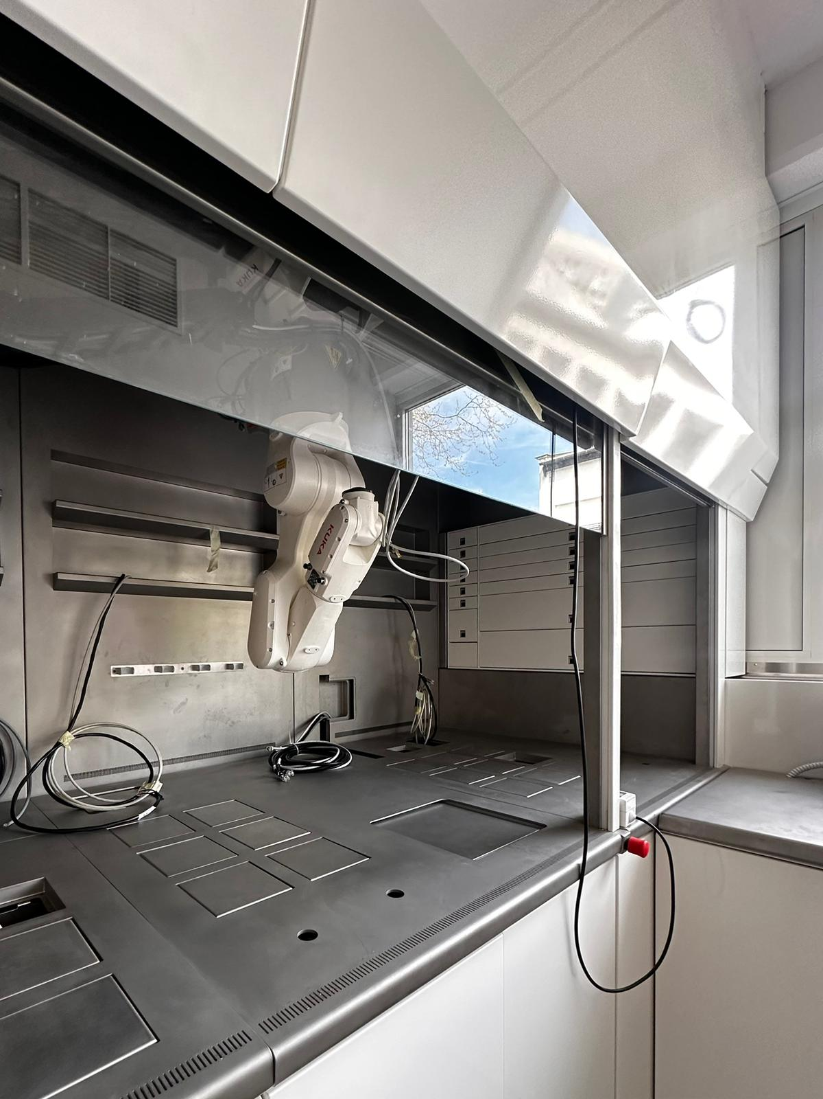
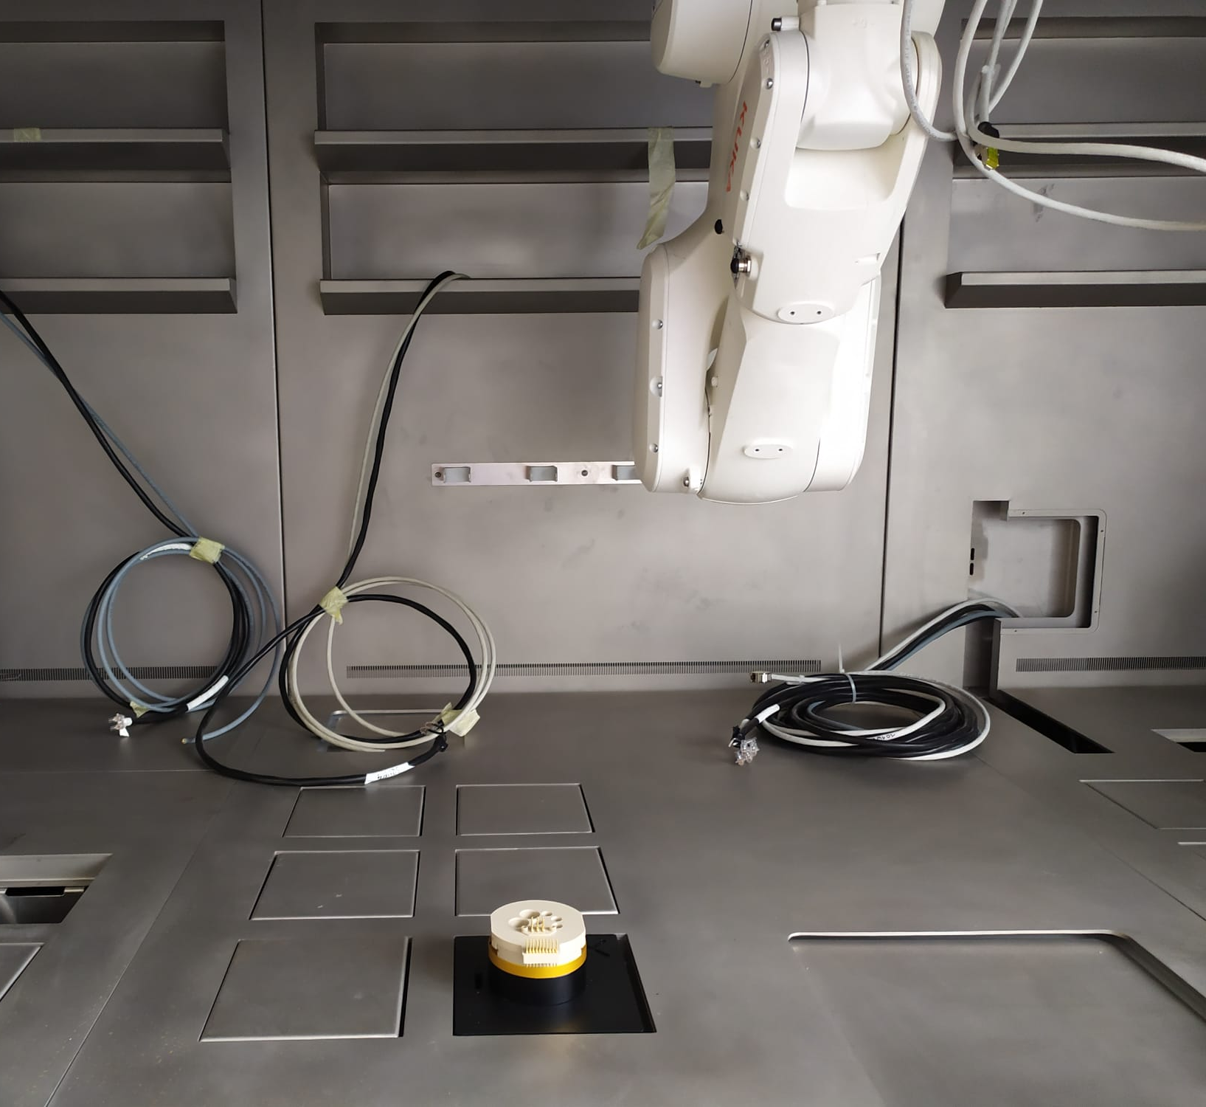
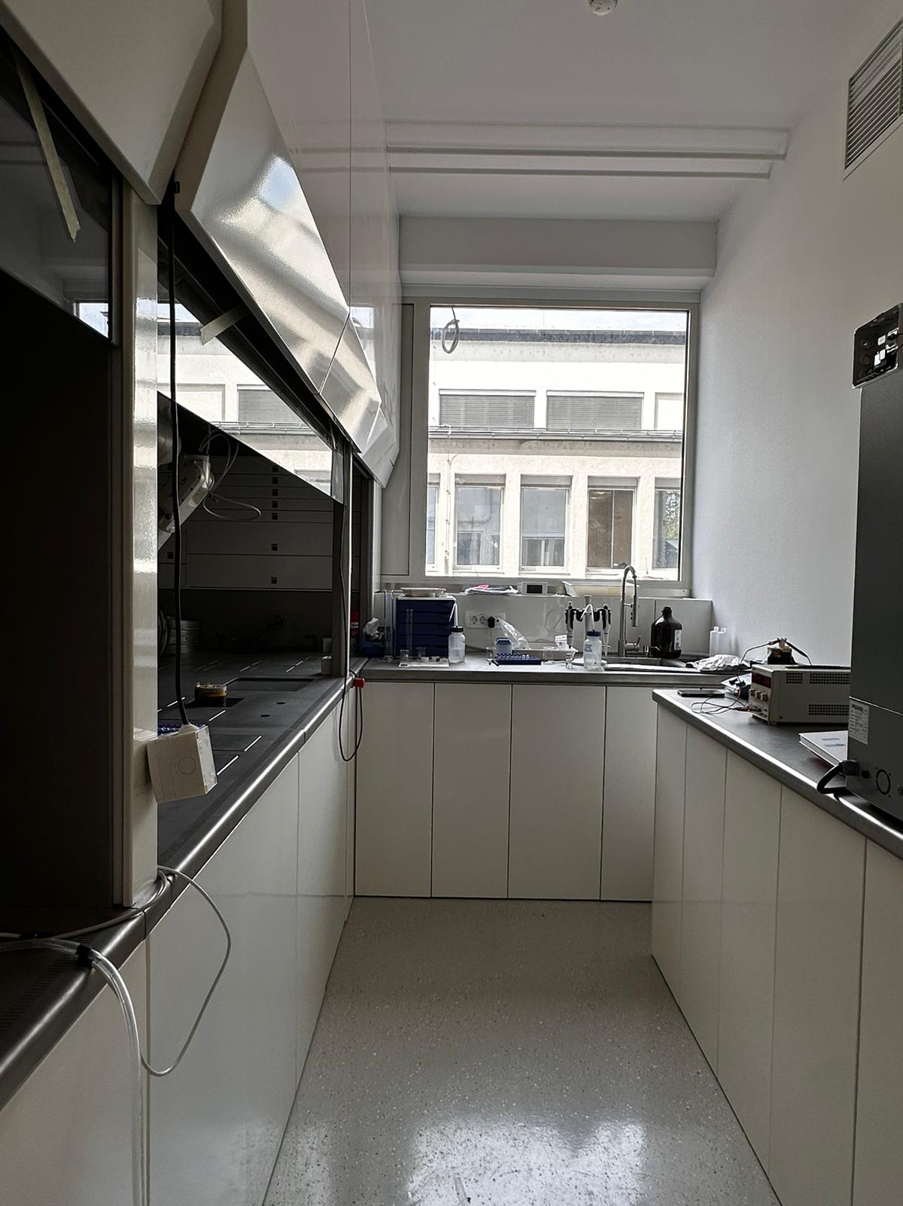
Current state

Slide 18
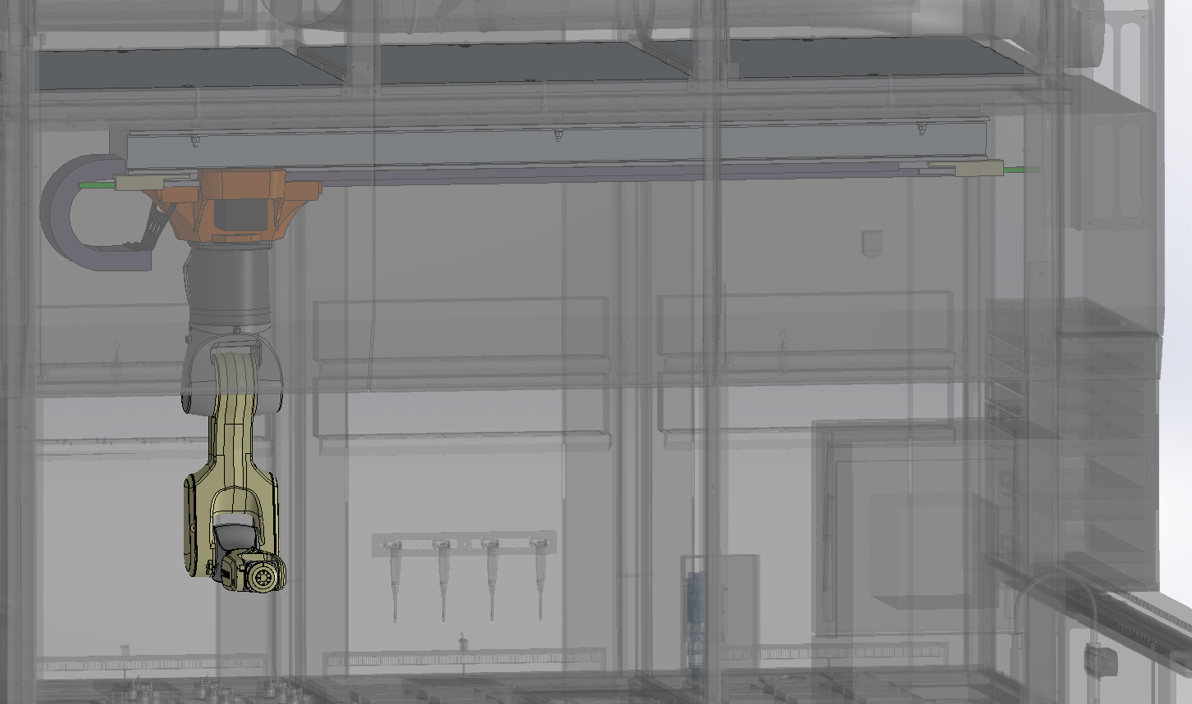
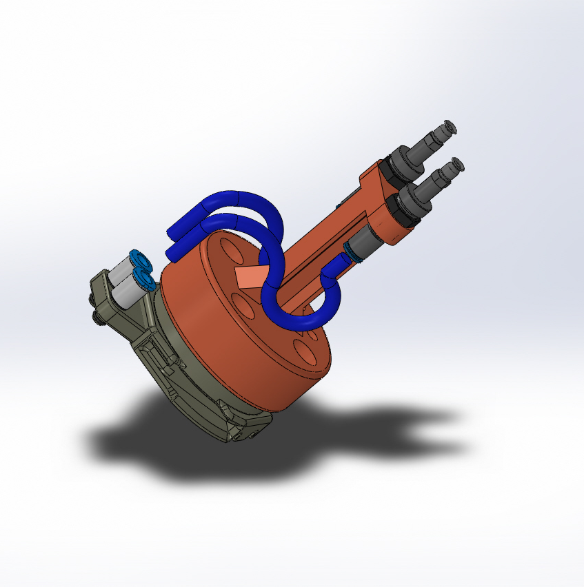
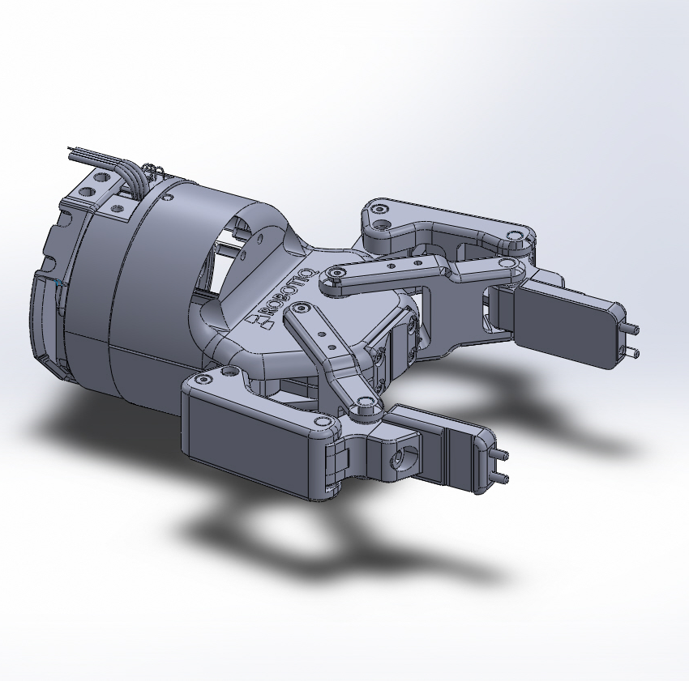
Robot on a linear track

Slide 19
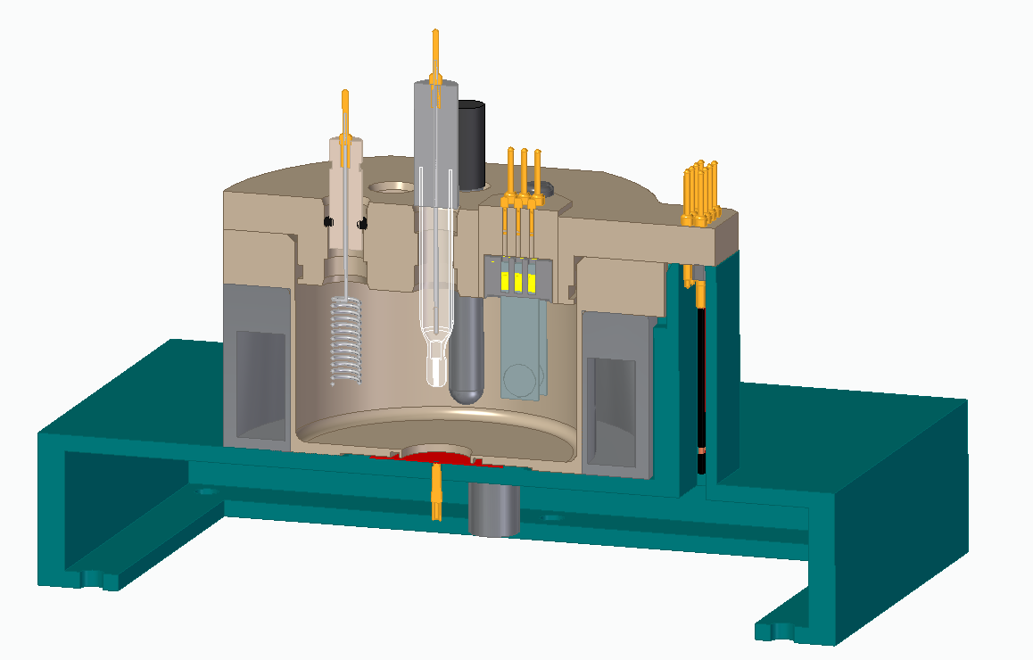
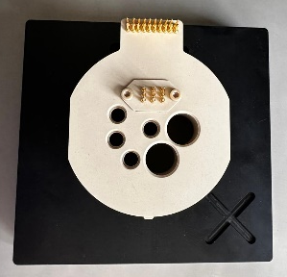
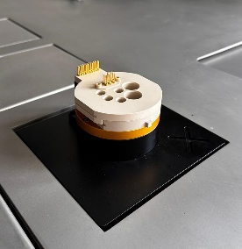
Custom-built electrochemical cell

Slide 20
The state-of-the-art fume hood: 15 functionalised sub-units

Slide 21
Initial testing – workflow for autonomous laboratory
Raw material (R)
Metallic Ti foil
AO + Annealed material (AO+AN)
TiO₂ crystalline nanotubes
Characterised material (C)
Electrochemical characterisation of AO+AN material
Anodised material (AO)
TiO₂ amorphous nanotubes
Preparation
Anodisation
Annealing
Characterisation
Synthesis
Characterisation

Slide 22
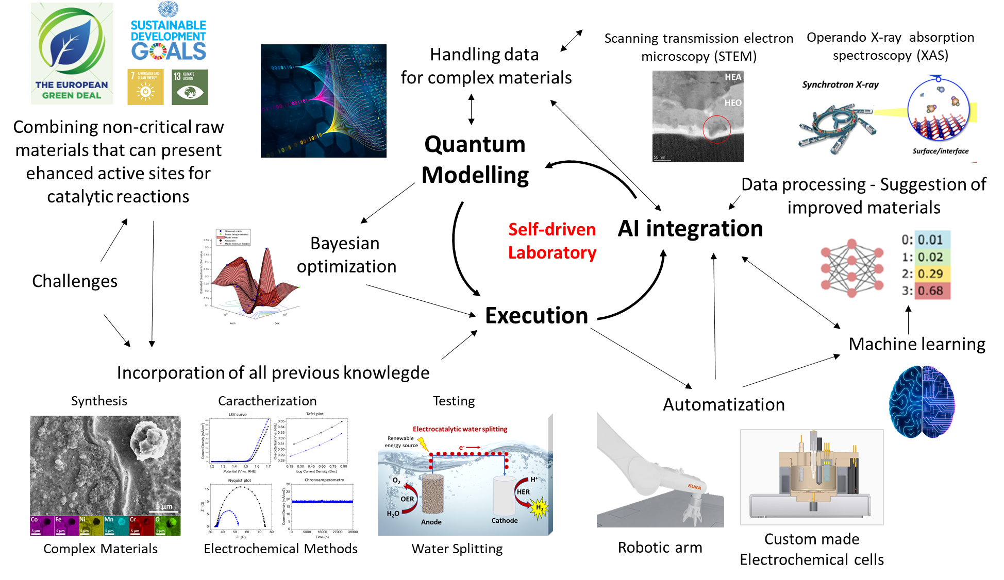
Future plans

Slide 23
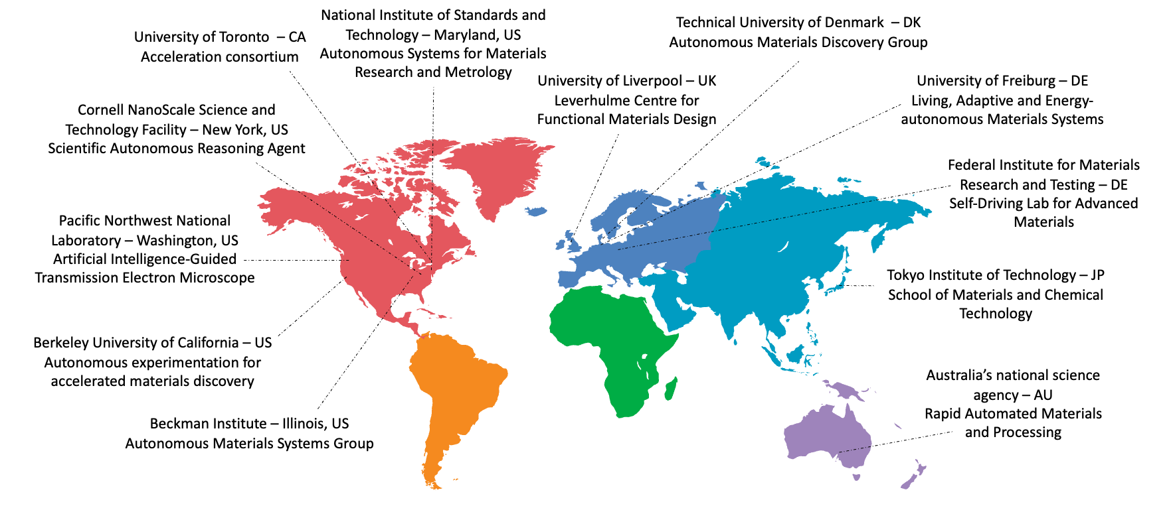
Autonomous laboratory for sustainable research and discovery of new materials at IJS
Leading Institutions and projects on Autonomous Research of Materials around the world
1988: Matsuda
Robot: Desktop robotic arm.
Finding: Optimized analytical colorimetric tests; first automated research report.
2009: King
Robot: Laboratory system with robots.
Finding: Identified genes for 13 orphan enzymes; hypotheses generated and tested autonomously.
2013: Desai
Robot: Flow reactor with automation.
Finding: Accelerated drug discovery; novel template identified for kinase inhibitors.
2016: Nikolaev
Robot: Laser-based system.
Finding: Optimized synthesis parameters for carbon nanotubes.
2020: Burger
Robot: Mobile robot.
Finding: Enhanced photocatalysts for hydrogen production; 6x more effective.
2020: Shimizu
Robot: Robot arm and sputtering system.
Finding: Optimized TiO₂ films; reduced resistance using machine learning.
2023: Szymanski
Robot: Full robotic arms sequence.
Finding: Produced over 51 types of inorganic powders; integrated machine learning improved synthesis success.
First autonomous laboratory for materials research in Slovenia.
Thank you for your attention!
For more info, please contact me at: saso.sturm@ijs.si

Slide 25



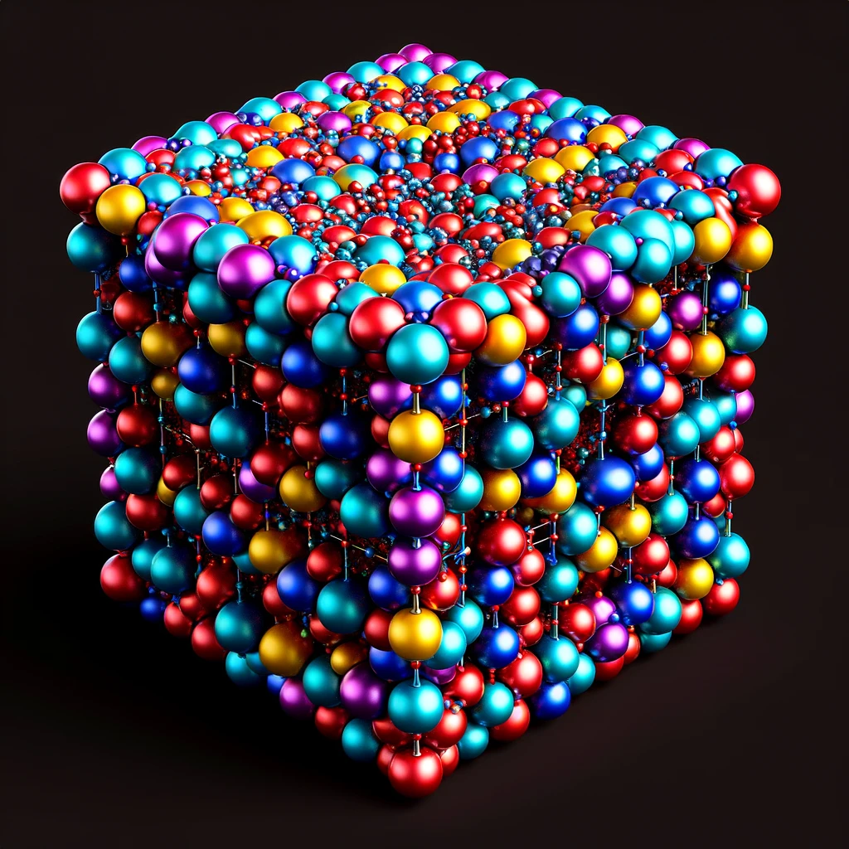
Great opportunity, great challenges: High-Entropy Oxides (HEO)
Autonomous laboratory for rapid material discovery
Integration with DFT
AI and automatization
Exploring new
applications (energy)
2024
New class of
materials
2022
Environmental
applications
Nanostructured thin films
Electrocatalytic water splitting
+
-
Renewable
energy source
Anodization of
single elements
O₂
H⁺
OER
HER
H₂O
H₂
2011
Anodic oxidation
process
Anode
(RuO₂/IrO₂/NiO)
Cathode
(Pt)

Slide 26
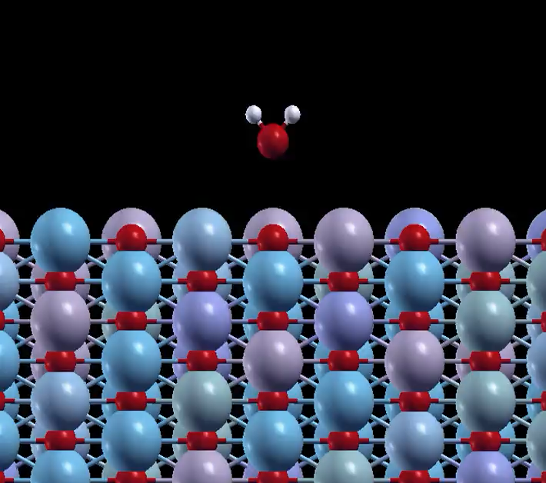
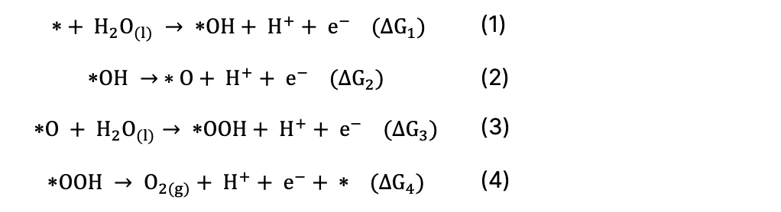
Material discovery: HEO catalyst for water-splitting reactions to generate green hydrogen
The conventional pathways for the OER:
$$+ H_{2}O_{(l)} → OH+ H^{+}+ e^{−} (∆G_{1})$$ | (1)
$$OH → ∗O+ H^{+}+ e^{−} (∆G_{2})$$ | (2)
$$O + H_{2}O_{(l)}→ OOH+ H^{+}+ e^{−} (∆G_{3})$$ | (3)
$$OOH → O_{2(g)}+ H^{+}+ e^{−}+  (∆G_{4})$$ | (4)
First simple questions:
What are the most efficient reaction pathways?
A rough estimate of possible local environments for an active adsorption site (*), considering only the nearest neighbour metal sites:
5 metal atoms forming HEO,
2 neighbour metal atoms (M),
4 bridge atoms (B),
2 sub-surface atoms (S)
5⁹ ∼ 1.95x10⁶ … and this is only for one compound!
* active adsorption site
M
Not-so-straightforward answer:
1.95x10⁶ – 6x10⁹ different possible active sites
B
S
B
*
B
S
B
M

Slide 27
Material discovery: HEO catalyst for water-splitting reactions to generate green hydrogen
Second simple questions:
How many high-entropy alloys could theoretically exist in a stable form for AO to HEO?
30.201 potential single-phase equimolar alloys in body-centred cubic structures.
5% of the possible combinations
Not-so-straightforward answers:
Possible active sites: 1.95x10⁶ – 6x10⁹
Possible HEA/HEO: 30.201
(possible HEA/HEO) x (possible active sites) ⇒ (possible pathways)
Chen, Wei, et al. "A map of single-phase high-entropy alloys." Nature Communications 14.1 (2023): 2856.

Slide 28
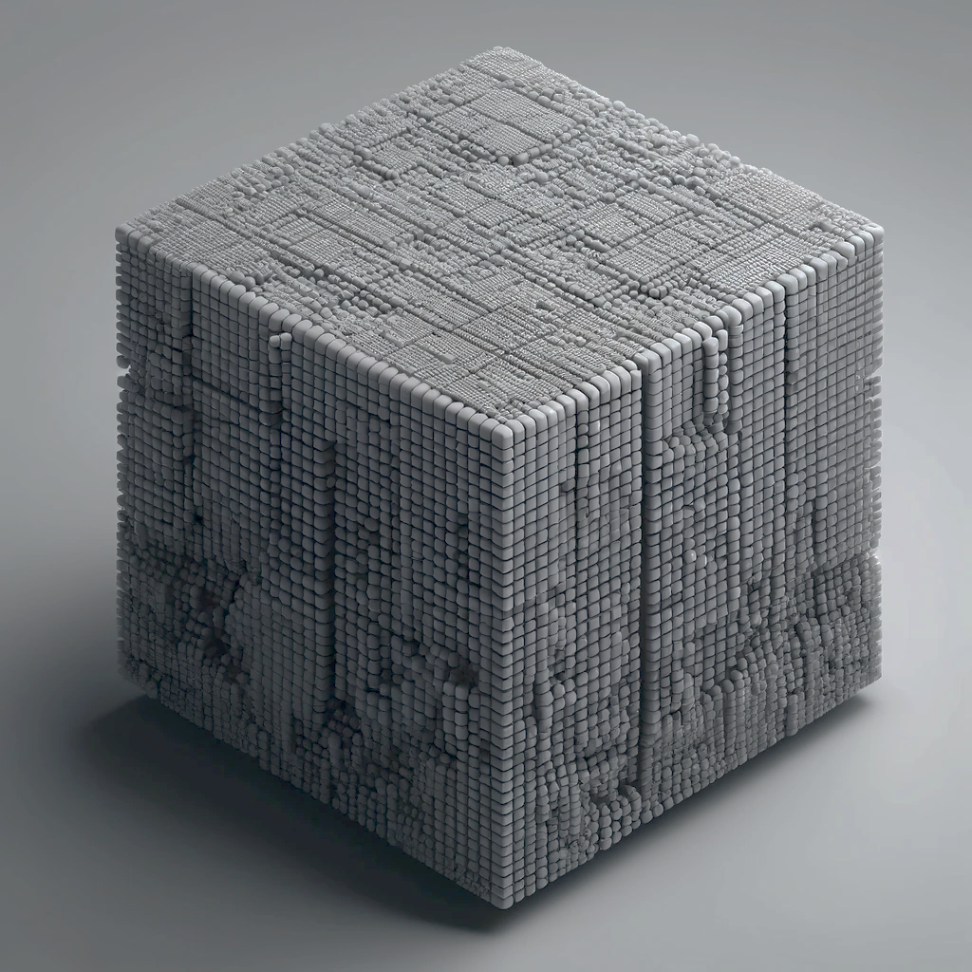
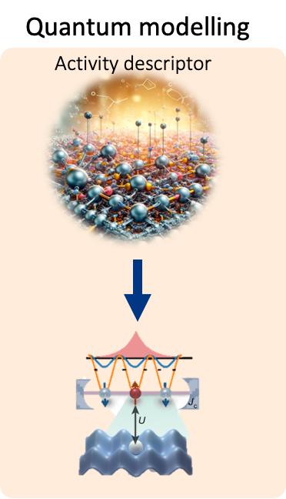
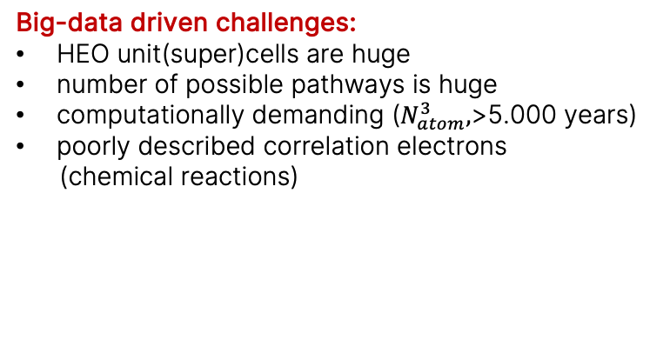
Material discovery - Big-data-driven challenges
DFT and quantum modelling proposed workflow
“Standard” DFT approach
Plan
DFT: Binding energies (E_{prod} − E_{react}) for particular OER steps.
Compare the energy-based probabilities of all possible reaction pathways.
Big-data driven challenges:
HEO unit(super)cells are huge
number of possible pathways is huge
computationally demanding ($N_{atom}^{3},$>5.000 years)
poorly described correlation electrons
(chemical reactions)
Goal
Most probable OER pathway for a given HEO surface.
Most promising HEO compound

Slide 29

Material discovery - Big-data-driven challenges
DFT and quantum modelling proposed workflow
“Standard” DFT approach
An AI/ML-aided pathway:
Reducing the number of binding-energy calculations

Slide 30

Material discovery - Big-data-driven challenges
DFT and quantum modelling proposed workflow
“Standard” DFT approach
Quantum algorithms for the future:
Decreasing the required computational time.
Correlated effects included
(correlated electrons/chemical reactions)
The quantum algorithms need to be developed before the respective hardware is capable of tackling the real problem.

Slide 31

Material discovery - Big-data-driven challenges
DFT and quantum modelling proposed workflow
“Standard” DFT approach
A combined
AI/ML
Quantum modelling approach

