Slide 1

Prof. Helge Stein
TUM School of Natural Sciences
Technische Universität München
Beyond acceleration?
& What got us here?
Prof. Dr.-Ing. Helge Sören Stein, Alexey Sanin,
Dr. Lorenz Falling, Dr. Frederic Felsen
Technical University of Munich
TUM School of Natural Sciences
Department of Chemistry
Munich Data Science Institute (MDSI)
Munich Institute for Robotic and Machine Intelligence (MIRMI)
Munich Institute of Integrated Materials, Energy and Process Engineering (MEP)

Slide 2
Prof. Helge Stein
TUM School of Natural Sciences
Technische Universität München
Before we start…
Materials are of strategic value.
Research is as well.

Slide 3
Discovery != Optimization
Prof. Helge Stein
TUM School of Natural Sciences
Technische Universität München
How do we do discovery?
Conventional
Experiments
Materials Intelligence
HTE
Workflow Automation Complexity
Stein & Gregoire, Chem. Sci., 2019, 10, 9640

Slide 4
Are we done with the hype?
Prof. Helge Stein
TUM School of Natural Sciences
Technische Universität München
LLMs
MAPs
HTE
BO
Lab Automation
Intention
Agnosticism
(please!)
Data Management

Slide 5
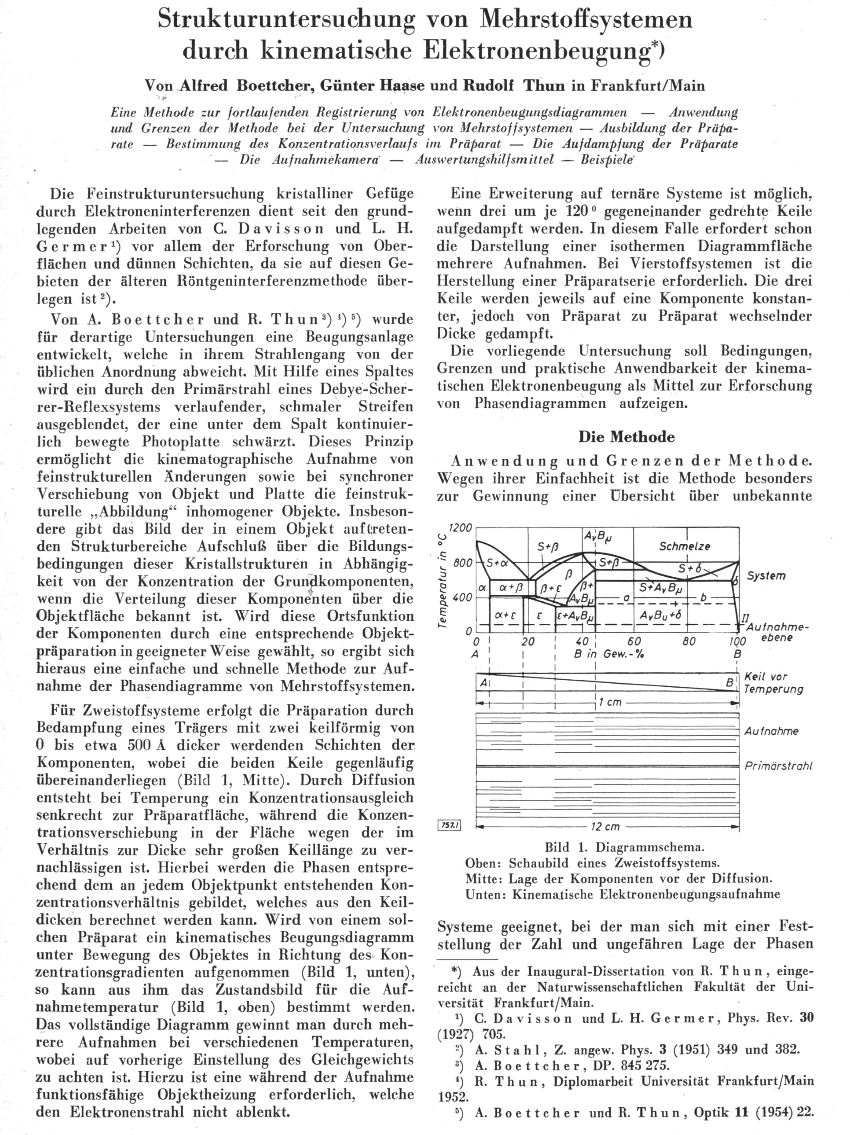
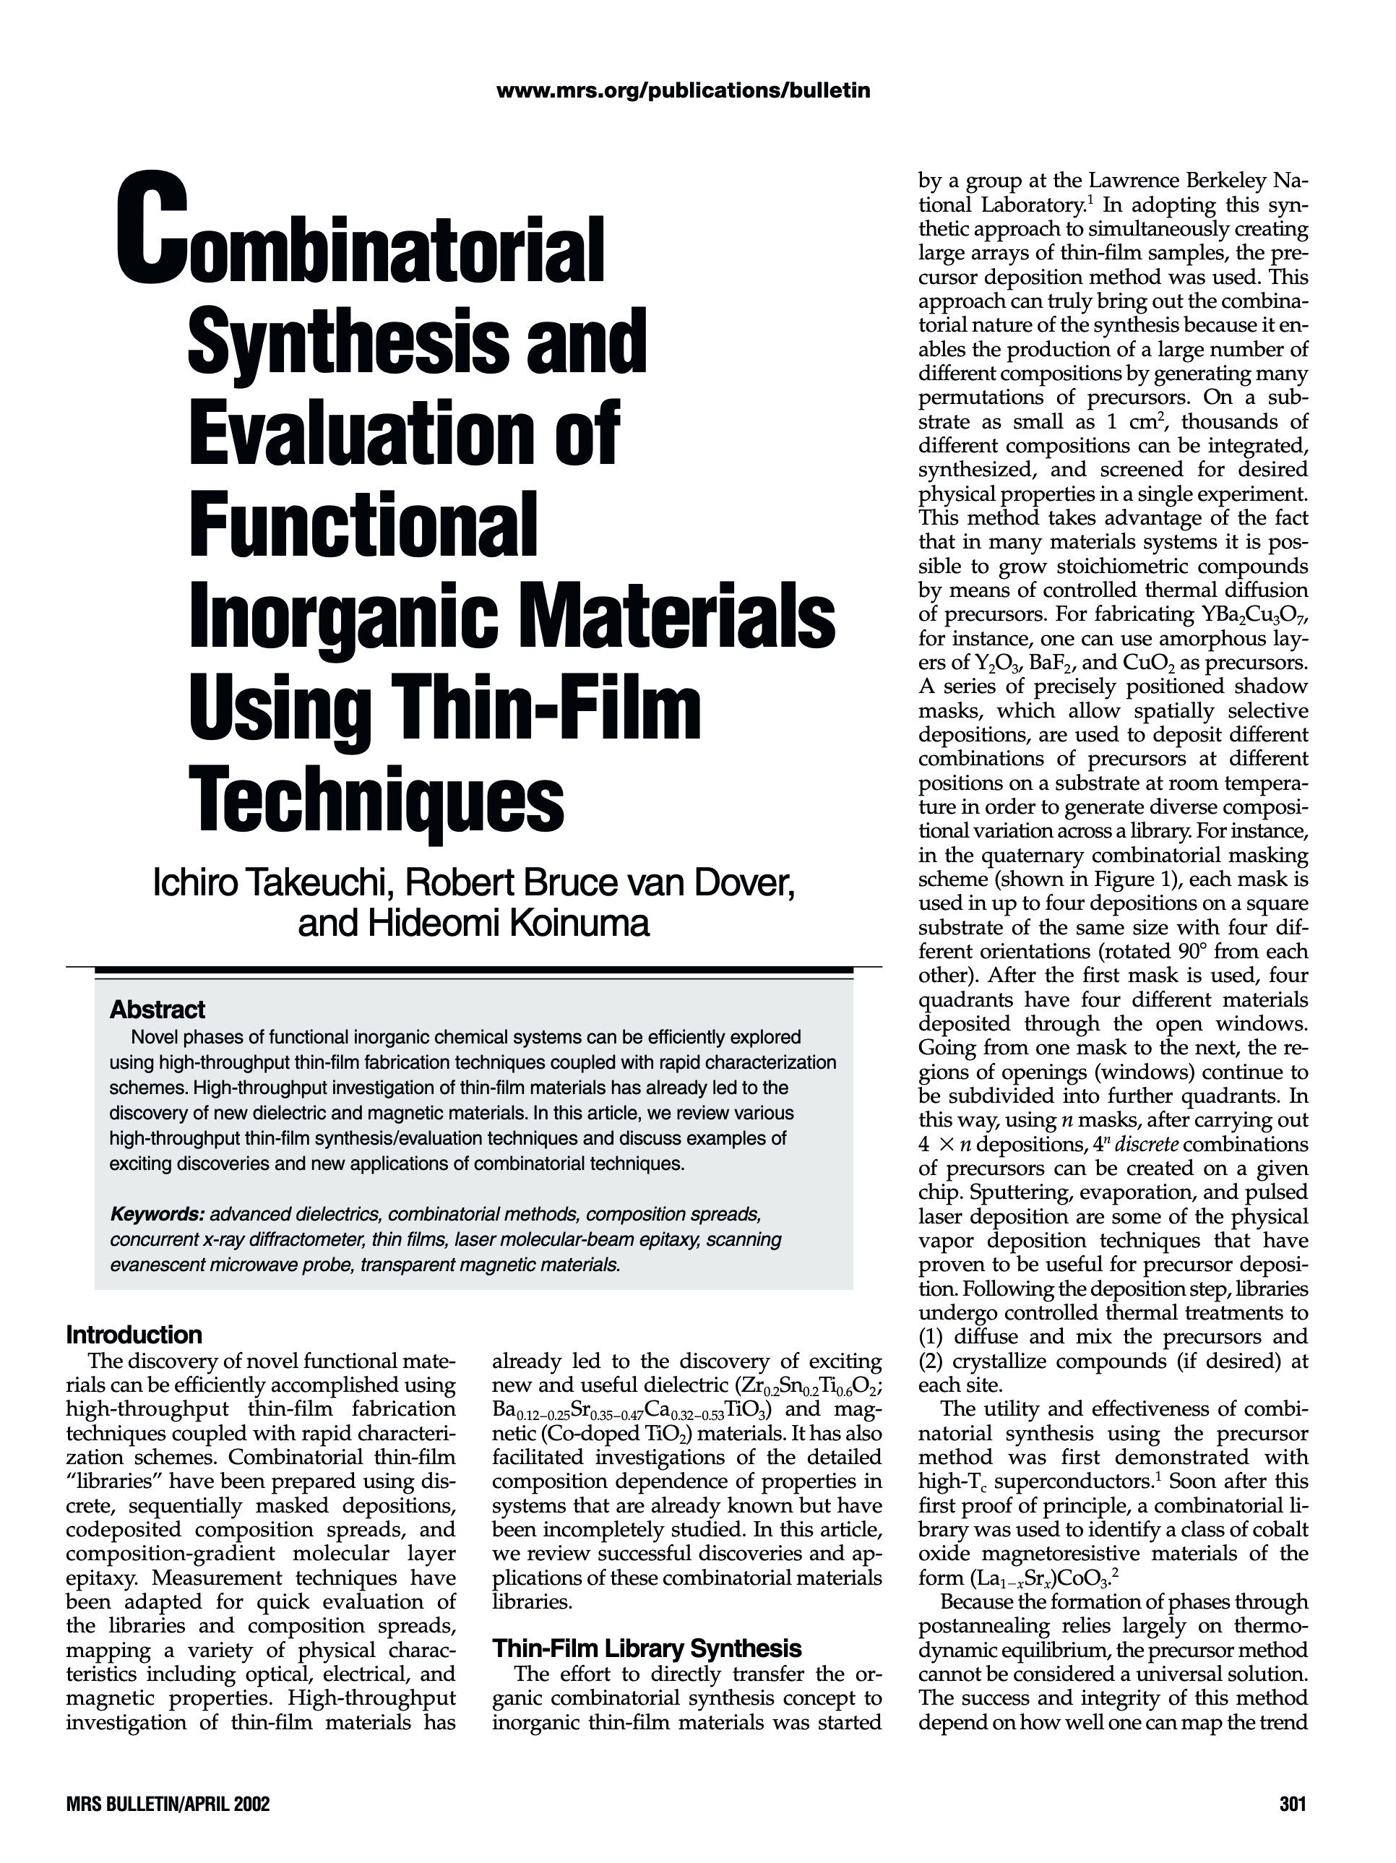
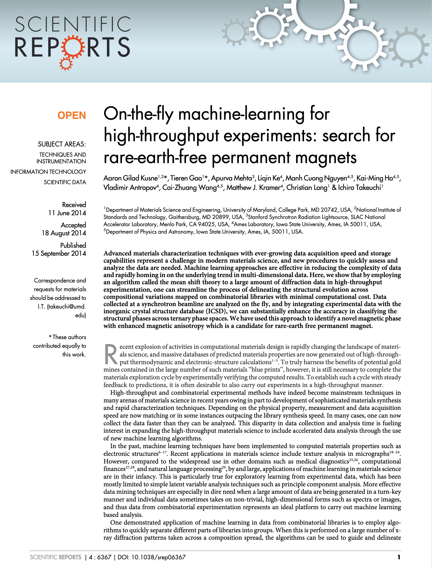
What got us here?
Prof. Helge Stein
TUM School of Natural Sciences
Technische Universität München
Impatient Scientist
Automation
Black Box
Process
1955
2004
2014

Slide 6
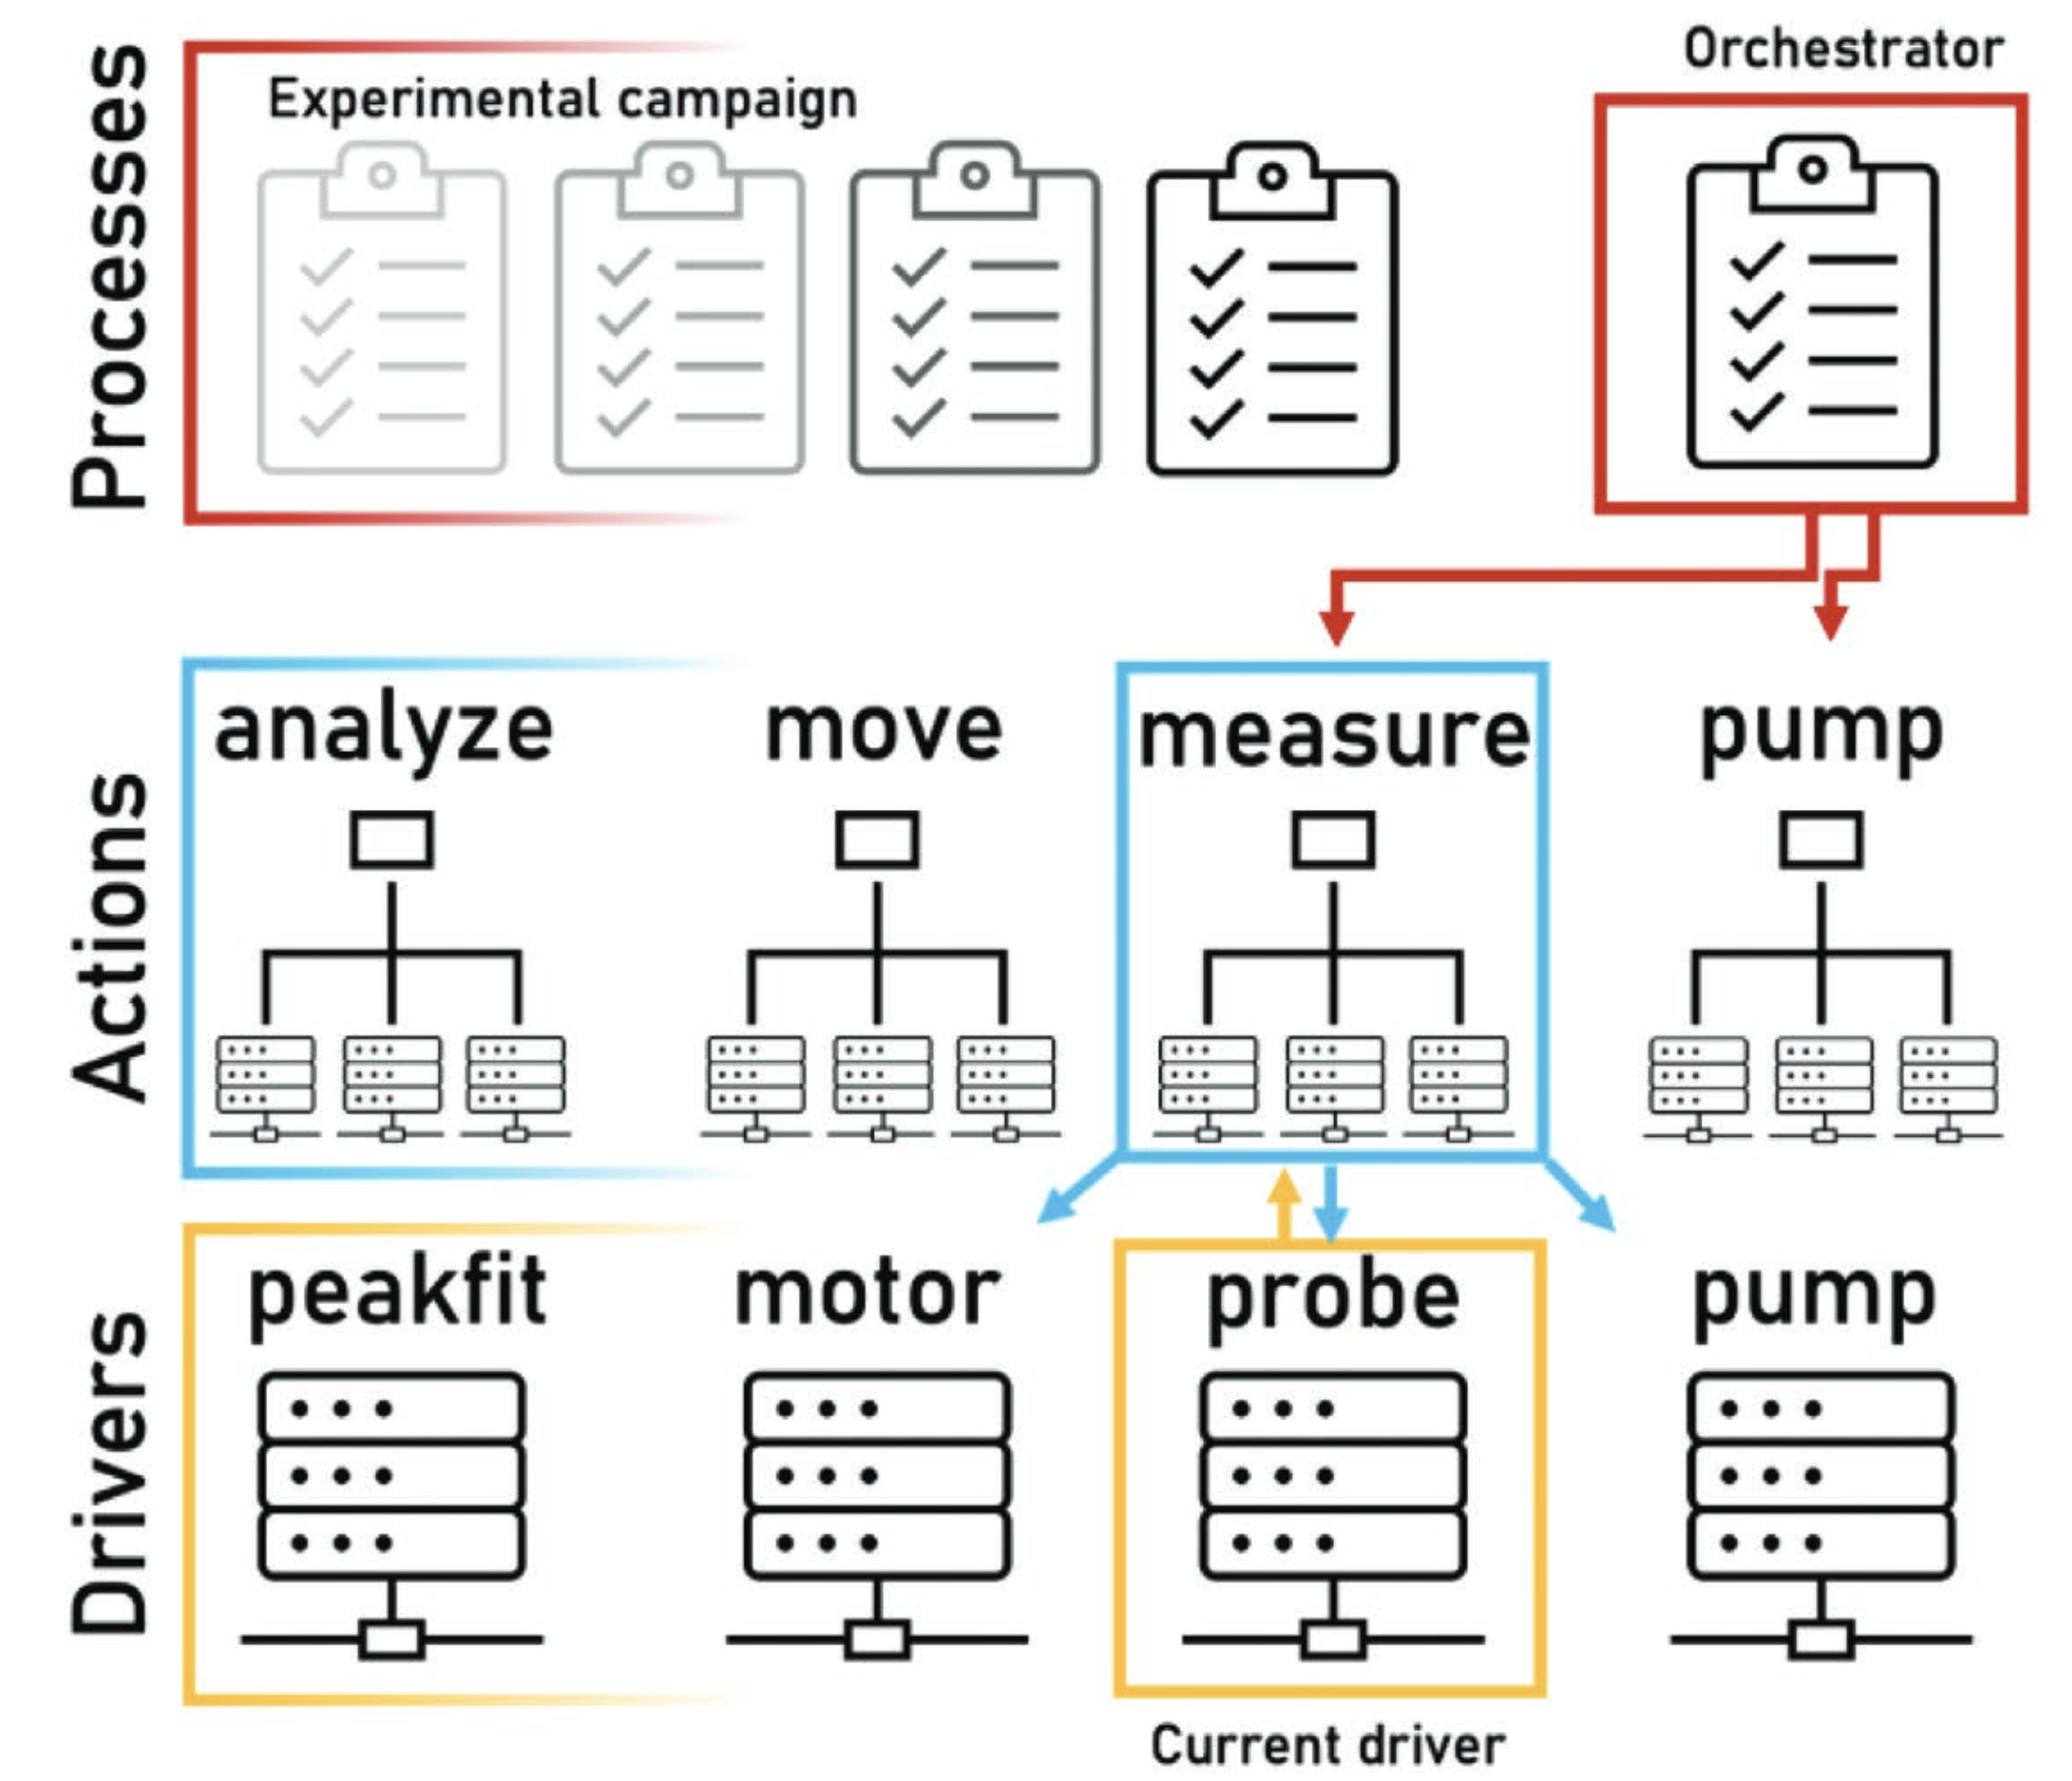
Vertical integration – abstraction lvl 1
Prof. Helge Stein
TUM School of Natural Sciences
Technische Universität München
Operator
Device 1
Device 2
Instrument
*actually started this development in 2018
Rahmanian et al. Adv. Mat. Interf. 2022, 9, 8, 2101987

Slide 7
Research Actions and Accelerators – abstaction lvl 2
Prof. Helge Stein
TUM School of Natural Sciences
Technische Universität München
Planning, Synthesis, Characterization, Data analysis, Quality Control, Data Management, Performance Evaluation, …
Research
Action
Accelerator
Research
Action
Parallelization, Automation, Data Lookup, Bayesian Optimization, …
Does your instrument care why you are measuring?
Research
Action
Stein & Gregoire, Chem. Sci., 2019, 10, 9640

Slide 8
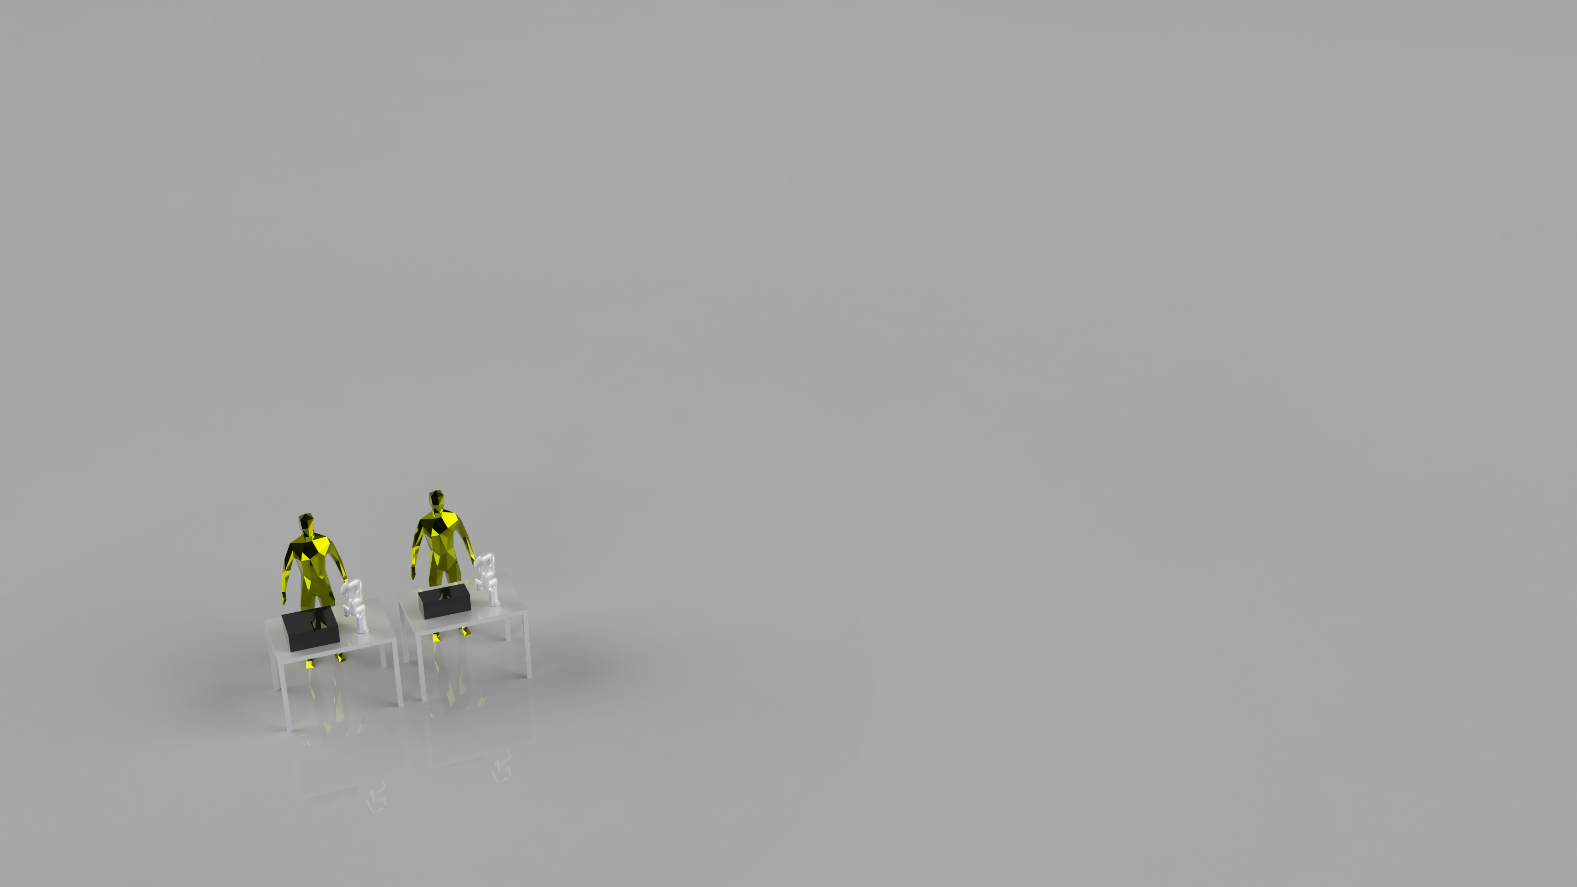
Research Actions,Accelerators, and their integration
Prof. Helge Stein
TUM School of Natural Sciences
Technische Universität München
Research
Action
Research
Action
Research
Action
Research
Action
Research
Action
Research
Action
Research
Action
Research
Action
“Closing the Loop”
Stein & Gregoire, Chem. Sci., 2019, 10, 9640

Slide 9
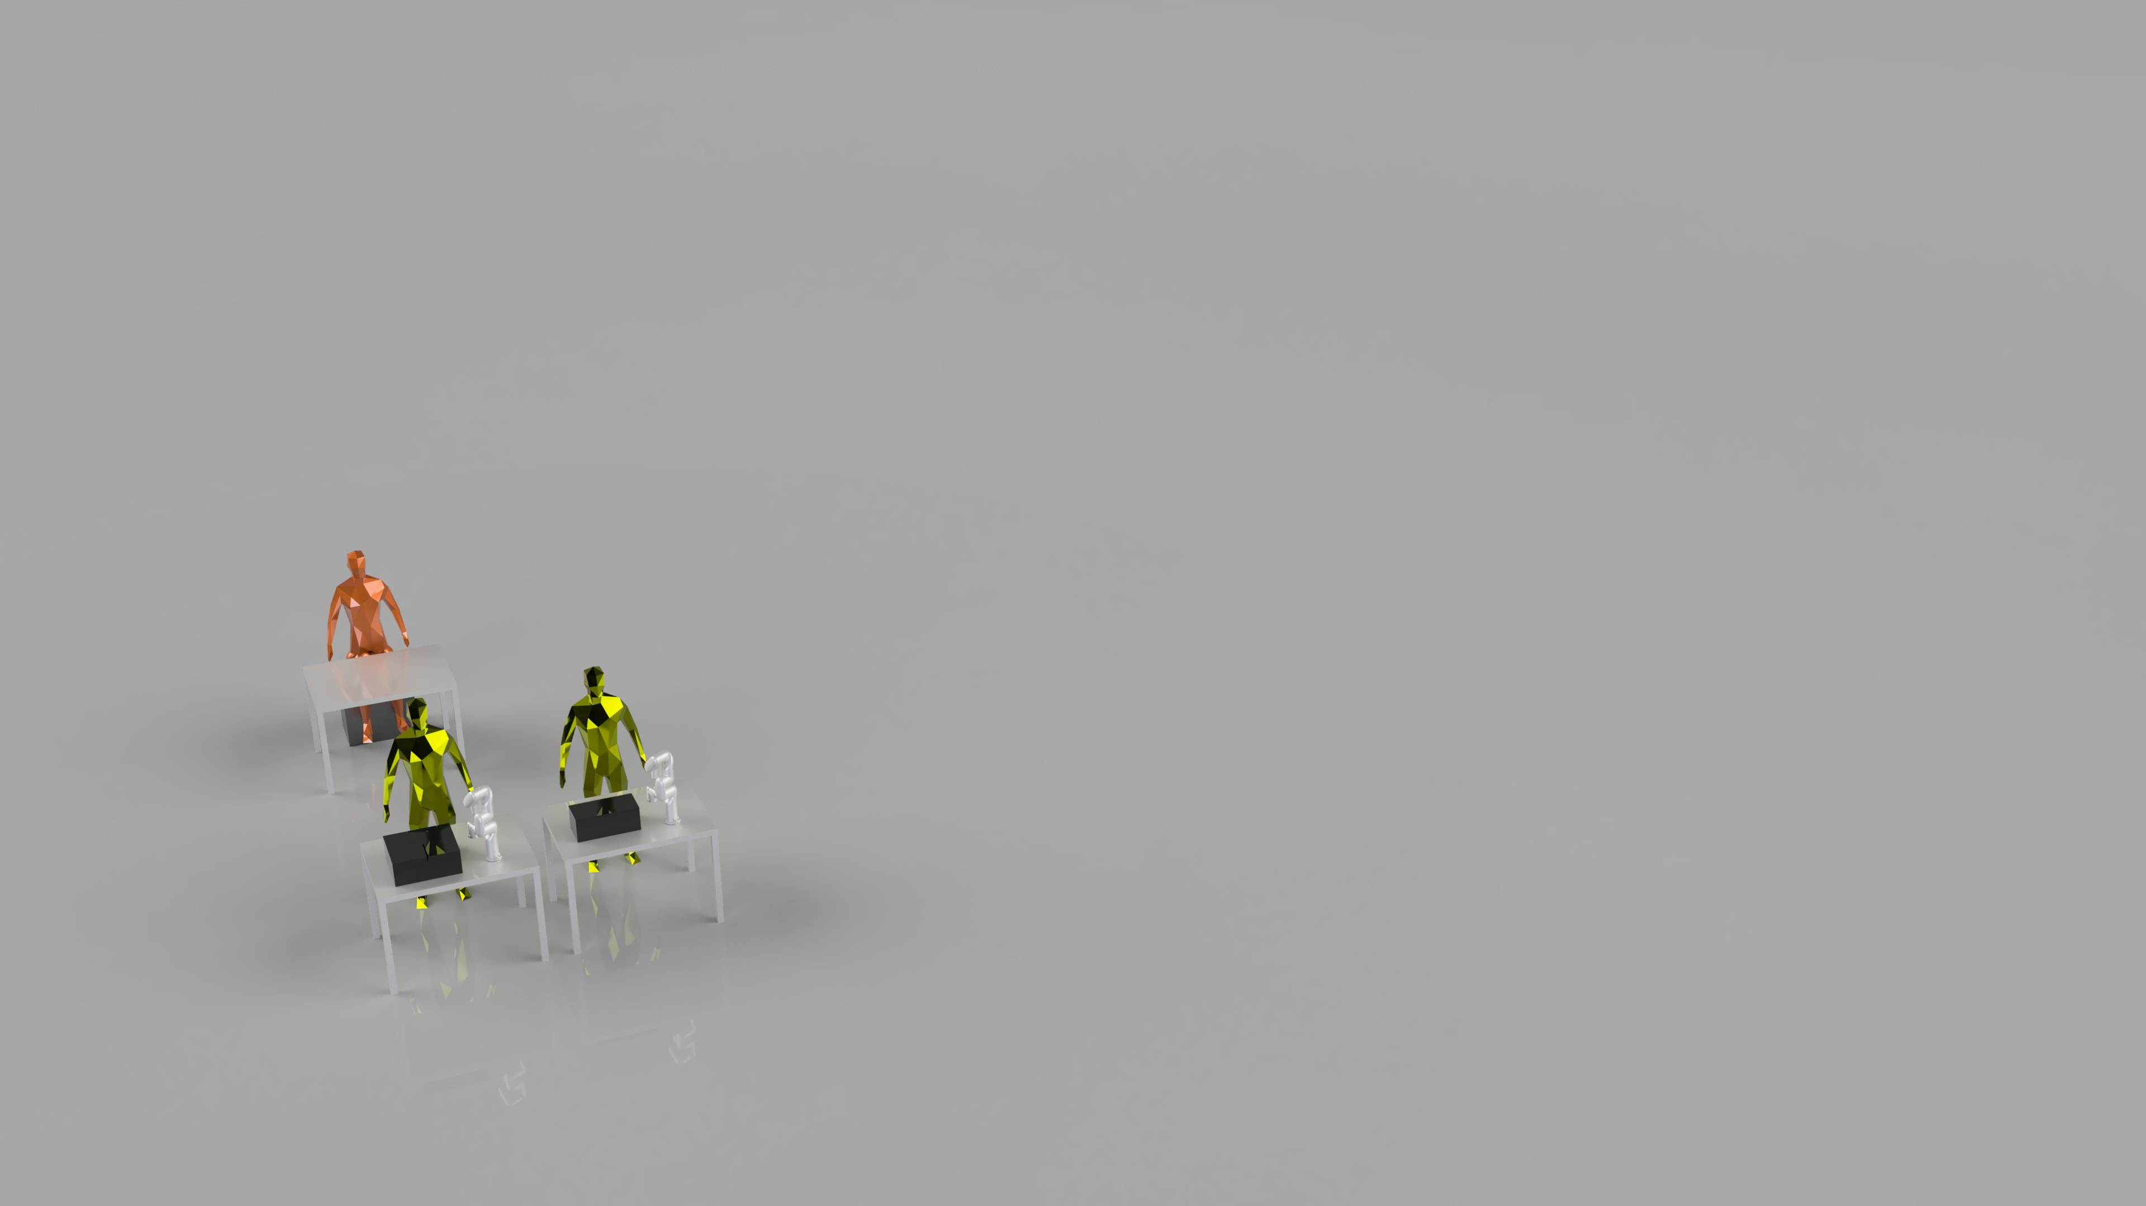
Research modes or „Why am I doing this?“
Prof. Helge Stein
TUM School of Natural Sciences
Technische Universität München
Supervisor
Find a good material / process condition
Find all good materials / process conditions
Fit materials properties well
Understand the underlying physics/chemistry
Students
Experiment
Define a baseline for your research mode!
Rohr et al. Chem. Sci., 2020, 11, 2696-2706

Slide 10
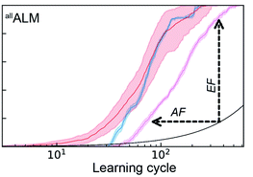
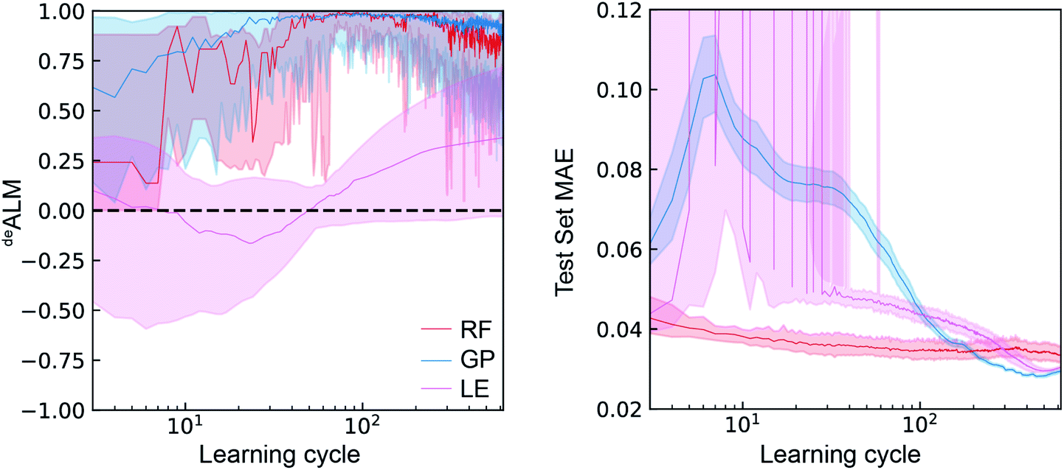
Accelerate science by beating benchmarks!
Prof. Helge Stein
TUM School of Natural Sciences
Technische Universität München
Supervisor
Students
Experiment
Rohr et al. Chem. Sci., 2020, 11, 2696-2706

Slide 11

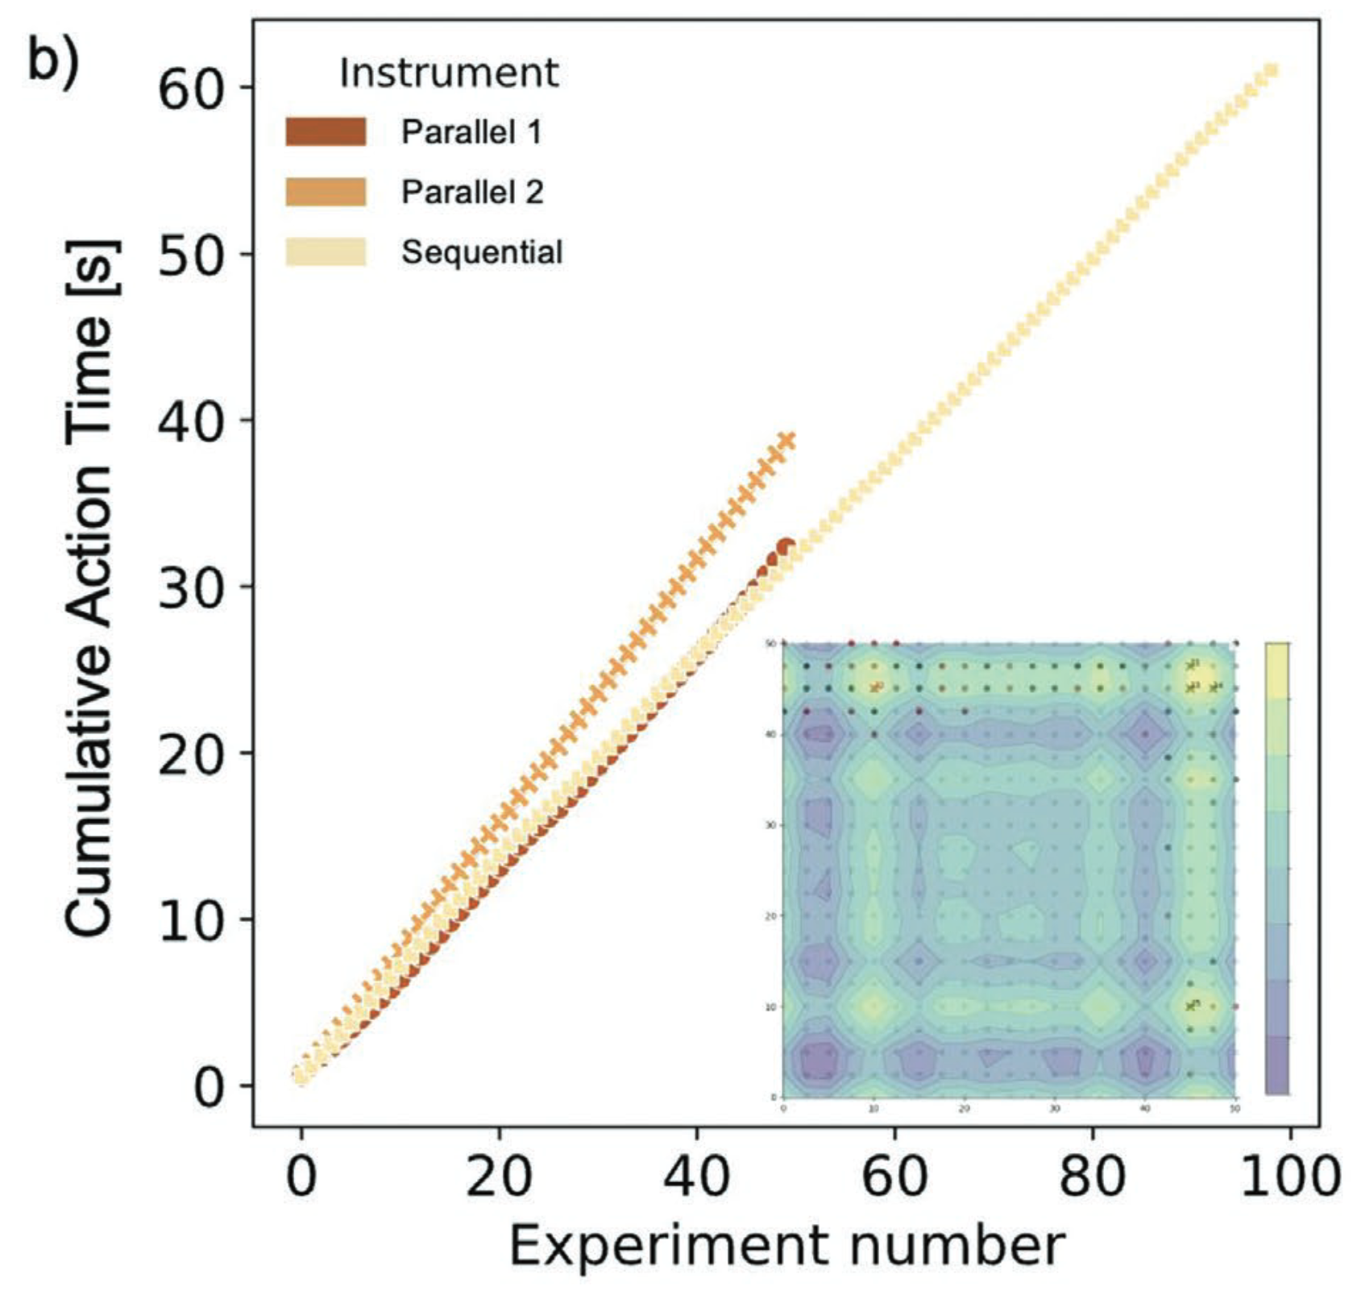
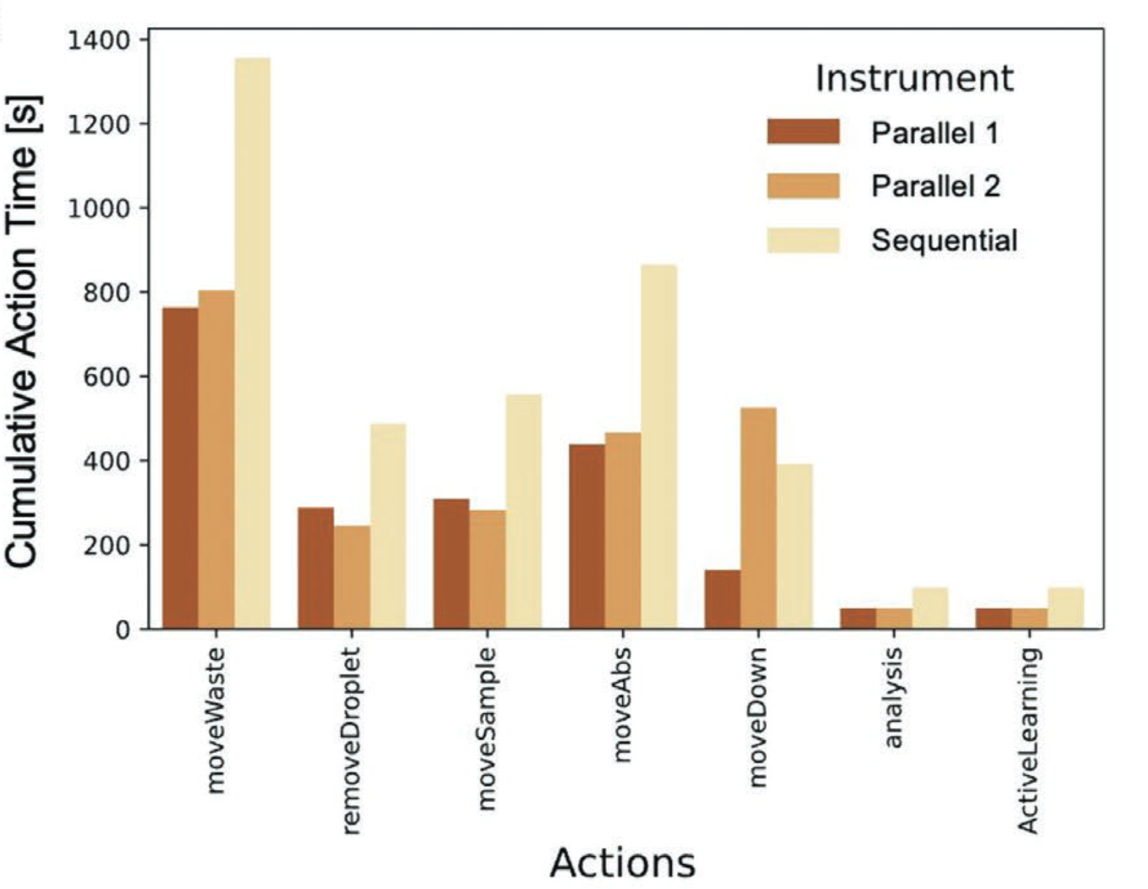
Is paralellization by n making it n-times faster?
Prof. Helge Stein
TUM School of Natural Sciences
Technische Universität München
Data Scientist
… in some office far away
Rahmanian et al. Adv. Mater. Interfaces 2022, 9, 2101987

Slide 12
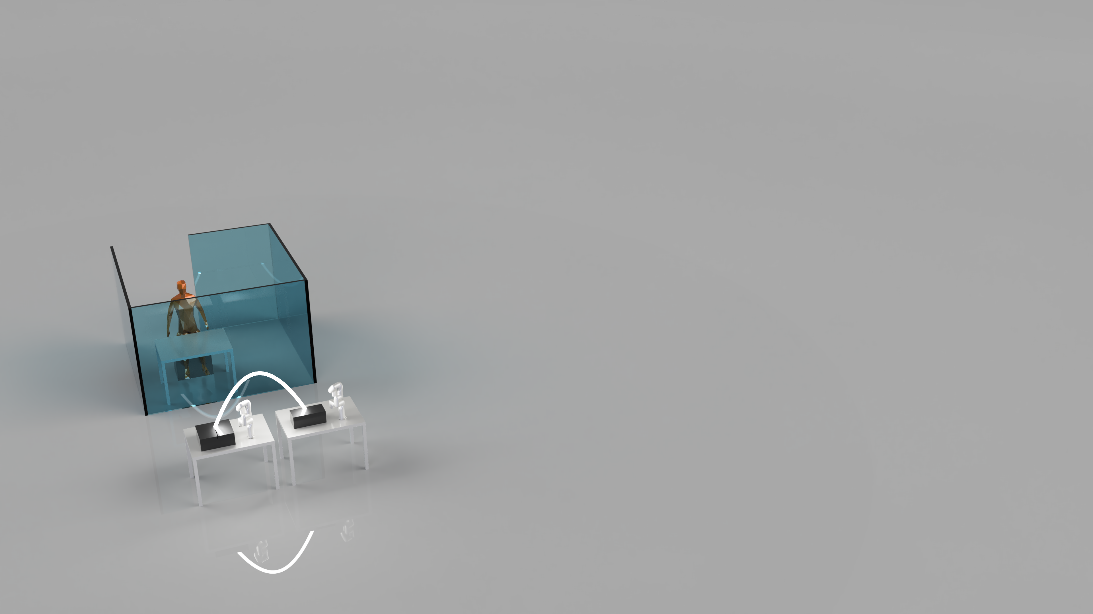
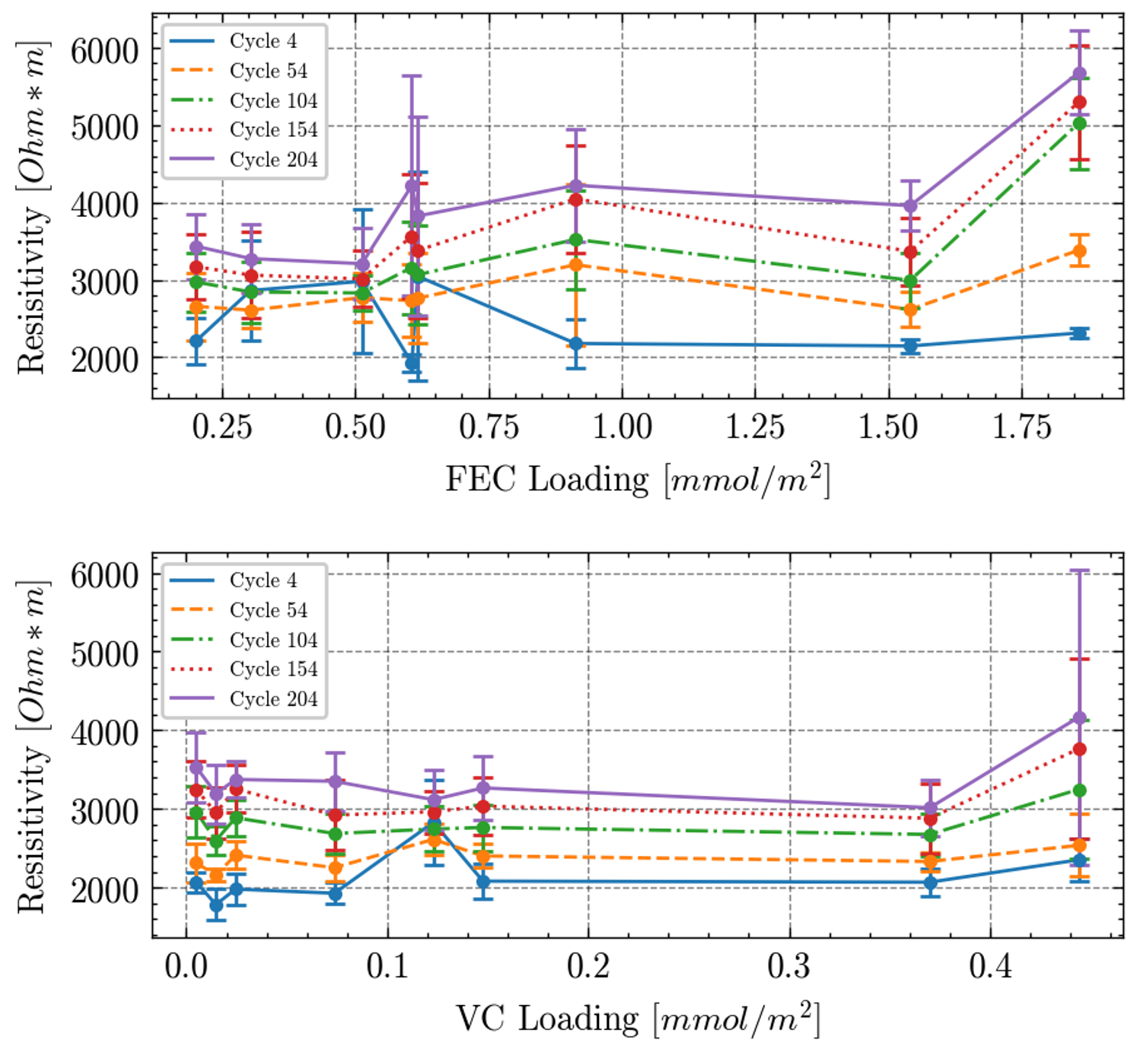
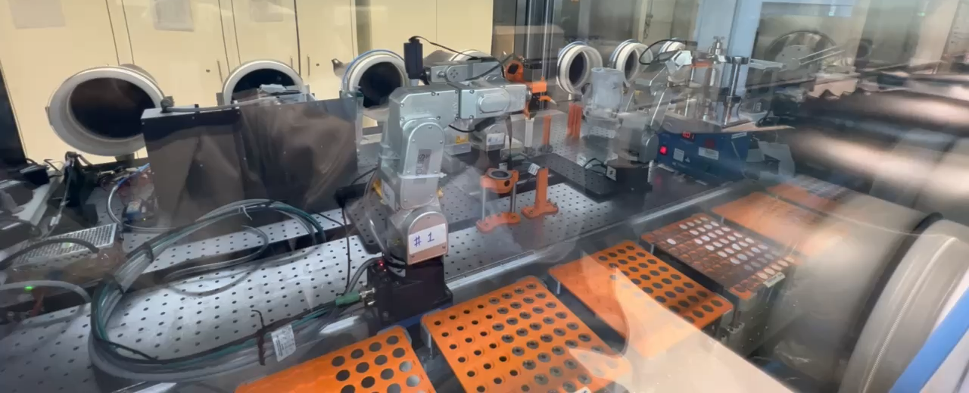
Example II: AutoBASS v2
Prof. Helge Stein
TUM School of Natural Sciences
Technische Universität München
work primarily done at KIT
Zhang et al. Digital Discovery, 2022, 1, 755
Data Scientist
Office far away
100% Automation

Slide 13
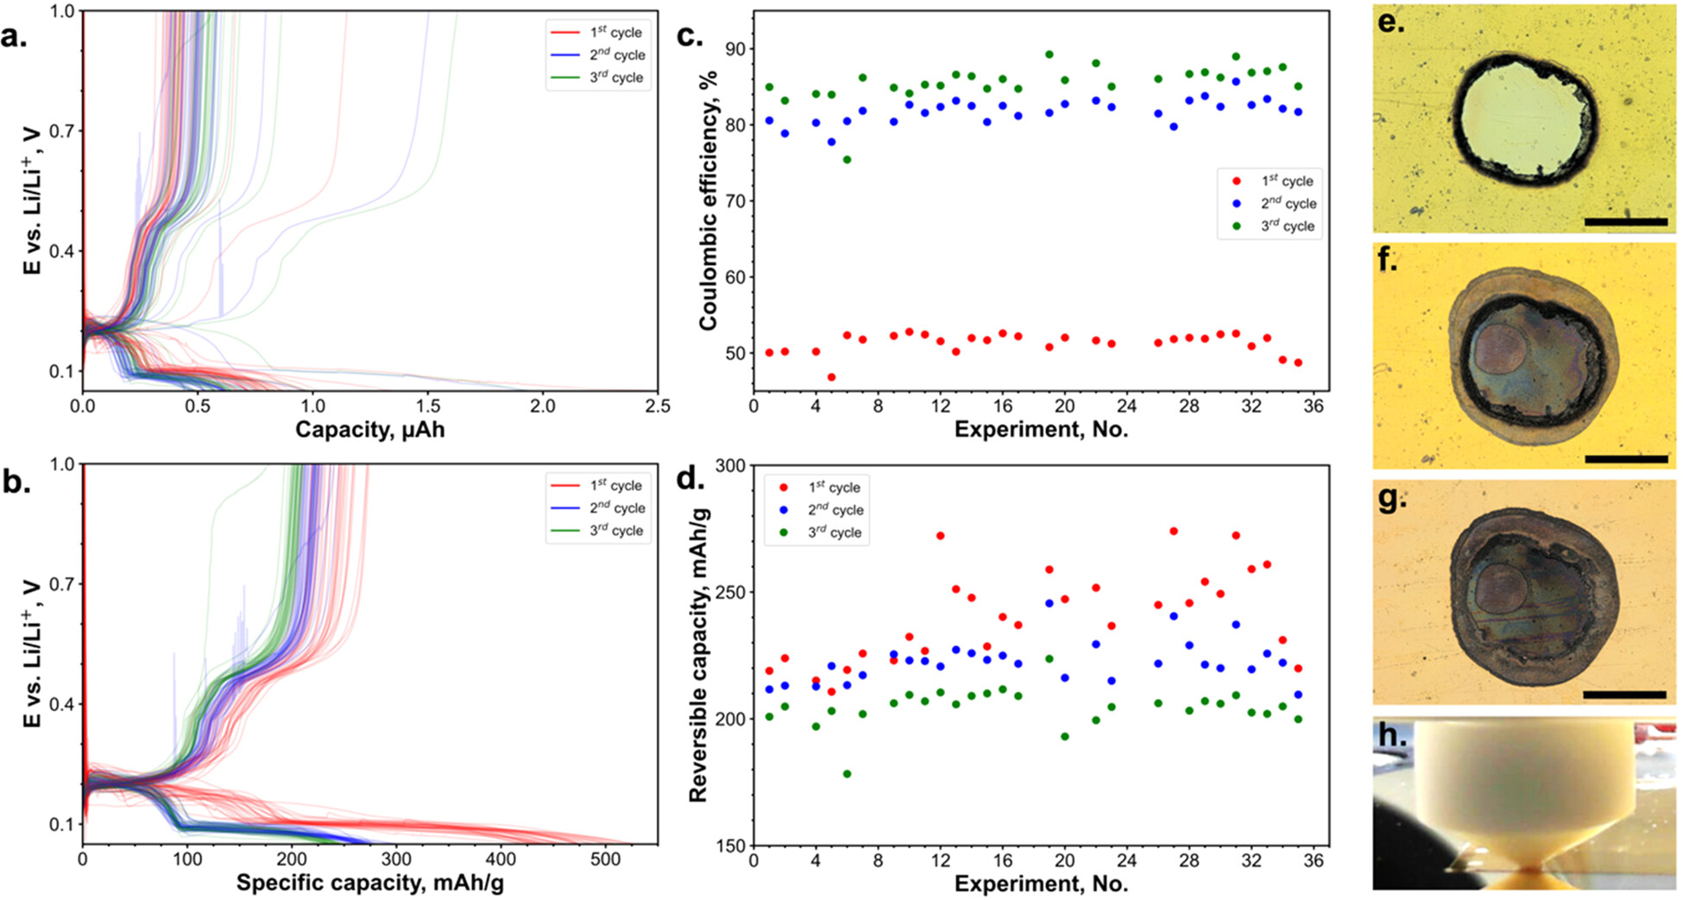
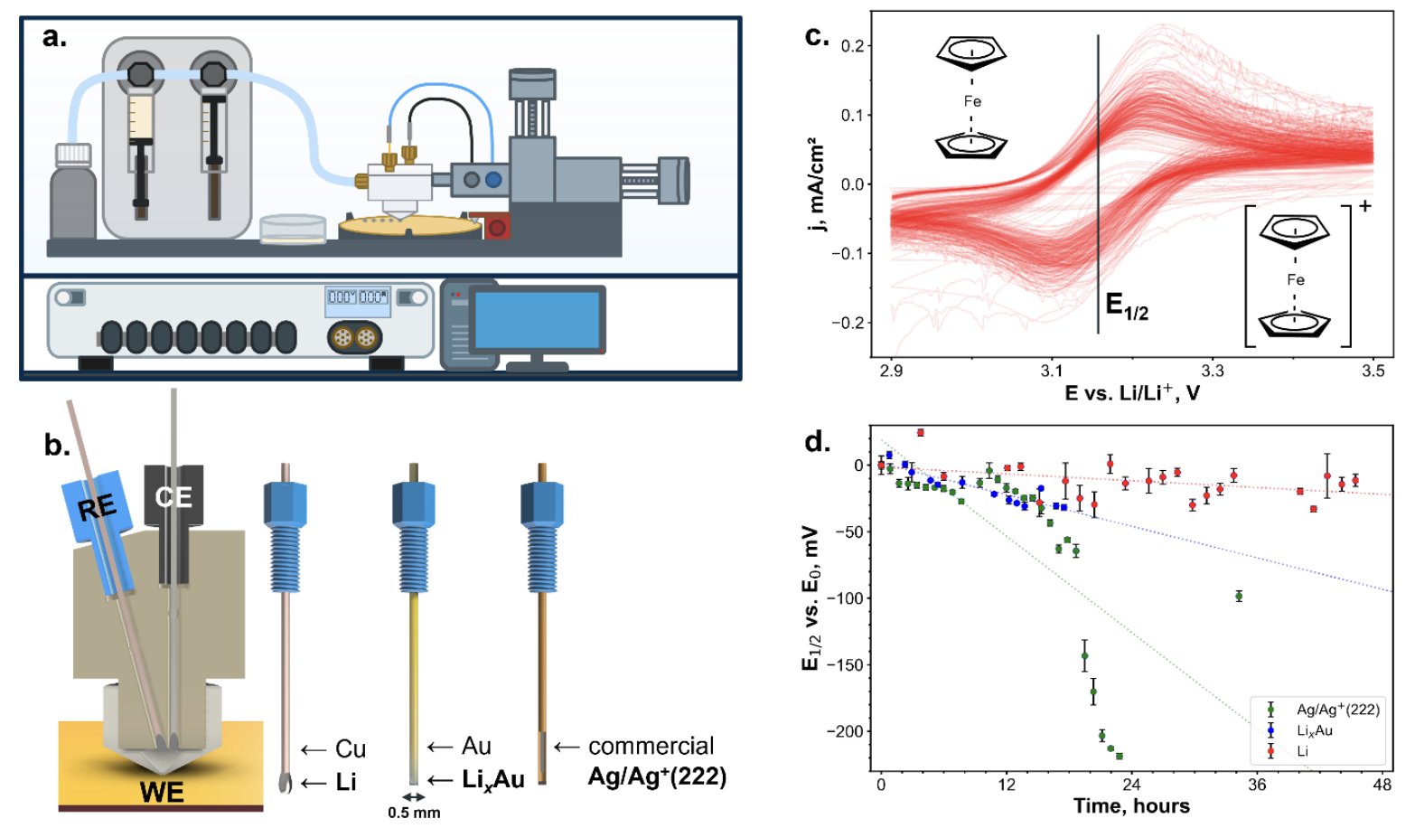
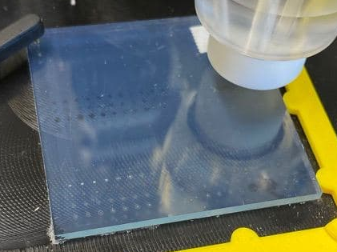
Example I: MISCHBARES
Prof. Helge Stein
TUM School of Natural Sciences
Technische Universität München
Data Scientist
Office far away
100% Automation
Sanin & Stein, Chem. Mater. 2024, 36, 8, 3536–3545

Slide 14
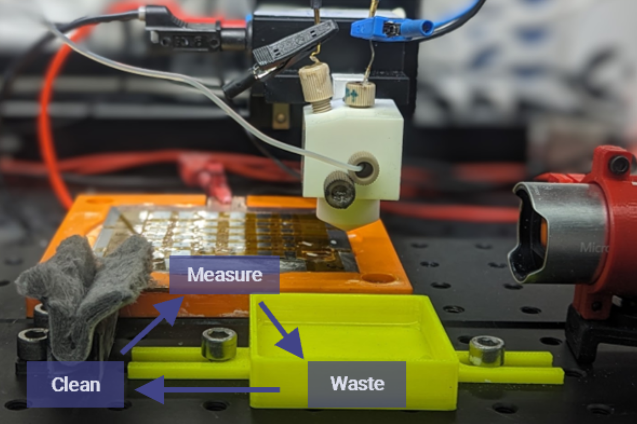
Example III: Auto-MISCHBARES
Prof. Helge Stein
TUM School of Natural Sciences
Technische Universität München
Data Scientist
Office far away
100% Automation
Rahmanian et al. Digital Discovery, 2024, 3, 883-895

Slide 15
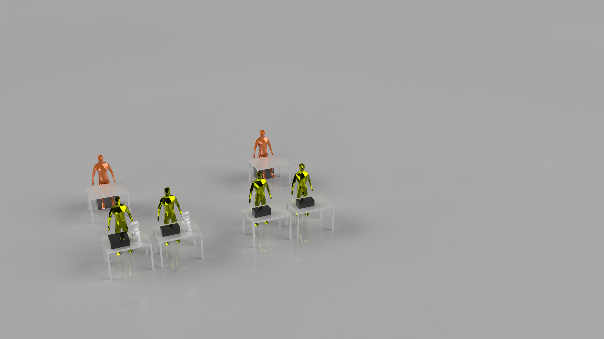
Now what?
Prof. Helge Stein
TUM School of Natural Sciences
Technische Universität München
Cannot be automated
How can we integrate them?
Yao et al, PNAS, 2020, 117 (12) 6316-6322

Slide 16
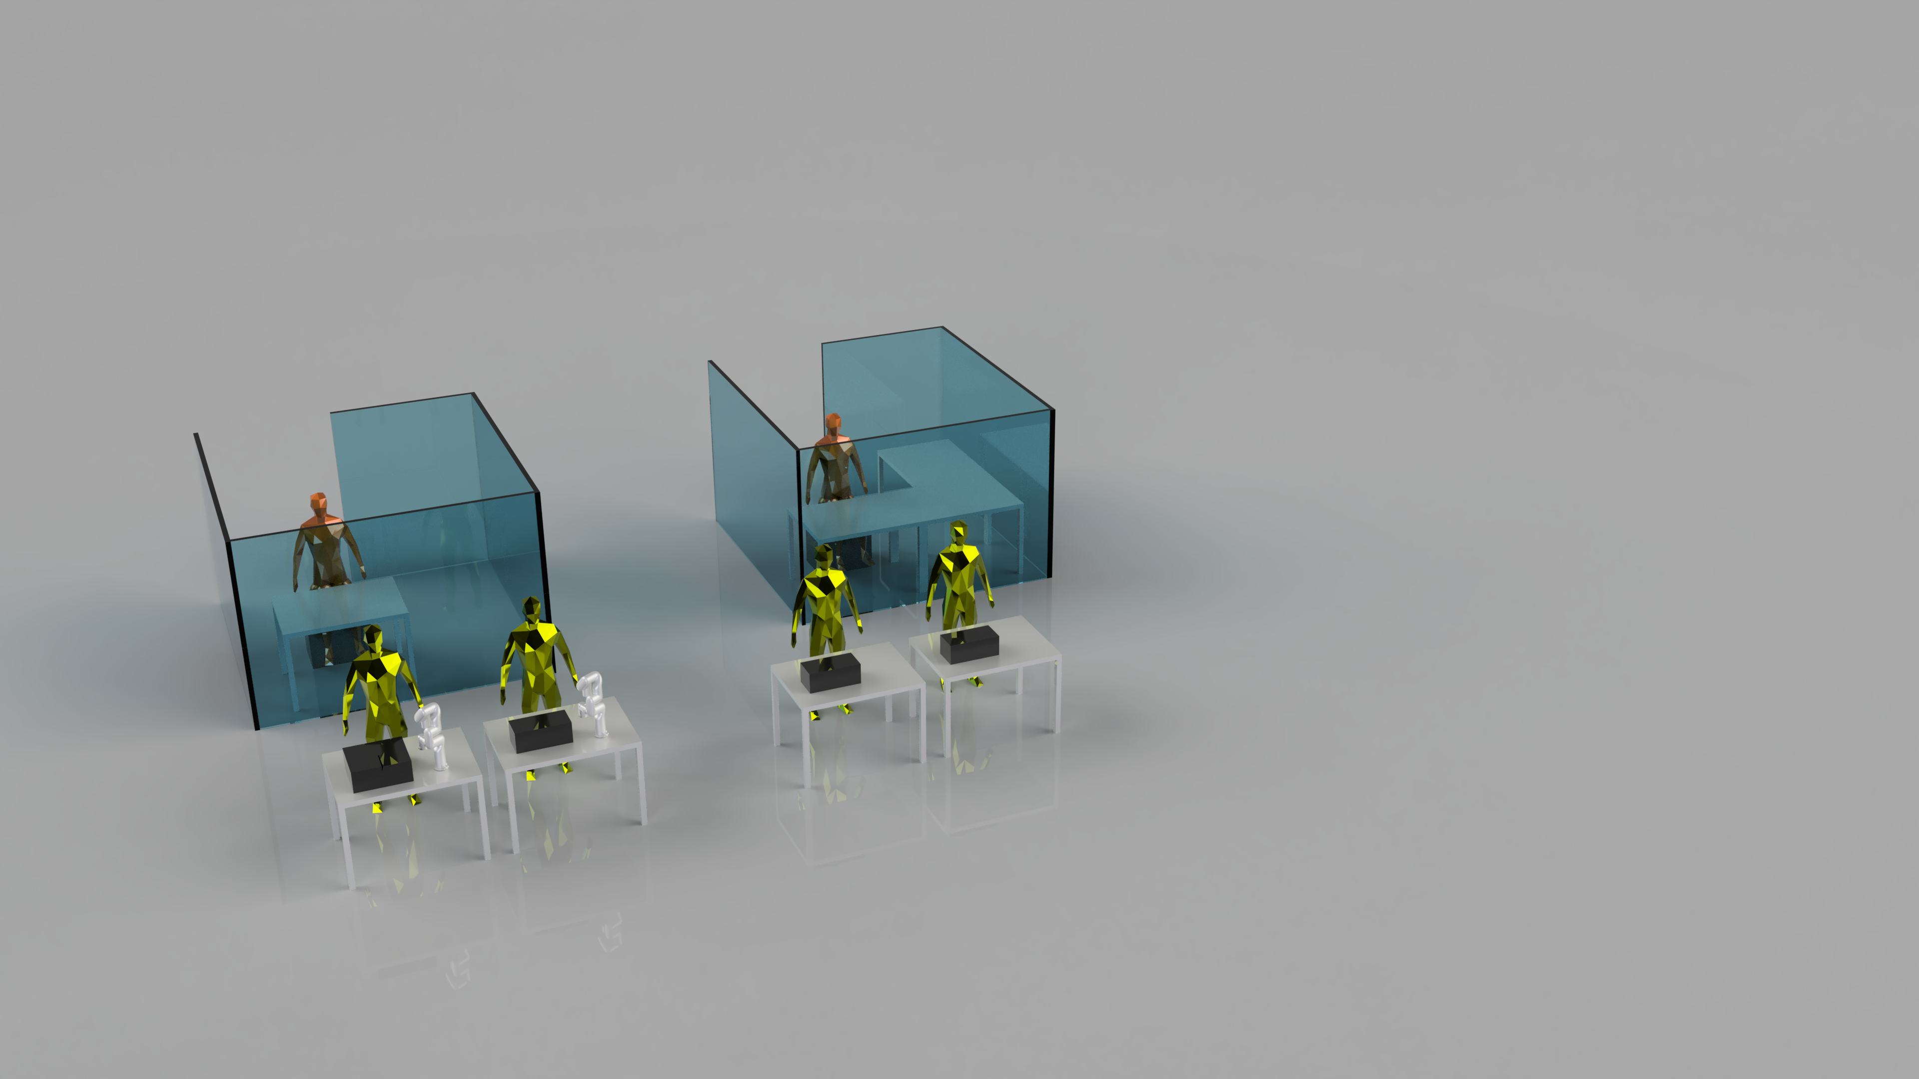
Now what?
Prof. Helge Stein
TUM School of Natural Sciences
Technische Universität München
IT-Administrator
IP-Lawyer
How to orchestrate
distributed experiments
when you at least
“speak the same language”?
Classic collaboration between
automated and conventional
experimental groups.
Firewall

Slide 17
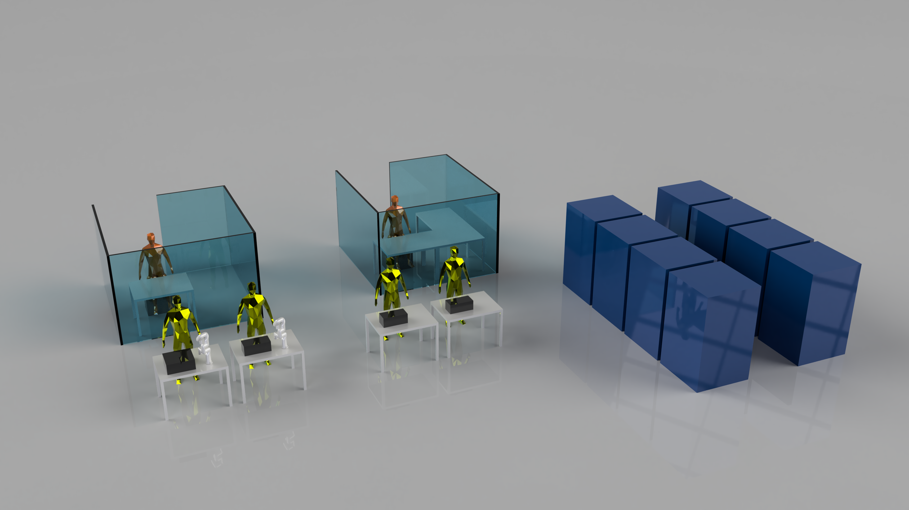
Let‘s add simulations to this!
Prof. Helge Stein
TUM School of Natural Sciences
Technische Universität München
What is your common denominator?

Slide 18
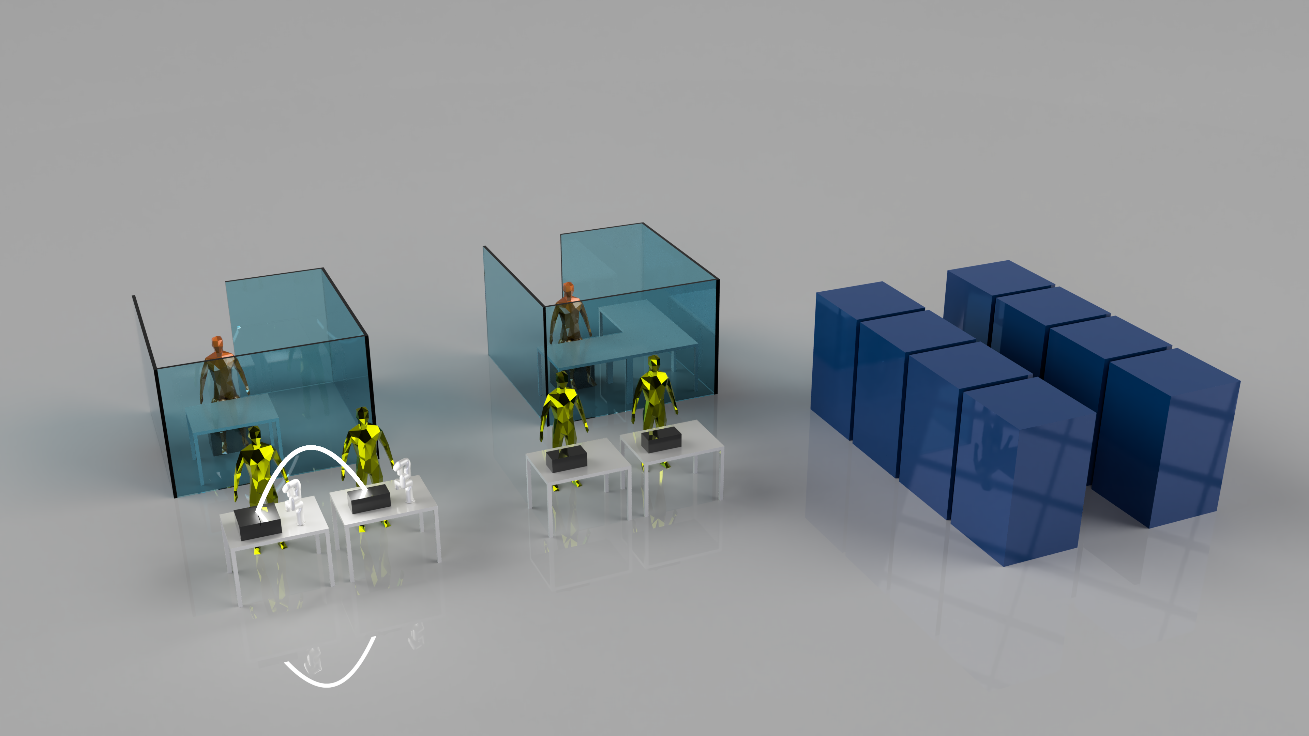
The reality: Theory before or after but never jointly
Prof. Helge Stein
TUM School of Natural Sciences
Technische Universität München
Cool. This is HTE + theory
Zhou et al. ACS Catal. 2018, 8, 12, 10938–10948

Slide 19
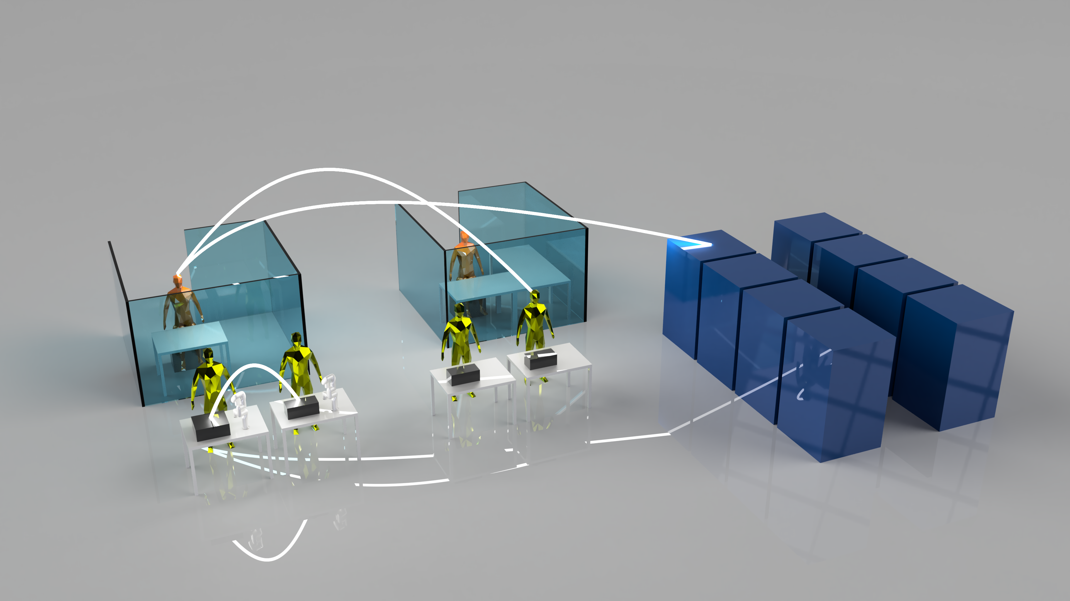
The initial workflow (that took you months to setup)…
Prof. Helge Stein
TUM School of Natural Sciences
Technische Universität München

Slide 20
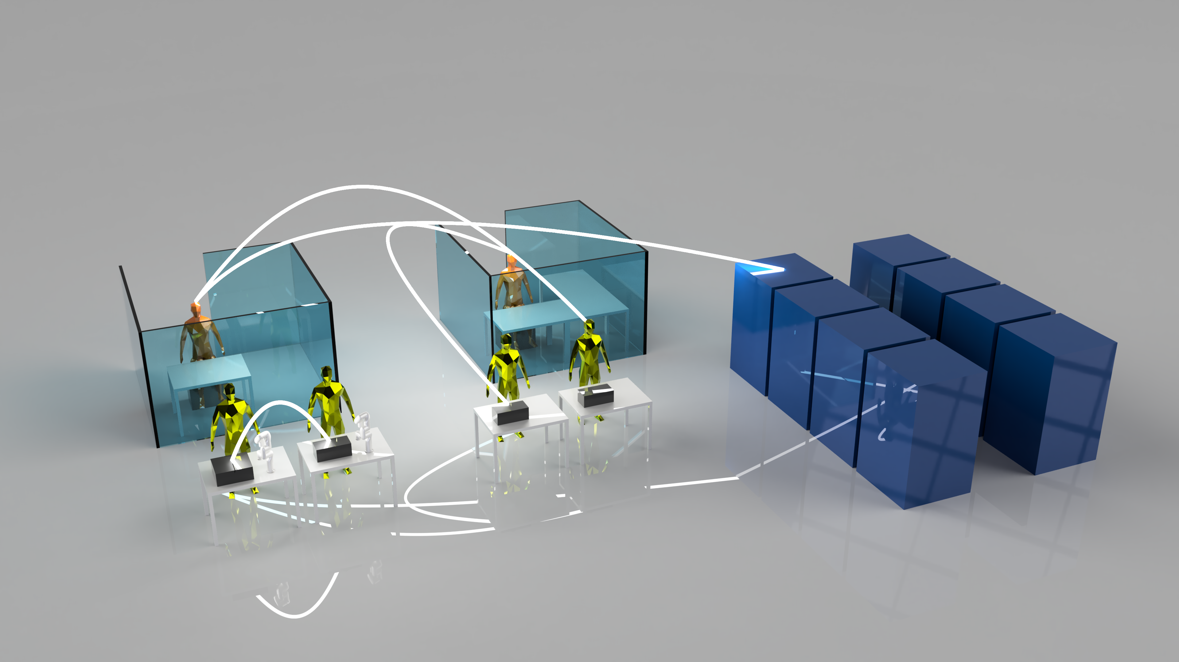
The PI talked to someone over lunch …
Prof. Helge Stein
TUM School of Natural Sciences
Technische Universität München

Slide 21
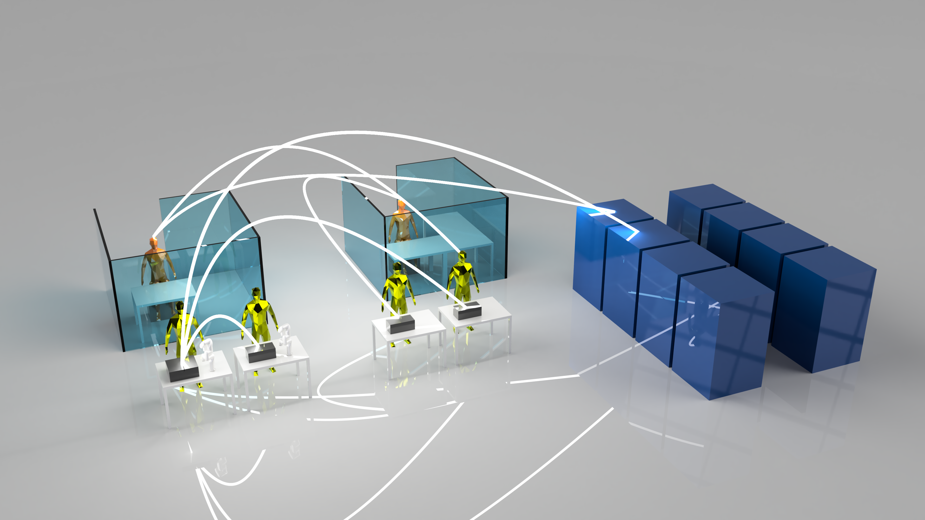
One more …
Prof. Helge Stein
TUM School of Natural Sciences
Technische Universität München

Slide 22
Prof. Helge Stein
TUM School of Natural Sciences
Technische Universität München
How hard can it be?
How much would it delay things
if now another collaborator is added?

Slide 23

Prof. Helge Stein
TUM School of Natural Sciences
Technische Universität München
We are doing
Engineering of Science

Slide 24
What do we actually want? Why do we want it?
Prof. Helge Stein
TUM School of Natural Sciences
Technische Universität München
Amici et al., Adv. Energy Mat. 12 (17), 2102785

Slide 25
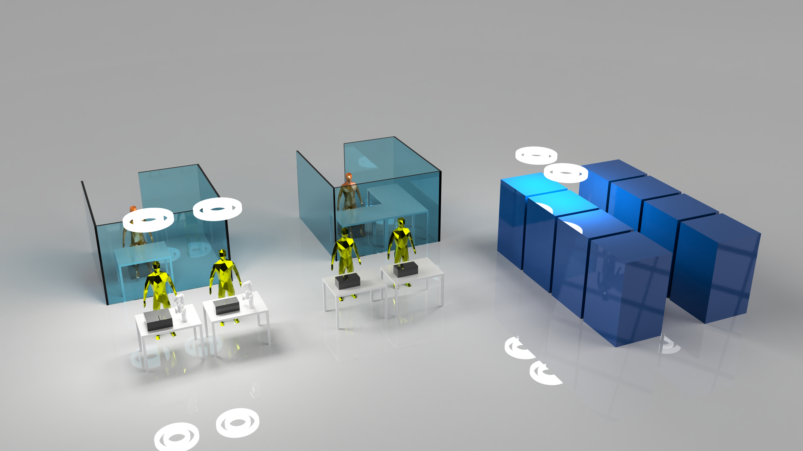
We want interfaces to interconnect in an agile manner!
Prof. Helge Stein
TUM School of Natural Sciences
Technische Universität München
Vogler et al., Matter,2023, 6, 2647–2665

Slide 26

Prof. Helge Stein
TUM School of Natural Sciences
Technische Universität München
Tenant A: T_{A}
1: T_{A} posts a request
4: T_{A} queries for results
A schema to request
a result from T_{n}
Broker
A schema of a
a result from T_{n}
2: T_{C} queries for requests
3: T_{C} posts a result
T_{B}
T_{C}
Vogler et al., Matter,2023, 6, 2647–2665

Slide 27
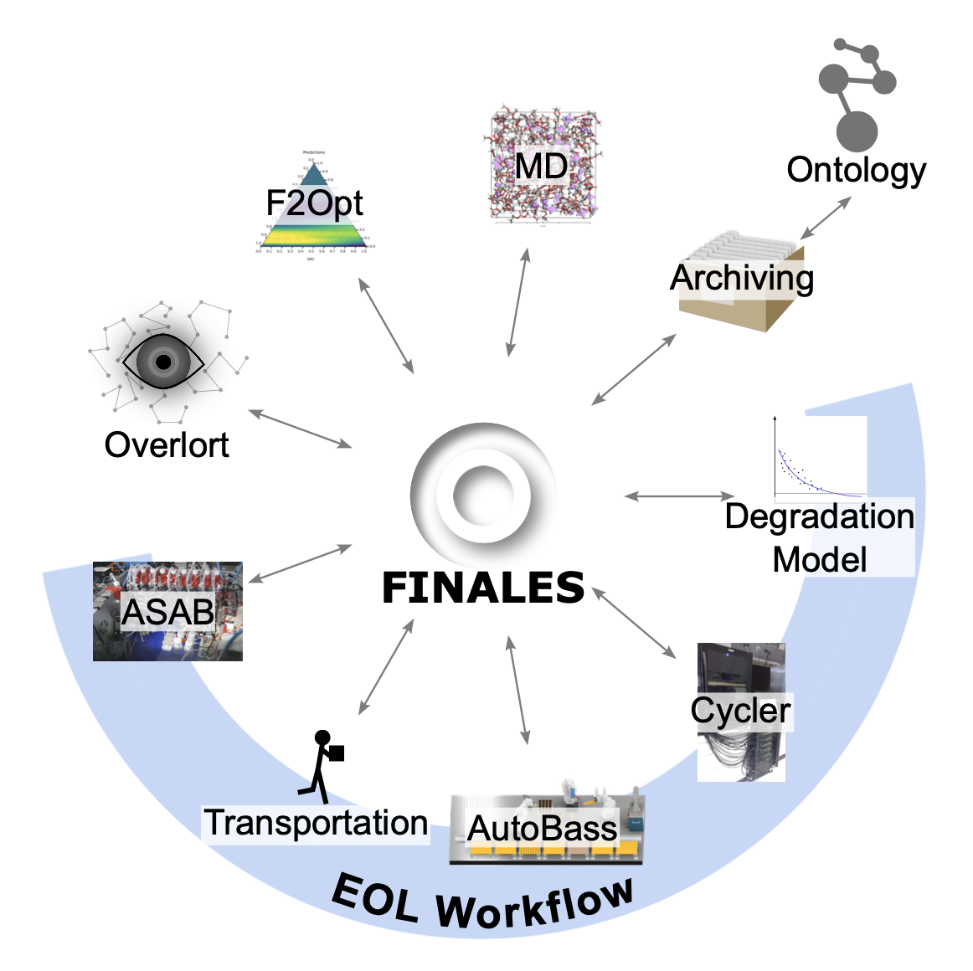
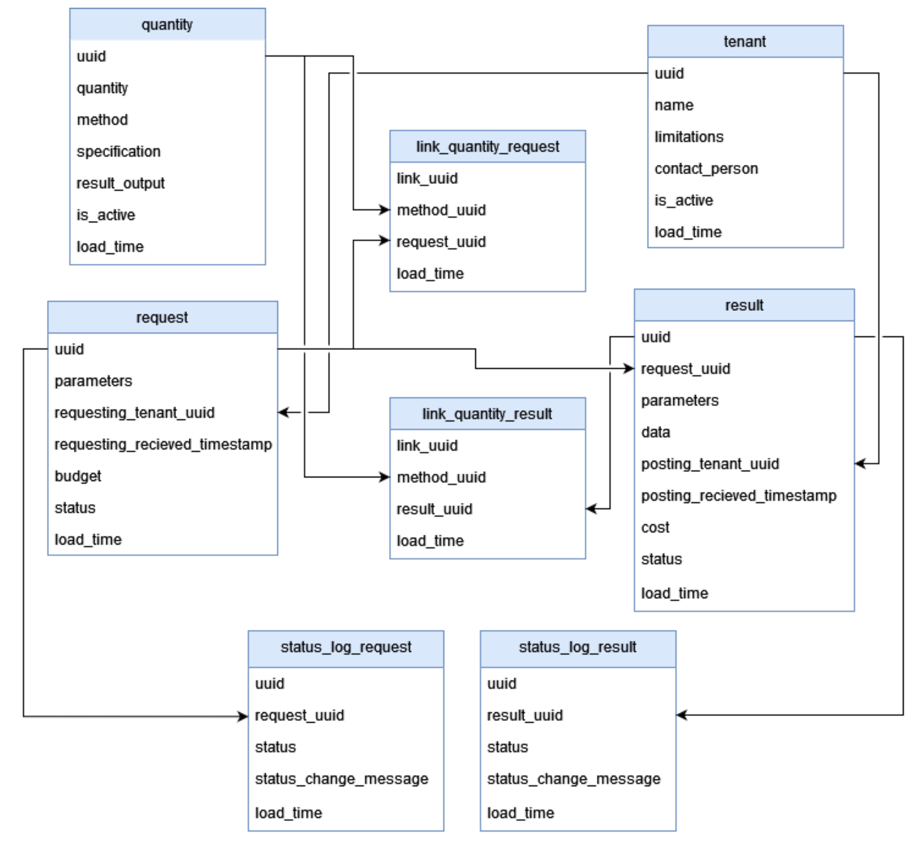
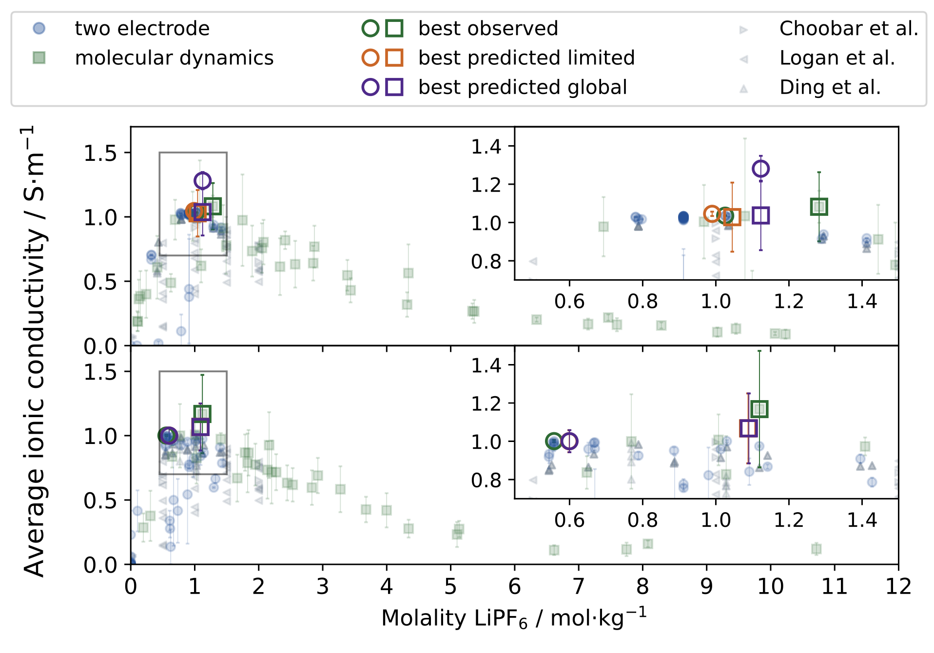
Prof. Helge Stein
TUM School of Natural Sciences
Technische Universität München
Vogler et al. preprint out today/tomorrow?

Slide 28
Prof. Helge Stein
TUM School of Natural Sciences
Technische Universität München
Any Chemistry
Any Format
Any D-Rate
Any Seq. length
Uncertainty Quantified
Physics Grounded
Rahmanian et al. npj Comp. Mat., 2024, 10, 1, 100

Slide 29






Prof. Helge Stein
TUM School of Natural Sciences
Technische Universität München
Thank you!

