Slide 1



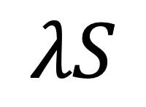

Spectral Operator Representations
$$A$$
$$=$$
$$λS$$
Austin Zadoks¹, Antimo Marrazzo², and Nicola Marzari^{1,3}
¹ Theory and Simulation of Materials (THEOS), École Polytechnique Fédérale de Lausanne (EPFL), Switzerland
² Scuola Internazionale Superiore di Studi Avanzati (SISSA), Italy
³ National Centre for Computational Design and Discovery of Novel Materials (MARVEL), École Polytechnique Fédérale de Lausanne (EPFL), Switzerland
Notes:
Good afternoon, my name is Austin Zadoks.
I’m a PhD student at the EPFL (Swiss Federal Institute of Technology) in Lausanne, Switzerland.
Today, I’ll be presenting a framework for electronic structure representations that I’ve been working on with my supervisors Prof. Antimo Marrazzo and Prof. Nicola Marzari which we call spectral operator representations.

Slide 2







Representing Atomic Systems
$$x_{1}$$
$$x_{2}$$
?
$$x_{3}$$
$$\hat{y}$$
H2O.xyz
3
O 0.00 0.00 0.00
H -0.76 0.59 0.00
H 0.76 0.59 0.00
$$x_{4}$$
$$x_{5}$$
$$x_{6}$$
Notes:
One of the fundamental aspects of applying machine learning to any problem is deciding how to represent your fundamental objects of interest as a series of numbers suitable as input for a given model.
In atomistic materials science and quantum chemistry, this often means finding a way to describe a material or molecule.
A key hurdle for applying machine learning to any problem is to determine how and what information to provide to the model; what will the input be for the function we would like to fit?
In atomistic modeling, the answer seems clear at first: provide atomic positions and species.
However, when we consider what this entails, the problem becomes less trivial.

Slide 3







Representing Atomic Systems
H2O.xyz
3
O 0.00 0.00 0.00
H -0.76 0.59 0.00
H 0.76 0.59 0.00
$$…$$
Symmetries
Rotation
Translation
Permutation
H2O.xyz
3
O 0.00 0.00 0.00
H -0.76 0.59 0.00
H 0.76 0.59 0.00
$$\vec{x}$$
$$⇒𝒪(4N)$$
$$\frac{∂}{∂R}$$
$$…$$
$$\vec{x}$$
Practicalities
$$\vec{x}′$$
Dimensionality
Differentiability
Uniqueness / Completeness
O. A. von Lilienfeld, et al., Int. J. Quantum Chem. 115, 1084 (2015).
F. Musil, A. Grisafi, et al., Chem. Rev. 121, 9759 (2021).
Notes:
In order to achieve efficient machine learning, we understand that there are various fundamental symmetries of many atomistic properties that we can impose on our input representations.
We know, for example, that total energies (no external electric field) are independent of:
Rotation of the system or coordinate axes
Translation of the system or coordinate axes
Permutation of atoms when we list atomic coordinates
Moreover, practical considerations like having a consistent space (dimensionality) for our representation are key.

Slide 4
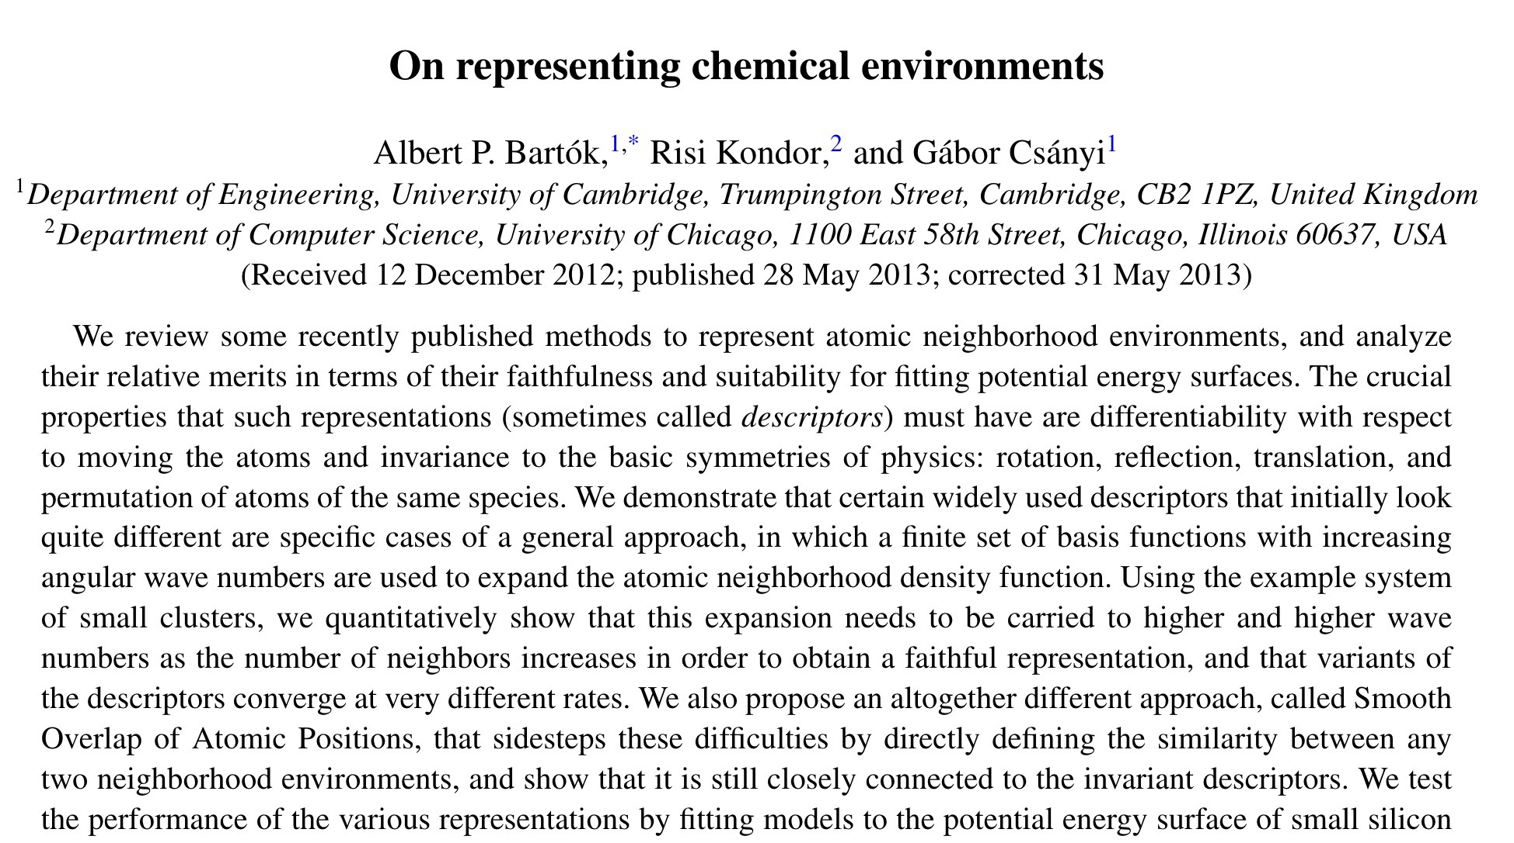
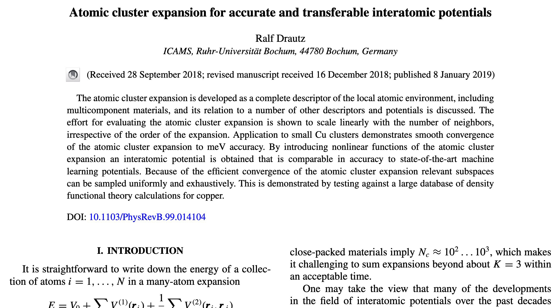
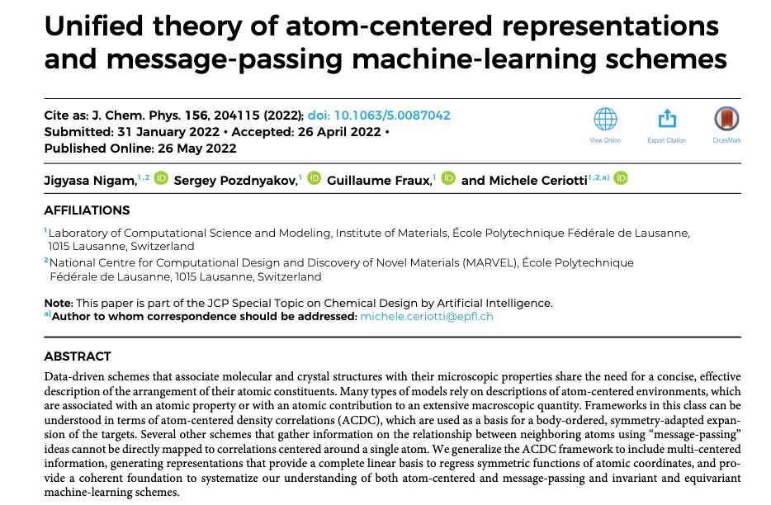
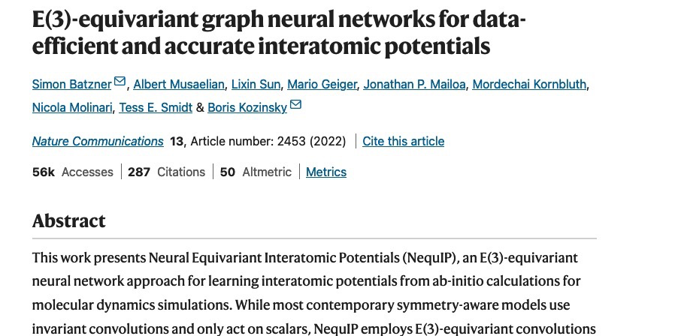






Atomic Structure Representations
$$\hat{y}=$$
$$f_{θ}$$
$$+$$
$$f_{θ}$$
$$+$$
$$f_{θ}$$
Notes:
Over the last 10-15 years, there has been a lot of work in the literature on designing good machine learning representations for molecules and materials.
Most approaches focus on describing atomic structure, often decomposing it into a collection of local atomic environments, which each contribute independently to predicting the property of interest.
This approach works very well for many properties, but isn’t conceptually well-suited for properties like the electronic band gap which cannot be readily atomically decomposed.
Behler-Parrinello
SOAP and family
NICE
ACE and family
Atom graphs
…

Slide 5
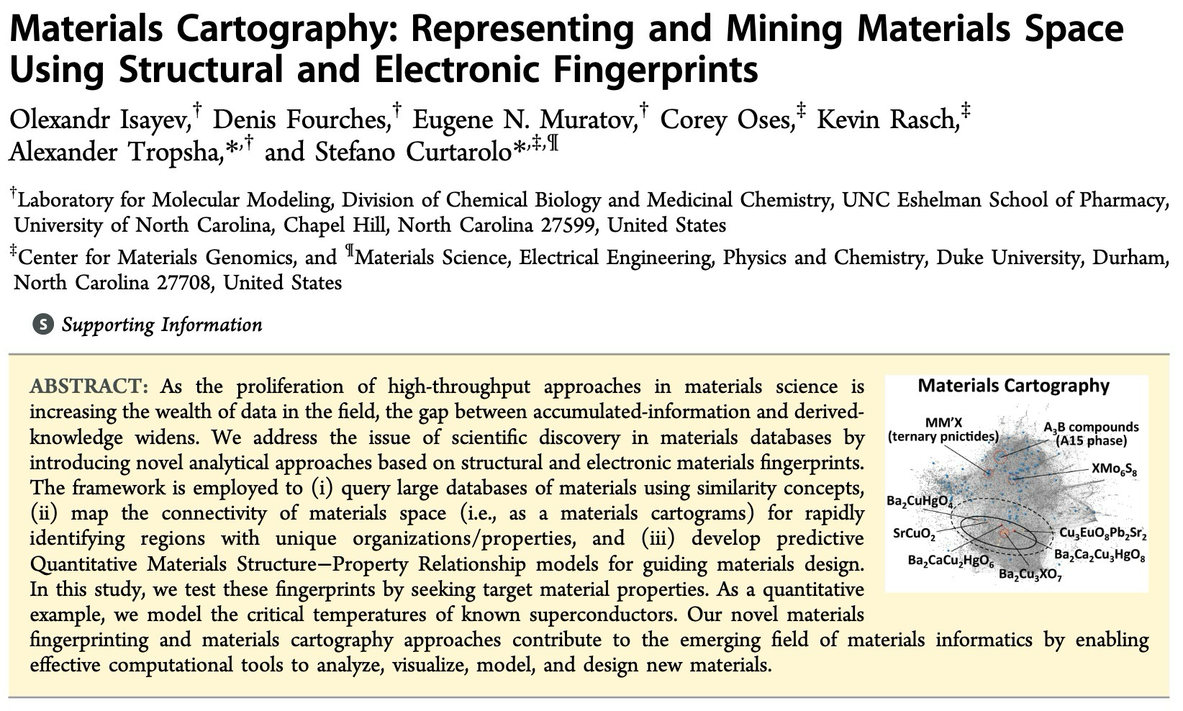
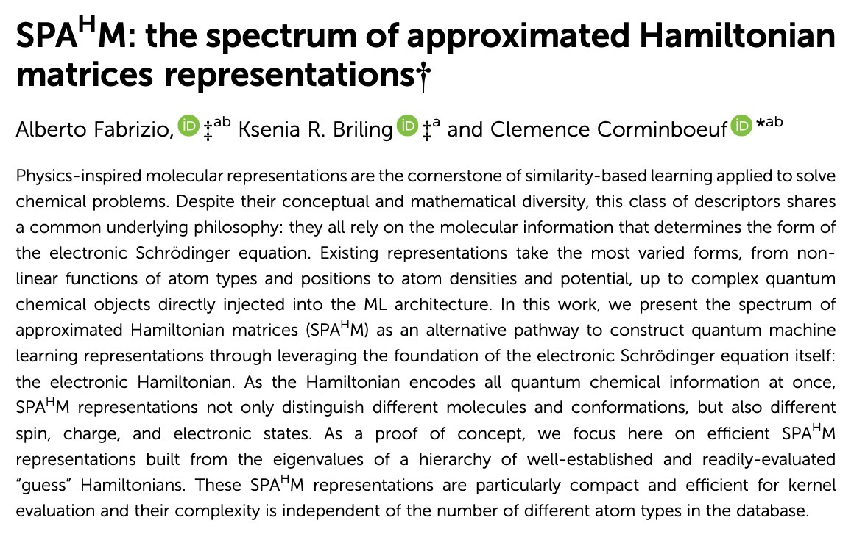

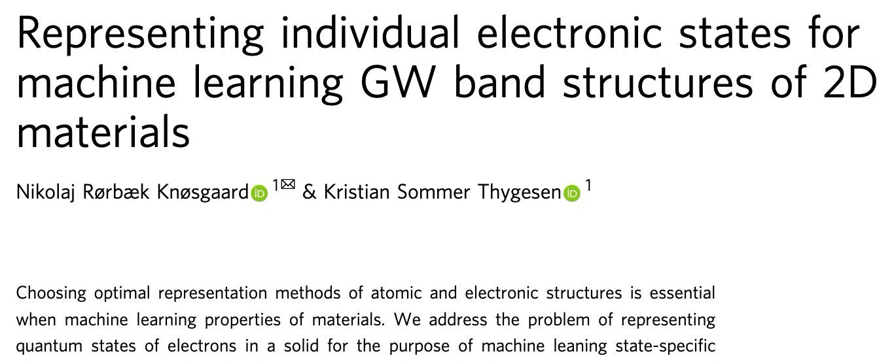
Electronic Structure Representations
Notes:
Over the last 5-10 years, there has been a growing interest in electronic structure representations which are more well-suited to predicting such properties.
SPAHM and family
ENDOME, RAD-PDOS
D-Fingerprint, B-Fingerprint
Overlap Matrix
SLATM and family

Slide 6




Spectral Operator Representations a unified approach
Generate electronic structure
$$f :\left\{R_{I}, Z_{I}, …\right\}→Ψ(r_{1}, r_{2},…, r_{N})$$
Define theoretical framework
$$f :\left\{R_{I}, Z_{I}, …\right\}→\{|φ_{i}⟩\}$$
Apply operator
$$A_{ij}=⟨φ_{i}\left|\hat{A}\right|φ_{j}⟩$$
Overlap, kinetic energy, Hamiltonian, …
Compute operator spectrum
$$A\left|φ_{i}\right\rangle =λ_{i}S|φ_{i}⟩$$
Basis independence and physical mixing
Map to ML features
$$g:\left\{λ_{i}\right\}→x$$
Define feature space
A. Zadoks et al., arXiv:2403.01514 (2024)
Notes:
In our work, we’ve formulated a unified approach for many of these electronic structure representations which we call spectral operator representations.
Our framework describes a general 4-step procedure for formulation such representations starting with computing an electronic structure from structural data that are taken, for example, from a materials database.
In principle, this could mean computing the many-body wavefunction, but in practice, this generally entails finding some set of single-particle orbitals.
The choice of method made here underpins the physical information content of the resulting SOREP.
Next, to distill more specific information

Slide 7

Properties of SOREPs
*
*
H2O.xyz
3
O 0.00 0.00 0.00
H -0.76 0.59 0.00
H 0.76 0.59 0.00
$$…$$
Symmetries
Rotation
Translation
Permutation
*
*
H2O.xyz
3
O 0.00 0.00 0.00
H -0.76 0.59 0.00
H 0.76 0.59 0.00
$$\vec{x}$$
$$⇒𝒪(4N)$$
$$\frac{∂}{∂R}$$
$$…$$
$$\vec{x}$$
Practicalities
$$\vec{x}′$$
Dimensionality
Differentiability
Uniqueness / Completeness
A. Zadoks et al., arXiv:2403.01514 (2024)
S. N. Pozdnyakov et al., Phys. Rev. Lett. 125, (2020).
Notes:
Get a lot of good properties “for free” or ”by construction”
Rotation, translation, permutation – choice of operator (Hermitian)
Dimensionality – choice of features derived from operator spectrum
Density of states
Padded spectrum
Uniqueness / Completeness -- work on overlap matrix features

Slide 8
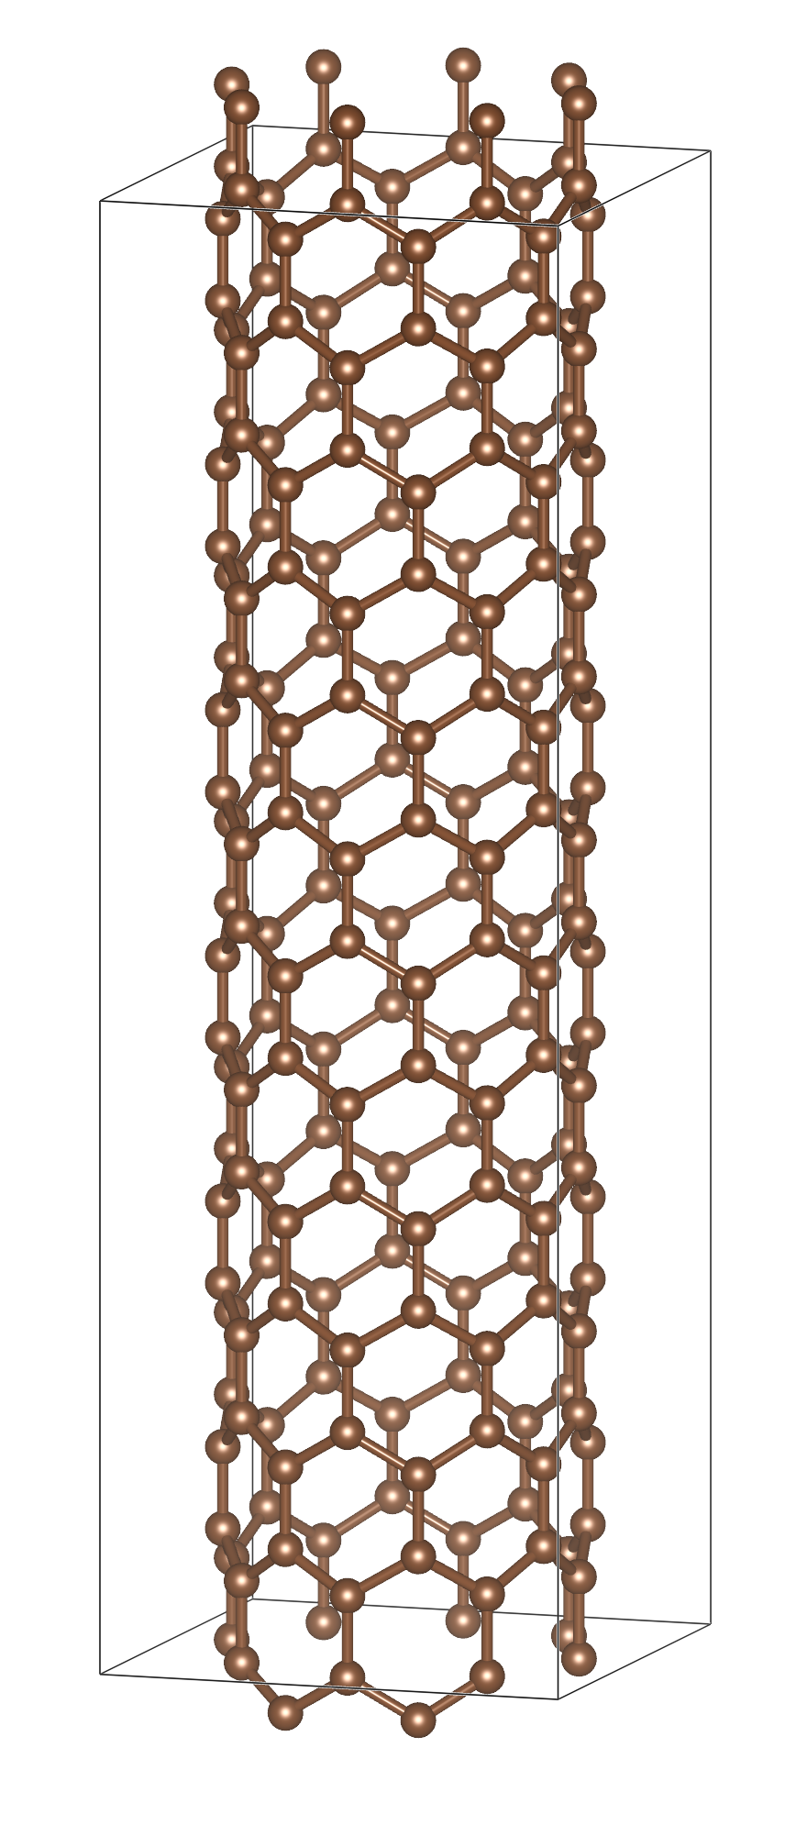
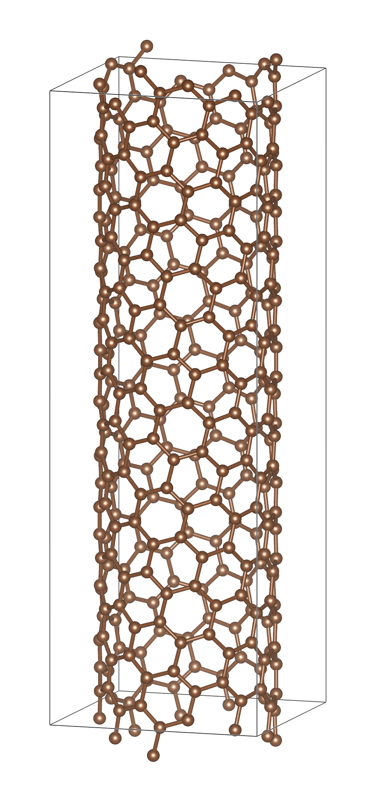
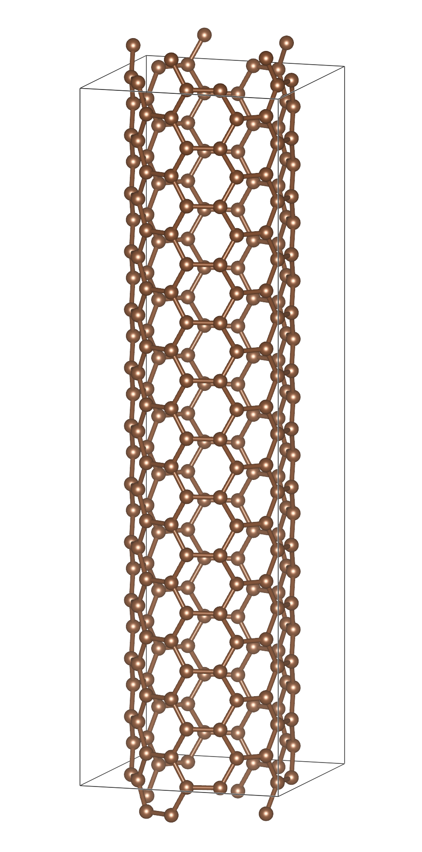
Carbon Nanotubes
(8,0)
Semiconducting
Compositionally-identical
Similar local-atomic environments
Different metallicity
(3,9)
Quasi-metallic
(5,5)
Metallic
A. Zadoks et al., arXiv:2403.01514 (2024)

Slide 9
Kinetic SOREP carbon nanotubes
Electronic structure
  Crystal dectorated w/ cGTOs
  Custom ANO basis
Operator
  Kinetic energy
Map to ML features
  Density of kinetic states
pz Tight-binding
(5, 5) Metal
(3, 9) Quasi-metal
(8, 0) Semiconductor
A. Zadoks et al., arXiv:2403.01514 (2024)

Slide 10

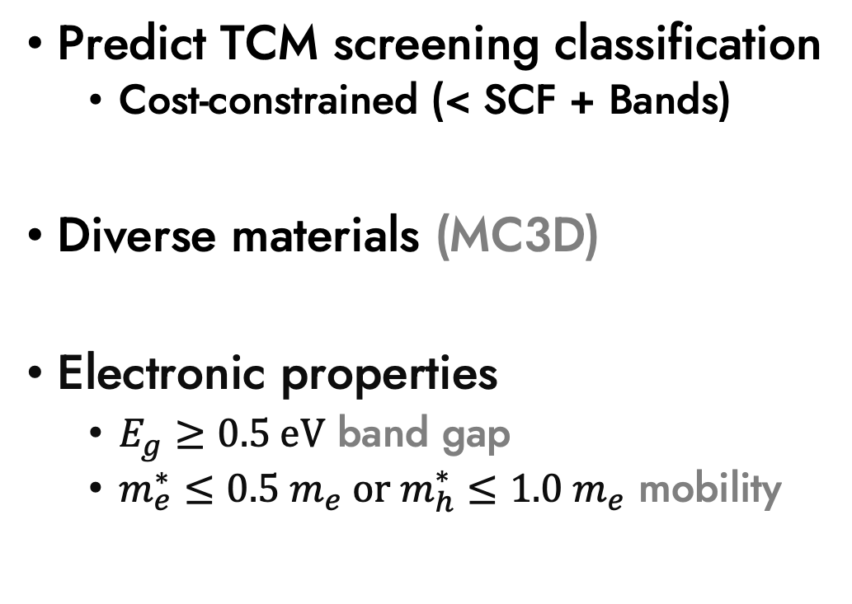
ML-Accelerated Screening transparent conducting materials
Predict TCM screening classification
  Cost-constrained (< SCF + Bands)
Diverse materials (MC3D)
Electronic properties
  $E_{g}≥0.5 \text{eV}$ band gap
  $m_{e}^{∗}≤0.5 m_{e} \text{or} m_{h}^{∗}≤1.0 m_{e}$ mobility
mc3d.materialscloud.org
mc3d.materialscloud.org
This work
A. Zadoks et al., arXiv:2403.01514 (2024)
M. Bercx et al., in preparation (2024)
R. Woods-Robinson et al., Chem. Mater. 30, 8375 (2018)

Slide 11
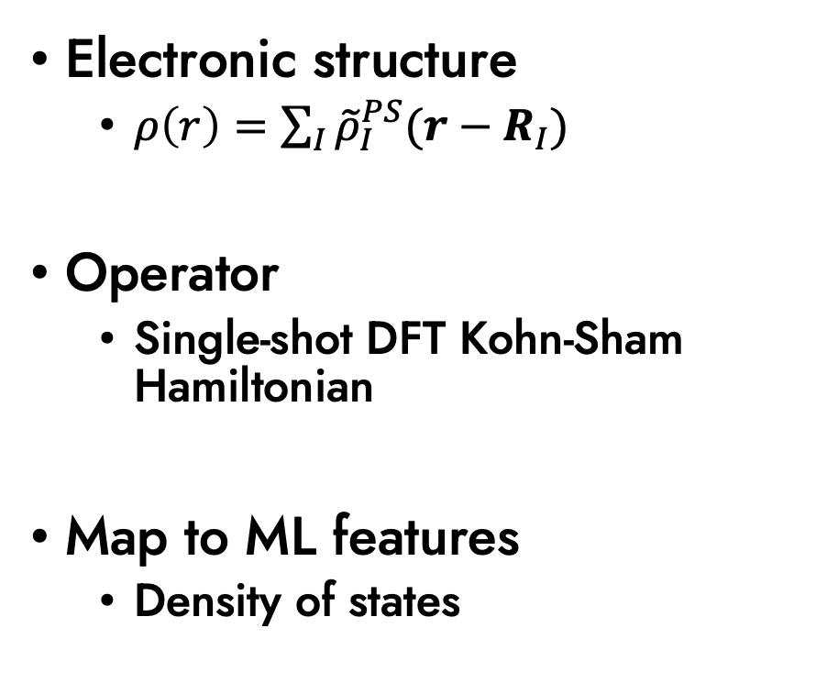


Single-shot DFT SOREP
SOREP vs. SCF DOS Euclidean Distance
Electronic structure
  $ρ\left(r\right)=\sum_{I}{{\tilde{ρ}}_{I}^{PS}(r−R_{I})}$
Operator
  Single-shot DFT Kohn-Sham Hamiltonian
Map to ML features
  Density of states
$$N=22,200$$
Si
$$\text{Si}$$
A. Zadoks et al., arXiv:2403.01514 (2024)
O. Isayev et al., Chem. Mater. 27, 735 (2015)

Slide 12
Classification Model
Fermi VBM Fermi “Scissor”
E
Balancing
  Undersample majority class
Hyperparameters optimized with gridded cross-validation
Feature importance analysis
  Physical interpretation
k
D
A. Zadoks et al., arXiv:2403.01514 (2024)

Slide 13


Model Performance
Balanced random forest classifier
Strong data efficiency
  Find 76% (N=1920) of TCMs with 1% (N=220) of data for training
  2.5x greater effective yield
Rapid saturation
  Insufficient model flexibility
$$f_{train}∈[0.8\%, 2.5\%]$$
$$N_{train}∈[170, 555]$$
A. Zadoks et al., arXiv:2403.01514 (2024)

Slide 14
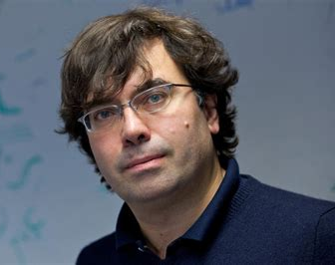


Conclusions
Electronic structure representations
SOREPs: flexible, physical, interpretable
Single-shot DFT SOREP: diverse systems
  screening, property prediction
Data-scarce contexts
  complex workflows (e.g. superconductivity)
  beyond-DFT theories (e.g. GW band gaps)
$$A$$
$$=$$
$$λS$$
Prof. Nicola Marzari
Prof. Antimo Marrazzo
arXiv:2403.01514
Notes:
80% w/ 1%
Tailored approach to different applications
Outlook – property prediction with beyond-DFT targets where data-efficiency is key (mention ENDOME / RAD-PDOS)

Slide 15
Comparison w/ SOAP
85 elements in data
Avg. SOAP → ~550,000 features
  ~65 GB @ float32
  17 min. on 20 cores
CUR compression
  1,000 random materials
  512 as reduced dimension
  2 hr. on 20 cores
Lower TPR, higher FPR
  Across the data regime
SOAP + CUR
SOREP
Notes:
80% w/ 1%
Tailored approach to different applications
Outlook – property prediction with beyond-DFT targets where data-efficiency is key (mention ENDOME / RAD-PDOS)

Slide 16
Classification model performance

Slide 17
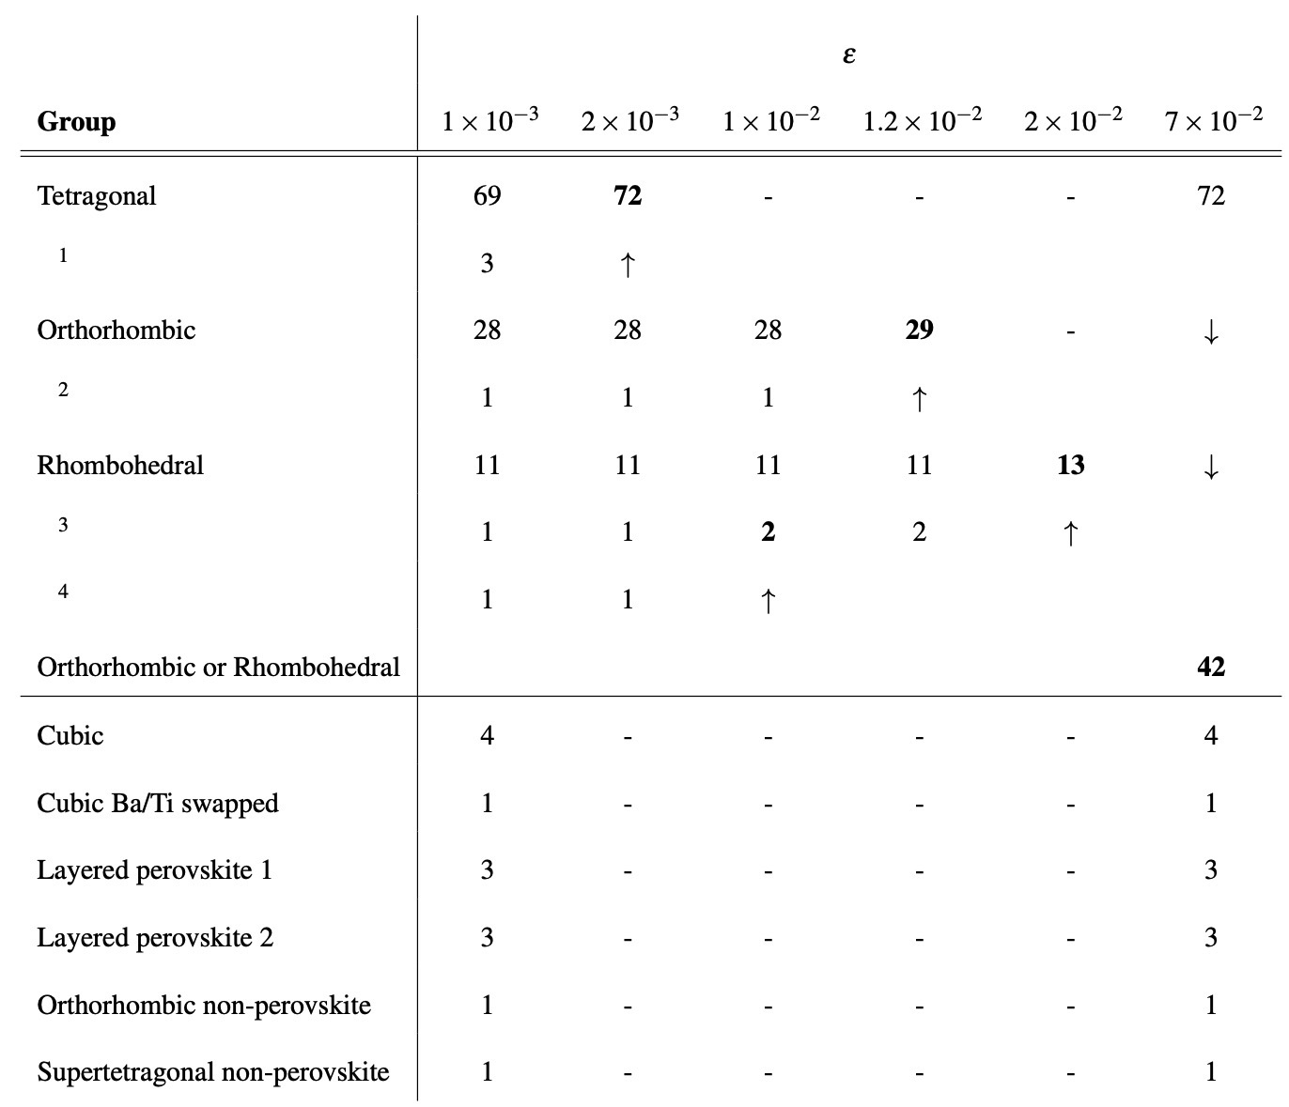
Kinetic SOREP
BaTiO₃
A. Zadoks et al., arXiv:2403.01514 (2024)

