Slide 1

Addressing Challenges in 4D STEM Data of Ferroelectrics Using Machine Learning
Andreja Benčan Golob, Oana Condurache, Katarina Žiberna
Electronic Ceramics Department, Jožef Stefan Institute
Sašo Džeroski, Sintija Stevanoska, Marjam Stoimchev, Dragi Kocev,
Pance Panov, Anastasija Manojlovska
Department of Knowledge Technologies, Jozef Stefan Institue
Goran Dražić
Department of Materials Chemistry, National Institute of Chemistry

Slide 2
J7-4637: 4D STEM of energy related materials down to quantum level
From project proposal:
“We propose a large, interdisciplinary project as a platform for development and application of knowledge-intense 4D STEM methodology that addresses the challenges associated with the determination of the light elements position, electrical, magnetic and strain fields, and charge density of energy-related materials more broadly, creating pathways for more successful application of cutting-edge STEM analysis from nanometer down to the quantum level.“
The project participating teams:
Jozef Stefan Institute, JSI:
Electronic Ceramics department, K5: Synthesis and 4D STEM, in situ biasing 4D STEM of ferroelectric materials
Department for Nanostructured materials, K7: Synthesis and 4D STEM, in situ heating 4D STEM of magnetic materials
Physical and Organic chemistry, K3: DFT calculations of charge density distributions and various fields to interpret experimental findings
Knowledge Technologies, E8: Machine learning algorithms for image analysis
National Institute of Chemistry, NIC:
Department of Materials Chemistry- Laboratory for Modern Battery Systems, D10Batt, Synthesis and 4D STEM of battery materials
Department of Materials Chemistry – Laboratory for Electrocatalysis, D10Ecat, Synthesis and 4D STEM of catalyst materials, in situ heating 4D STEM

Slide 3
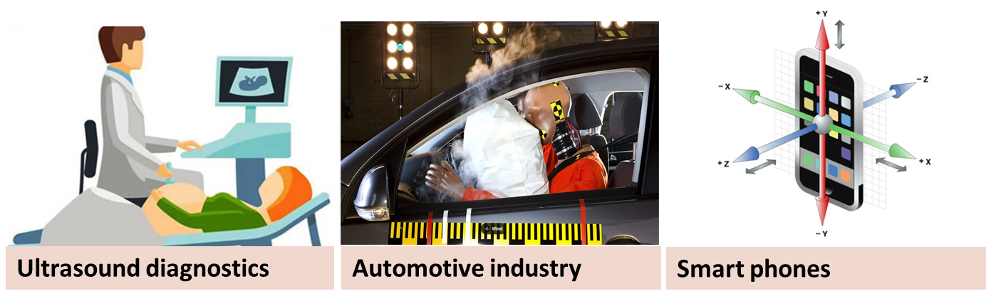
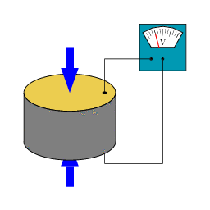
Piezo-/Ferroelectric materials
d = D/T = S/E [C/N, m/V]
d=piezoelectric constant
D=dielectric displacement (charge per unit area), T=stress
S= strain (expansion or contraction), E = Electric field
https://en.wikipedia.org/wiki/Piezoelectricity

Slide 4
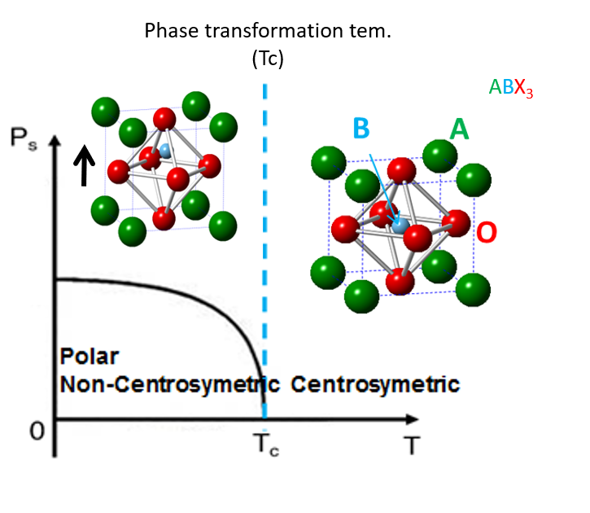
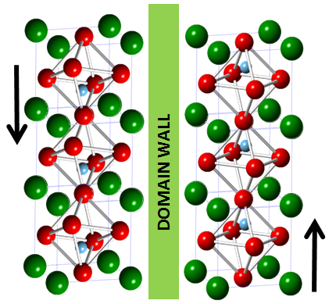
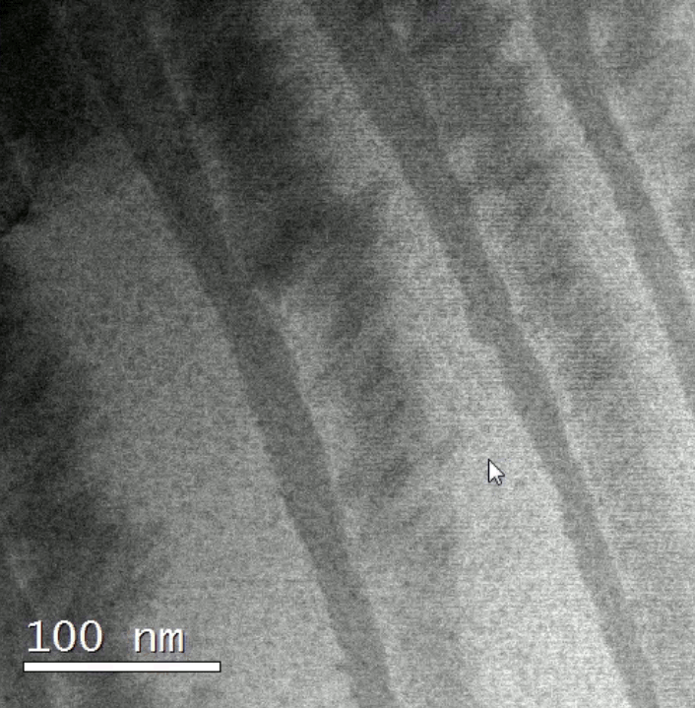
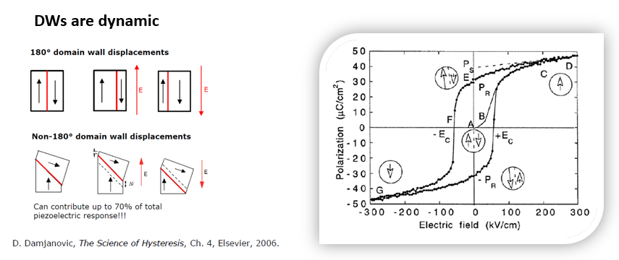
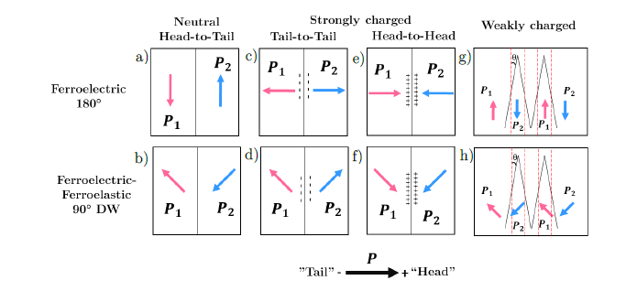
Domains/domain walls/defects
In situ biasing STEM
D. Damjanovic, Rep. Prog. Phys. 61, 1998
G. F. Nataf et al., Nature Review Physics 2, 2020

Slide 5
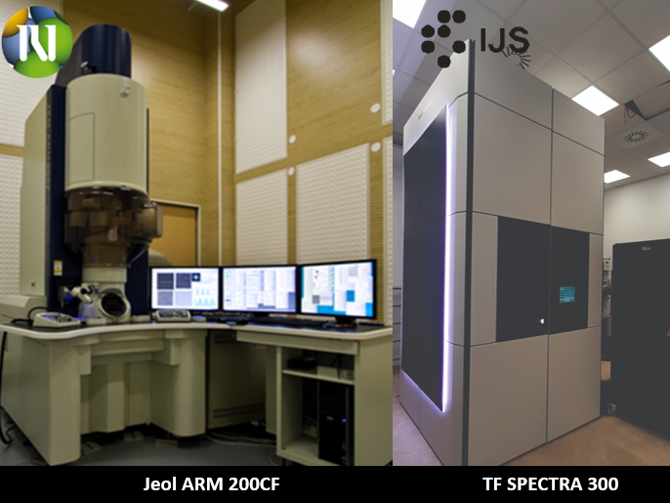

Slide 6
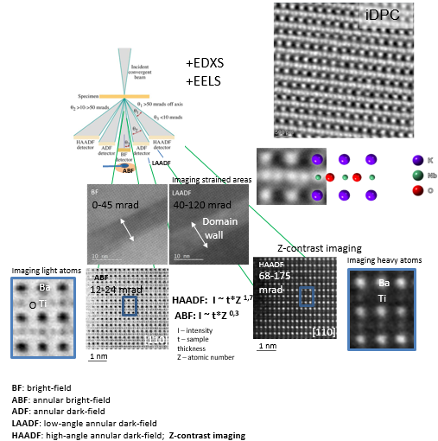
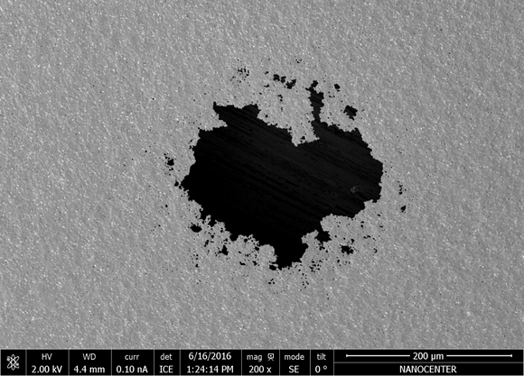
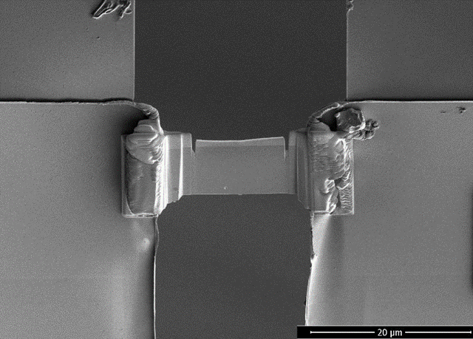
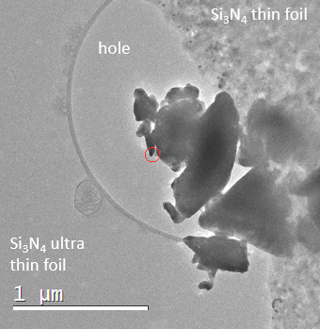
Methods: STEM
mechanical polishing, followed by argon ion beam milling
200 μm
FIB lamella
20 μm
powder

Slide 7
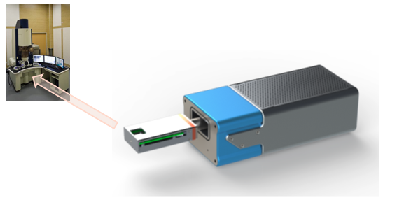
Quantum detectors : Merlin 256 x 256 pixelated detector
Retractable type
Direct electron detection
Pixel size: 50 x 50 µm
Active area: 14 x 14 mm²
Number of pixels: 256 x 256
Sampling frequency (max): 2 kHz
Dynamical range: max 24 bit
Energy range: 60 keV – 300 keV
On line computer: 32GB RAM, 1TB SSD, 3TB HD
Off line computer (storage): 128GB RAM, 1T SSD, 16TB HD
- additional 7 free slots (for max 8 x 16 TB)
Triggering:
- Gatan Spectrum imaging (6 bit):
128 x 128 image ~ 30 sec (1,05 GB)
256 x 256 image ~ 2 min (4,2 GB)
512 x 512 image ~ 6 min (16,8 GB)
1k x 1k image ~ 30 min (67,2 GB)

Slide 8
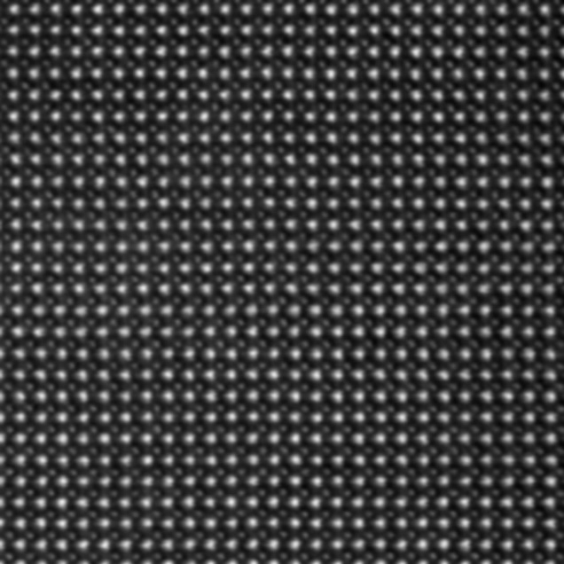
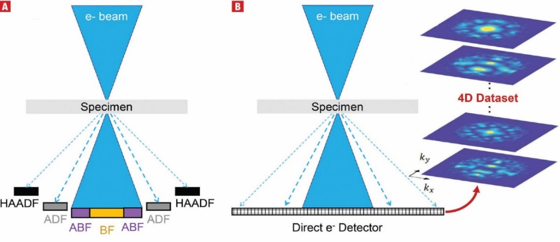
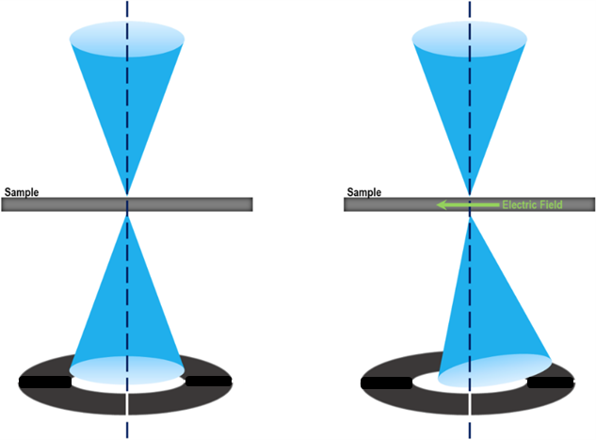
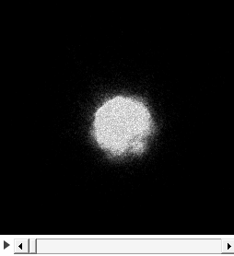
4D STEM
In 4D STEM the probe is scanned in a 2D array and at each probe position 2D diffraction pattern is imaged on pixelated detector.
+ mathematical reconstruction
Stack of diffraction patterns at each pixel position in a STEM map
Movement of “zero” beam

Slide 9
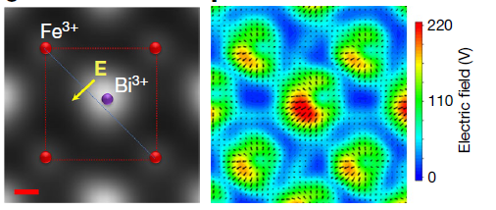
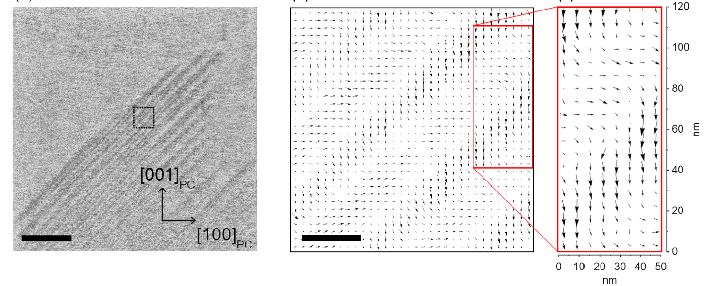
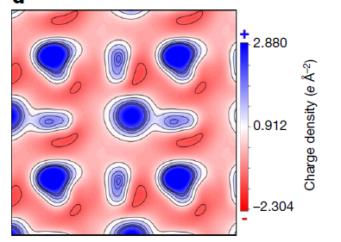
Electric Fields (Electric potential, Charge distribution etc.)
Long-range
Atomic level
Ignatans et al., Phys. Rev. Lett. 2021, 127, 167601
Ignatans et al., Adv. Funct. Mater. 2022, 32, 2100271
Gao et al., Nature 2019, 575, 480

Slide 10
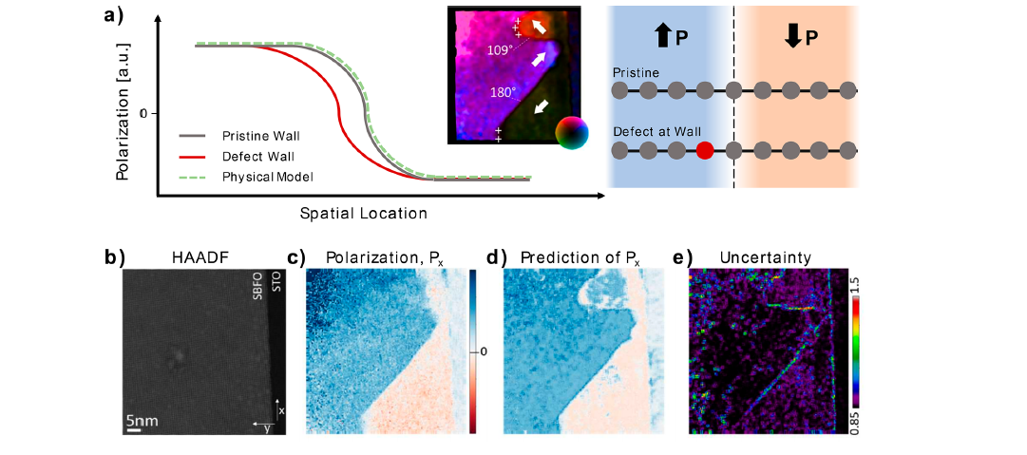

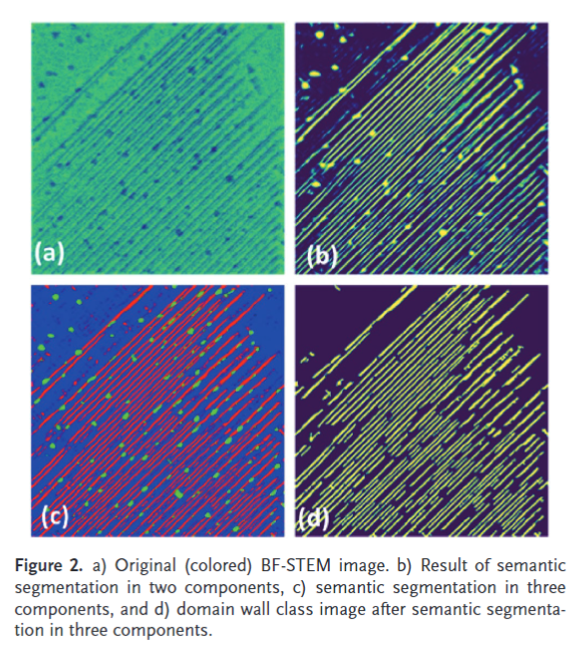
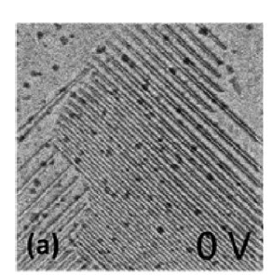
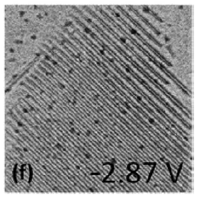
STEM and AI on ferroelectrics
Automated and Automous Experiments in Electron and Scanning Probe Microscopy
S. Kalinin et al., ACS Nano 2021, 15, 12604
M. Ziatdinov et al., Appl. Phys. Rev. 8, 011403 (2021)
Automatic Domain walls detection to the
identification of ferroelectric switching pathways
ML
Sergei V. Kalinin
Oak Ridge National Laboratory, USA
In situ biasing TEM of ferroelectric domain evolution
Ignatans et al., Adv. Funct. Mater. 2022, 32, 2100271

Slide 11
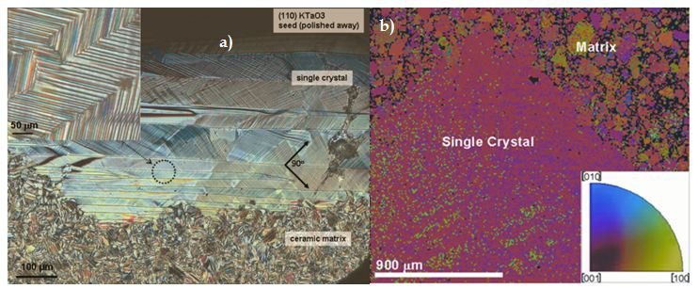
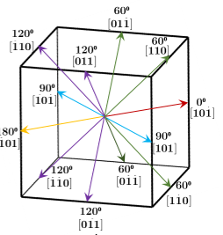
K_{0.5}Na_{0.5}NbO₃
a) Optical microscope micrographs of the KNN single crystal and its domain microstructure. The inset shows a herring bone 90º arrangement of smaller domains, b) EBSD orientation map of the KNN single crystal and the corresponding color-key inverse-pole-figure
A. Benčan et al., Microscopy and Microanalysis, 15, 2009
Orthorhombic symmetry:
spontaneous polarization along [110]pc directions
four different types of DWs: 60⁰, 120⁰, 90⁰ and 180⁰
J. Hirohashi et al., Journal of Applied Physics, vol. 98, 2005
M. Bah et al., RSC Adv., vol. 6, no. 54, 2016

Slide 12
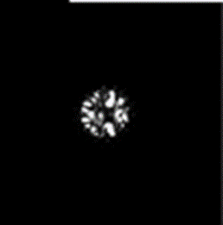
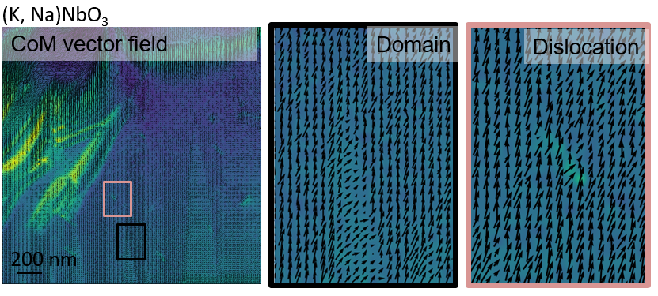
4D STEM
Calculating center of mass
Image J
Calculation of the charge density (divergence)
Virtualization
Digital micrograph
4D STEM data acquisition
(CBED)
+ mathematical reconstruction
…
256 x 256 pix
16384 tiff images (32 bit)

Slide 13
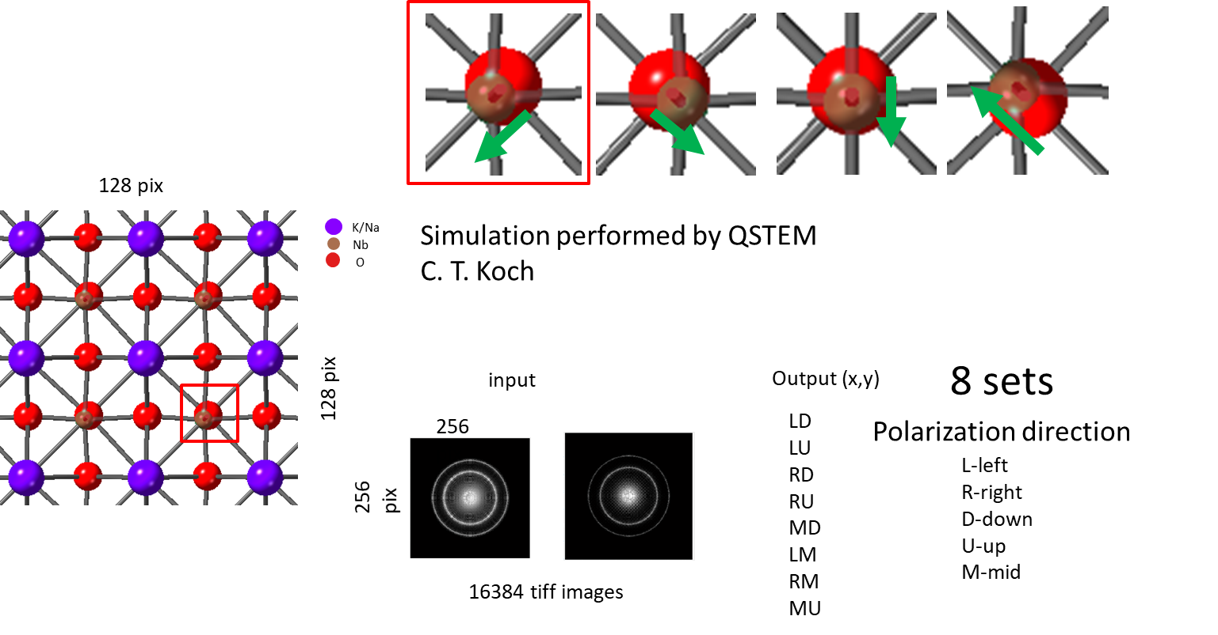
4D STEM and ML
LD
RD….
Projection of the KNN structure along [100]_{pc}

Slide 14
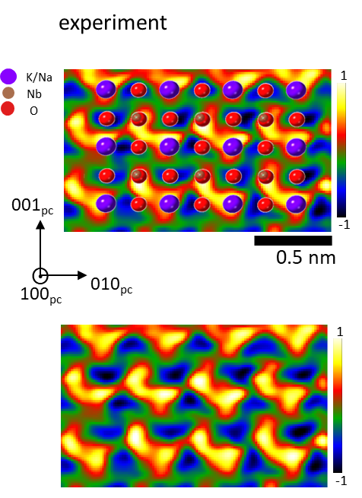
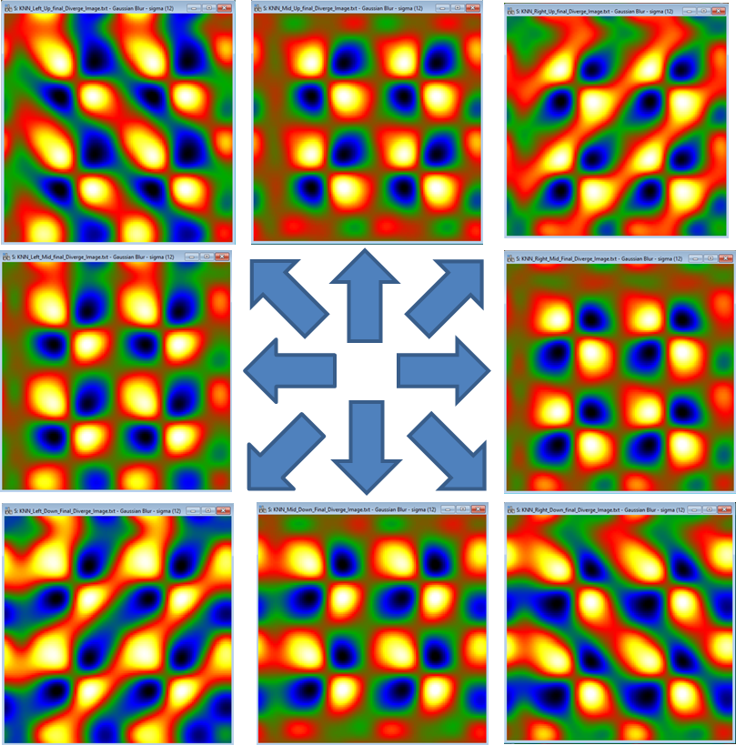
4D STEM
Divergence of the momentum change of the electron probe
simulation
Yellow contours along on 011 planes in both experiment and simulation
The B atoms are displaced along 011 planes. Can be this directly correlated with charge density distributions?

Slide 15
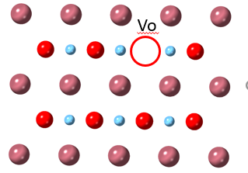

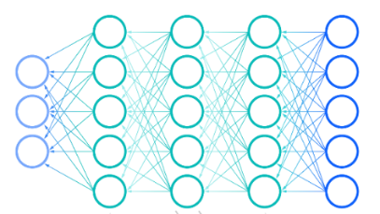
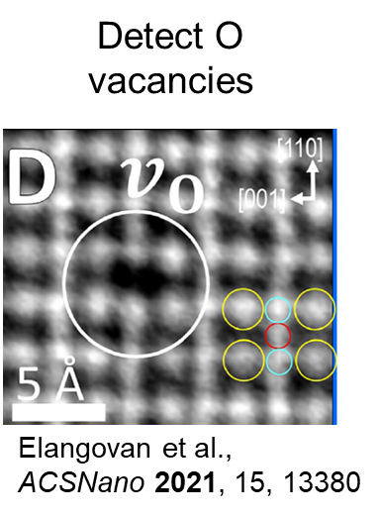
Future perspectives
DFT & relaxation
Diffraction patterns
4DSTEM
Multislice simulations
simulated crystallographic models containing crystal defects
4D STEM experiments
ML

Slide 16
THANK YOU!

